Slide 1
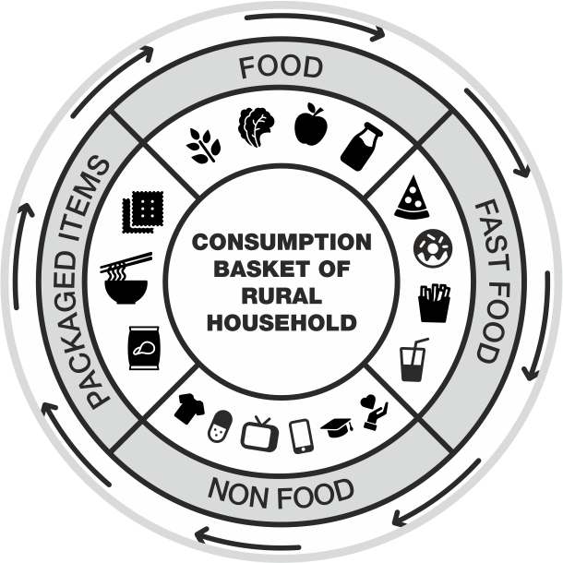
Changing baskets of consumption in rural areas and reflection in rural markets
Synthesis from 4 field work based research studies
Presented by: Archana Chandola
VikasAnvesh Foundation

Slide 2
Consumption as a concept
Defined as a process in which consumers use goods and services from market
Major component of Gross Domestic Product
Economic development leads to capital formation increasing the disposable income at household level
Keynesian psychological law of consumption states that increased income is distributed between consumption and saving
Consumption is a measure for the overall well-being of the households, measure of distribution of wealth
In a market economy, consumption drives retail markets as consumer money is spent here
Consumption as a social and cultural phenomenon, governed by social structures

Slide 3
Consumption and Rural Areas
Rural areas considered as engines of growth
Household Survey on India’s Citizen Environment & Consumer Economy’, ICE 360° survey, 2016 states that rural households in India contribute to around 46 per cent of the country’s income and 57 per cent of the aggregate spending
More than 6 lakh villages contribute to large consumer base; dynamic and evolving
Socio-economic conditions of households, the primary driver of consumption
Evolving rural environment
Diversity of income, consumption and assets across different regions in the country
Association between rural societal factors and emerging rural markets

Slide 4
Exploratory Questions
What are the changes in the consumption patterns of households?
New products in the consumption basket
What is the change in spending pattern as compared to 5 & 10 years interval
How is the shift of expenditure from food to non-food, as estimated in NSSO reports, happening?
How income is driving the consumption basket? Other factors?
Impact of various factors such mass media, internet, advertisement on consumption decisions?
How markets are transforming and influencing the household consumption?
What are the implications on livelihoods?

Slide 5
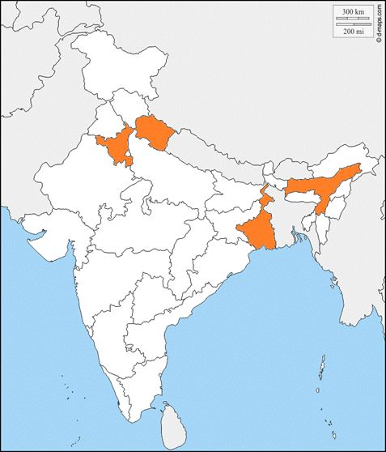
Study areas and Methods
Characterisation at two levels- Household and Market
Quantitative and qualitative instruments
Household level questionnaire, with focus group discussions with community
FGDs and Interviews with shopkeepers
Coverage of a sample of 268 households across 18 villages and 16 markets, both at block level and village level
Data collected for 3 time periods i.e. 2017-18, 2012-13 and 2007-08

Slide 6
Consumption basket of households
Consumption expenditure as indicator of consumption patterns
Production patterns changing in study areas, subsidised food supply scheme
Increase in disposable income; diversification of income sources
Remittances from migration a major source
Increased expenditure on non-food items as compared to food items
Disposable income utilised towards non-food items- Aspirations, luxury, social constructs
Major heads of expenditure mobile, private tutions for children, and toiletries and cosmetics
Consumption of packaged and processed food- a new entrant in the consumption basket
Consumption basket is more dependent on the market; especially in food category, a major shift in past ten years

Slide 7
Emerging Rural Markets
16 markets studied across 4 study locations
Transformation from small markets to thriving big markets; increased number of shops and variety of products and services
Number of shops between 50-3000
15 to 20 percent temporary thelas (food carts)
Rural consumer demand driving the markets to expand and shopkeepers to invest in opening new shops and increasing product portfolio in the existing ones
Investment ranges from 50,000 to 2,00,000 (small shop)
Penetration of FMCGs, technology- mobile and internet and increased connectivity of markets to villages and to bigger town markets
Evolving demands of rural households- scope for business (profit), employment option for youth
New additions to the markets- mobile, electronics, repairs, fast food , beauty parlours

Slide 8
Inferences
Access to markets, increased awareness, migration and penetration of mass media and mobile technology, increased brand awareness are major influencers in consumption choices
Households have evolved from basic need fulfillment to ‘constructed’ choices
The expenditure patterns of the households are an indicator of their evolving choices, preferences and aspirations
Symbiotic relationship between rural households and markets
Migration- a source of additional income?
Changes in the consumption basket has implications on livelihoods ,health, nutrition and overall well-being of the household
Way forward- Scoping of livelihood opportunities given the changing landscape

Slide 9
Thank You!

