Slide 1
Beyond Leading: Explicating collective leadership in community-based organizations through social network analysis
Bikalp Chamola (VAF)
Shyam Singh (IRMA)

Slide 2
Introduction
What do we already know?
Community based collective actions are solutions to ineffective and inequitable delivery of public goods
Processes of such collective actions are democratic and decentralized, and the distribution of the benefits to its member is equitable
There could be the problem of free-riding
Collective actions need initial support and handholding
Collective actions are suppose to be sustainable in long run
What do we want to know in a collective action?
How do members share information among themselves?
How does advice seeking behavior take shape?
How cohesive consultation and collaboration among the members is?
What do we achieve?
We are able to understand structural properties of a collective action: cohesiveness, social capital, mutual trust, group dynamics, individual and group preferences
Notes:
How effective are consultations and collaborations ?

Slide 3
Introduction

Slide 4
Methodology
Social Network Analysis: a method to understand a collective action within the framework of relational sociology
Network Boundaries:
Entire governing body: general members, members of the advisory committee & board members
Size of the network: 43
Analytical Concepts
Whole network measures: density, centralization, reciprocity, inter-group densities
Actor level measures: Degree Centrality, closeness, betweenness
Data: primary data collected through a network survey and semi-structured interviews
Network Data Analysis: UCINET and NetDraw software
Notes:
Whole Network measures are about the overall network
Actor level vs Whole Network

Slide 5
Preliminary Definitions
Social network
A finite set (or sets) of actors and the relations defined on them. It consists of three elements: (1) a set of actors; (2) each actor has a set of individual attributes; and (3) a set of ties that defines at least one relation among actors
Density
The number of ties in the network reported as a fraction of the total possible number of ties
Reciprocity
The proportion of mutual ties in a network

Slide 6
Preliminary Definitions
Betweenness centrality
An important node lies on a high proportion of paths between other nodes in the network. Model based on communication flow. A person who lies on communication paths can control communication flow, and is thus important
Closeness centrality
An important node is typically “close” to, and can communicate quickly with, the othernodes in the network.Length of the average shortest path between a given node and all other nodes in a graph

Slide 7
Analysis: Network measures
 | Info sharing | Advice seeking | Consultation | Collaboration
No of ties | 172 | 159 | 144 | 156
Isolates | 0 | 1 | 1 | 2
Avg Degree | 4 | 3.698 | 3.349 | 3.628
Deg Centralization | 0.025 | 0.057 | 0.066 | 0.109
Out-Deg Centralization | 0.024 | 0.056 | 0.065 | 0.107
In-Deg Centralization | 0.756 | 0.69 | 0.674 | 0.692
Density | 0.095 | 0.088 | 0.080 | 0.086
Diameter | 5 | 7 | 7 | 5
Arc Reciprocity | 0.186 | 0.176 | 0.194 | 0.192
Notes:
Number of Ties are per member on an average establish
In an intense relationship average degree. Highly connected network. People are not excluded.
Density is in percentages. Talks about one person taking all the decision. No benchmark in literature to identify, where less centralization. Overall well connected. Decision making is very centralized.
Number of ties ‘distance’ between the farthest points in the network. No one is above 5 in info sharing. Well connected.
Arc Reciprocity : Give and take of info. Though it is an interconnected network, the reciprocity of the network is abysmally low, this could be attributed to decision making centralization. Not all actors are living in one village.
Out degree centralization is very low. Information is being parked somewhere and not making a claim

Slide 8
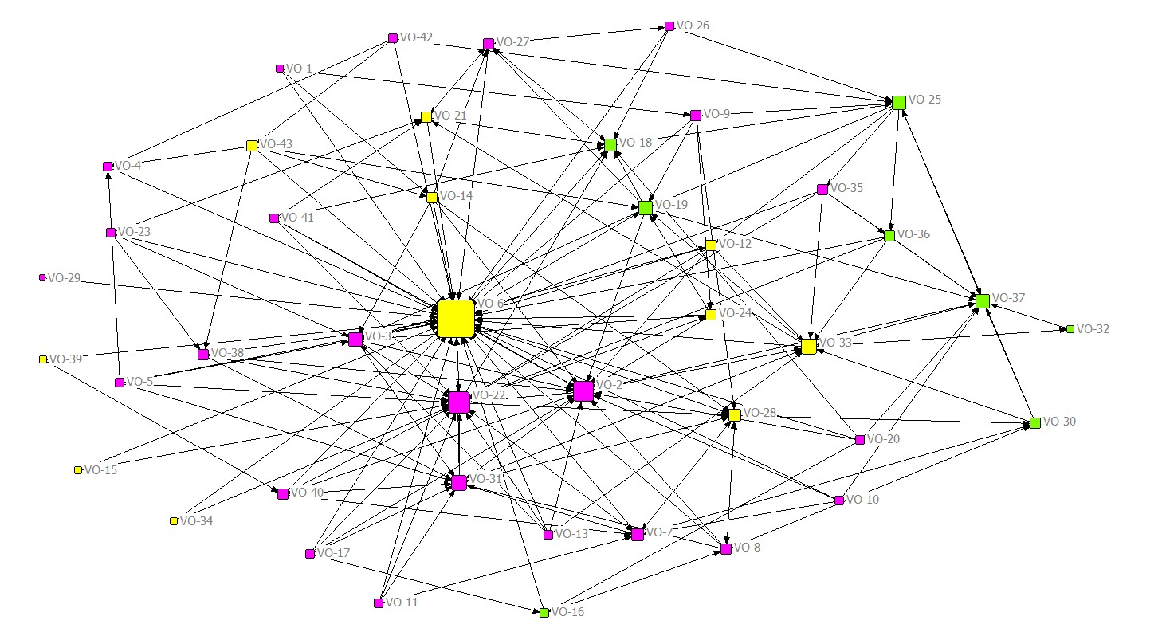
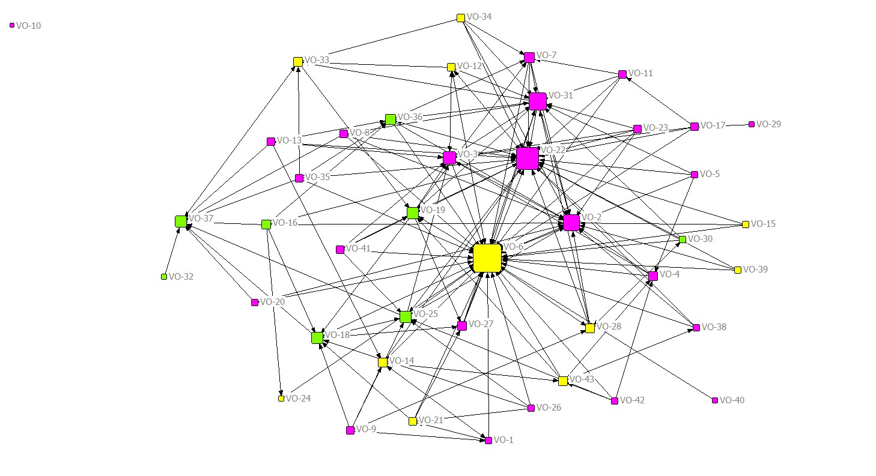
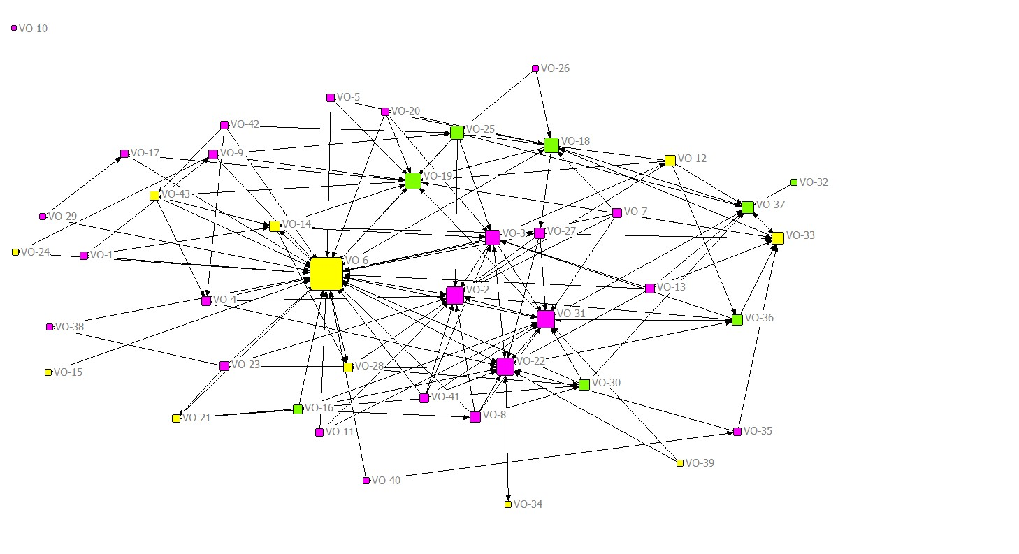
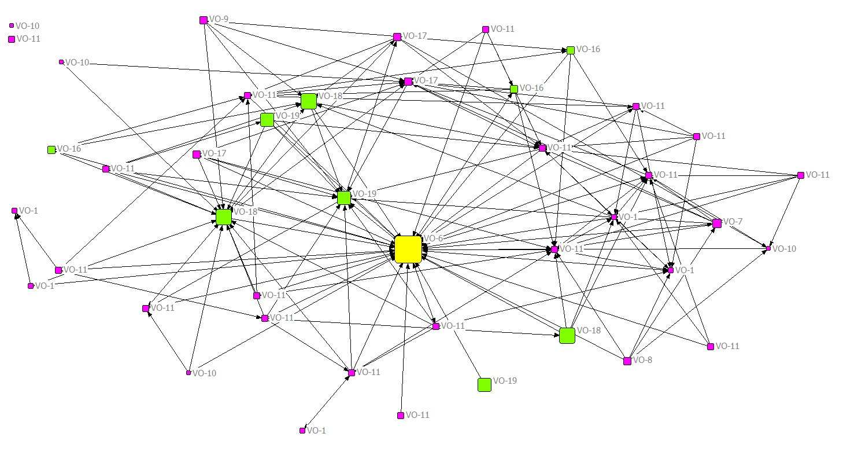
Network Visualization
Info Sharing
Advice Seeking
Collaboration
Consultation
Size - degree centrality; Color: position (Yellow – board members, Green- advisory committee members, Red – general body members)
Notes:
Centralized network or a decentralized network

Slide 9
Actor level Analysis
Info Sharing
 | OutDeg | Indeg | OutClos | InClose | Between
VO-2 | 4 | 15 | 177 | 72 | 77
VO-3 | 5 | 7 | 175 | 106 | 31
VO-4 | 1 | 3 | 184 | 237 | 0
VO-5 | 5 | 0 | 168 | 252 | 0
VO-6 | 5 | 35 | 168 | 49 | 297
VO-7 | 5 | 6 | 172 | 97 | 29
VO-8 | 5 | 2 | 173 | 117 | 12
VO-9 | 5 | 1 | 165 | 247 | 7
VO-10 | 4 | 0 | 175 | 252 | 0
VO-11 | 4 | 0 | 175 | 252 | 0
VO-12 | 5 | 2 | 173 | 128 | 9
VO-13 | 5 | 0 | 169 | 252 | 0
VO-14 | 5 | 2 | 166 | 238 | 13
VO-17 | 5 | 0 | 169 | 252 | 0
VO-18 | 4 | 8 | 173 | 80 | 147
VO-19 | 5 | 6 | 173 | 79 | 89
VO-20 | 5 | 0 | 164 | 252 | 0
VO-21 | 3 | 5 | 178 | 101 | 16
VO-22 | 5 | 18 | 171 | 68 | 139
VO-23 | 4 | 0 | 170 | 252 | 0
VO-24 | 5 | 2 | 173 | 106 | 13
VO-25 | 5 | 5 | 174 | 107 | 119
VO-28 | 3 | 8 | 180 | 80 | 81
VO-29 | 1 | 0 | 184 | 252 | 0
VO-30 | 5 | 3 | 170 | 115 | 32
VO-31 | 5 | 9 | 174 | 94 | 24
VO-33 | 5 | 9 | 175 | 91 | 110
VO-34 | 2 | 0 | 181 | 252 | 0
VO-35 | 5 | 1 | 173 | 146 | 4
VO-36 | 4 | 2 | 176 | 143 | 4
VO-37 | 1 | 10 | 195 | 87 | 6
VO-41 | 5 | 0 | 167 | 252 | 0
VO-42 | 4 | 0 | 157 | 252 | 0
 | Advice Seeking
 | OutDeg | Indeg | OutClos | InClose | Between
VO-1 | 4 | 2 | 200 | 134 | 80
VO-2 | 1 | 16 | 217 | 81 | 6
VO-3 | 4 | 8 | 207 | 105 | 20
VO-4 | 4 | 3 | 202 | 167 | 9
VO-5 | 4 | 0 | 195 | 336 | 0
VO-6 | 6 | 32 | 194 | 61 | 486
VO-7 | 4 | 4 | 203 | 115 | 15
VO-8 | 5 | 0 | 196 | 336 | 0
VO-9 | 5 | 1 | 198 | 174 | 3
VO-10 | 0 | 0 | 336 | 336 | 0
VO-11 | 4 | 1 | 197 | 323 | 3
VO-12 | 5 | 3 | 201 | 96 | 43
VO-13 | 5 | 0 | 191 | 336 | 0
VO-14 | 4 | 5 | 196 | 95 | 247
VO-15 | 3 | 0 | 201 | 336 | 0
VO-18 | 4 | 6 | 204 | 90 | 43
VO-19 | 5 | 6 | 203 | 88 | 131
VO-20 | 3 | 0 | 207 | 336 | 0
VO-22 | 5 | 21 | 207 | 81 | 191
VO-23 | 5 | 0 | 196 | 336 | 0
VO-24 | 1 | 1 | 214 | 157 | 3
VO-25 | 4 | 6 | 209 | 97 | 23
VO-26 | 4 | 0 | 202 | 336 | 0
VO-27 | 3 | 3 | 204 | 117 | 22
VO-28 | 5 | 3 | 202 | 98 | 58
VO-29 | 1 | 0 | 210 | 336 | 0
VO-30 | 4 | 1 | 203 | 138 | 0
VO-31 | 5 | 12 | 199 | 97 | 33
VO-32 | 1 | 0 | 262 | 336 | 0
VO-33 | 2 | 5 | 222 | 104 | 54
VO-34 | 5 | 0 | 205 | 336 | 0
VO-36 | 5 | 4 | 202 | 117 | 20
VO-37 | 1 | 9 | 245 | 103 | 32
Notes:
Closeness : No of ties cumulates the number of ties Independence and efficiency
Betwenness : mediators

Slide 10
 | Consultation
ID | OutDeg | Indeg | OutClos | InClose | Between
VO-1 | 3 | 1 | 212 | 134 | 80
VO-2 | 2 | 14 | 221 | 84 | 19
VO-3 | 5 | 7 | 212 | 101 | 58
VO-4 | 3 | 3 | 216 | 114 | 5
VO-5 | 3 | 0 | 212 | 336 | 0
VO-6 | 6 | 31 | 204 | 62 | 434
VO-7 | 5 | 0 | 209 | 336 | 0
VO-8 | 5 | 1 | 204 | 329 | 1
VO-9 | 4 | 1 | 211 | 172 | 43
VO-10 | 0 | 0 | 336 | 336 | 0
VO-11 | 3 | 0 | 214 | 336 | 0
VO-12 | 5 | 1 | 213 | 140 | 5
VO-13 | 5 | 0 | 205 | 336 | 0
VO-14 | 5 | 4 | 207 | 94 | 170
VO-16 | 5 | 0 | 198 | 336 | 0
VO-17 | 2 | 1 | 217 | 329 | 1
VO-18 | 5 | 7 | 212 | 87 | 107
VO-19 | 3 | 11 | 214 | 81 | 101
VO-20 | 4 | 0 | 207 | 336 | 0
VO-21 | 1 | 3 | 223 | 169 | 0
VO-22 | 5 | 15 | 212 | 82 | 179
VO-23 | 5 | 0 | 200 | 336 | 0
VO-24 | 1 | 1 | 222 | 209 | 0
VO-25 | 5 | 4 | 212 | 119 | 30
VO-26 | 2 | 0 | 223 | 336 | 0
VO-27 | 5 | 2 | 211 | 120 | 25
VO-28 | 4 | 3 | 211 | 99 | 78
VO-29 | 2 | 0 | 212 | 336 | 0
VO-30 | 5 | 2 | 214 | 136 | 42
VO-31 | 5 | 11 | 211 | 101 | 44
VO-32 | 1 | 0 | 260 | 336 | 0
VO-33 | 3 | 6 | 224 | 116 | 62
VO-34 | 1 | 1 | 233 | 122 | 0
VO-35 | 2 | 1 | 218 | 329 | 4
VO-36 | 5 | 2 | 218 | 120 | 16
VO-37 | 1 | 8 | 245 | 98 | 37
 | Collaboration
ID | OutDeg | Indeg | OutClos | InClose | Between
VO-1 | 1 | 1 | 191 | 171 | 0
VO-2 | 4 | 9 | 177 | 100 | 32
VO-3 | 2 | 7 | 181 | 93 | 5
VO-4 | 0 | 2 | 252 | 242 | 0
VO-5 | 3 | 0 | 170 | 252 | 0
VO-6 | 8 | 32 | 167 | 64 | 367
VO-7 | 5 | 3 | 173 | 99 | 13
VO-8 | 5 | 0 | 173 | 252 | 0
VO-9 | 5 | 0 | 175 | 252 | 0
VO-10 | 0 | 0 | 252 | 252 | 0
VO-11 | 3 | 0 | 174 | 252 | 0
VO-12 | 5 | 3 | 174 | 98 | 10
VO-13 | 5 | 0 | 171 | 252 | 0
VO-14 | 5 | 3 | 172 | 133 | 58
VO-16 | 3 | 2 | 178 | 147 | 8
VO-17 | 5 | 0 | 168 | 252 | 0
VO-18 | 5 | 15 | 172 | 94 | 85
VO-19 | 2 | 12 | 185 | 84 | 62
VO-20 | 3 | 0 | 174 | 252 | 0
VO-21 | 2 | 3 | 179 | 112 | 10
VO-22 | 5 | 10 | 176 | 90 | 25
VO-23 | 4 | 0 | 169 | 252 | 0
VO-24 | 5 | 1 | 172 | 102 | 78
VO-25 | 4 | 6 | 175 | 113 | 50
VO-26 | 4 | 0 | 169 | 252 | 0
VO-27 | 5 | 2 | 176 | 113 | 36
VO-28 | 3 | 6 | 178 | 104 | 9
VO-30 | 2 | 4 | 181 | 120 | 4
VO-31 | 5 | 8 | 173 | 92 | 48
VO-32 | 0 | 0 | 252 | 252 | 0
VO-33 | 4 | 11 | 177 | 99 | 28
VO-34 | 5 | 0 | 177 | 252 | 0
VO-35 | 4 | 0 | 172 | 252 | 0
VO-36 | 5 | 2 | 174 | 101 | 27
VO-37 | 4 | 11 | 179 | 93 | 60
VO-43 | 5 | 1 | 164 | 247 | 7
Notes:
Betwenness is the measure of number of ties between two pair.

Slide 11
Major Findings
Network Level Findings
An active network (no of ties are many and densities are quite higher)
An inclusive network (not many isolates)
Info sharing network is well connected, which is good sign! (there are gatekeepers)
However, other networks are quite centralized.
Reciprocity is not very high!
Actor level findings
Few leaders are very dominant!
Position
Experience (no of years/no of tenures)
Few leaders do not have reciprocal relationships
Few are completely ignored/isolated
While network characteristics indicate that social capital does exist, the collective leadership needs to be oriented on basic principles of collective action

Slide 12
Discussion
While network characteristics indicate that some form of social capital may exist, the leadership needs to be oriented on basic principles of collective action
Caste based analysis does not indicate any significant results whereas experience does play an important role in determining the key actors

