Slide 1
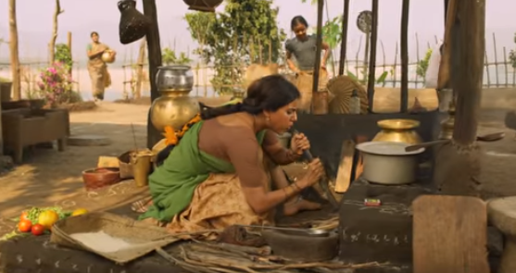
Daily Chores and its health impacts on Women
A qualitative study in rural tribal areas of Telangana State
Presented By: K.Spurthi
Research Guide: Dr.Abhijit
29-Sept-2018

Slide 2
The Real Deal

Slide 3
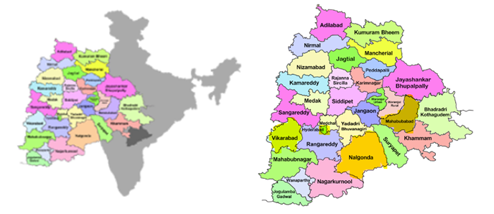
Methodology – Qualitative, purposive sampling
Geographical Coverage:
Mahabubabad District – 2 Villages – Nelvancha (10) and Kongarigidda (10)
Nalgonda District – 2 villages – Jamsthanpalli (10)and Gudapur (10)

Slide 4
Demographics and Basic Necessities
Age Range: 20 yrs to 70 yrs (mean: 39.9 yrs)
Social demography
Education
< 30 yrs | 31 - 50 yrs | > 50 yrs
14 | 20 | 11
ST | SC | BC
25 | 10 | 10
Nil | Mid school | X grade | XII grade | Graduates
32 | 4 | 4 | 2 | 3

Slide 5
Demographics and Basic Necessities
4. Marital Status
5. House
6. All the HHs had access to electricity
Married | Widowed | Unmarried
34 | 9 | 2
Kuchha house | Pucca
31 | 14

Slide 7
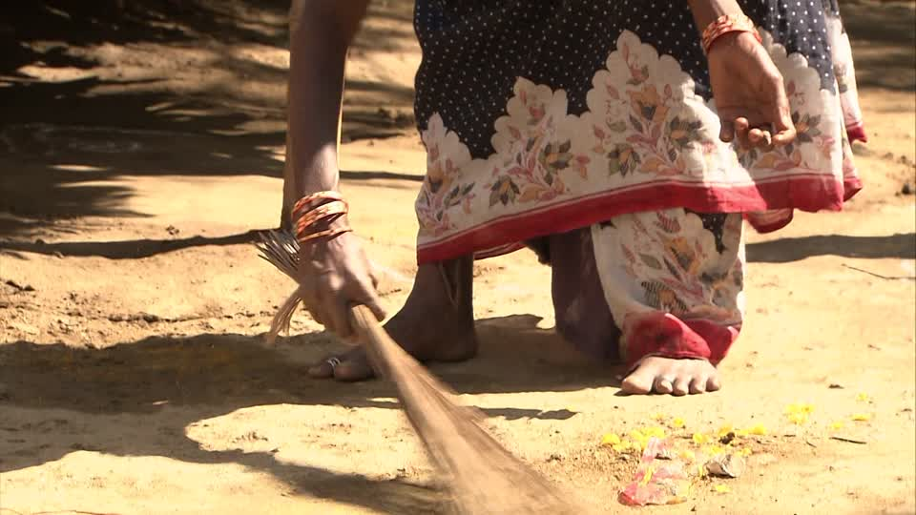
Chore 1 - Daily Domestic Work Schedule

Slide 8
"...day begins at 4-5 AM, get up, clean, sweep, cook, eat, around 2 hours at home. Then go to work at 9 AM. come back at 6 PM. The routine again. feed kids etc. all seasons same..." said a woman from Jamasthanpalli

Slide 9
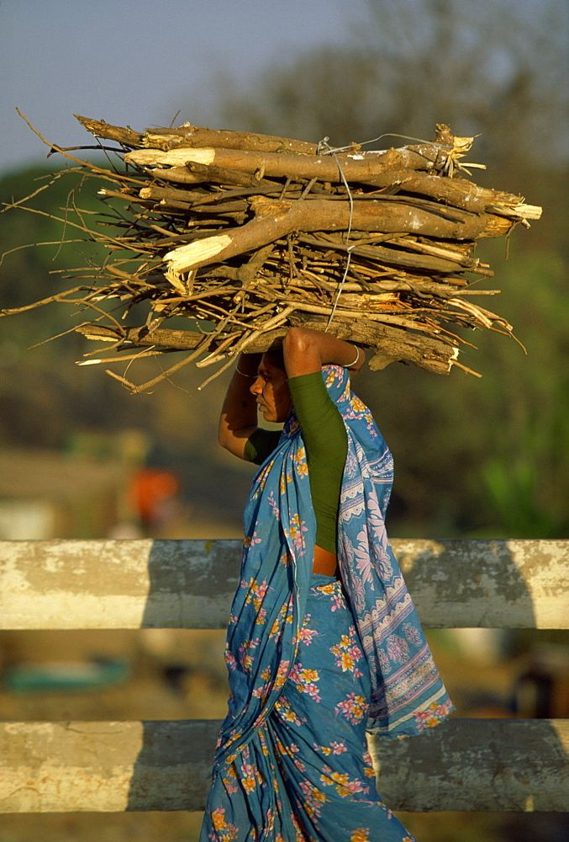
Chore 2 – Fetching Firewood

Slide 10
Ujwala much?
"...Use both fire wood and gas. mostly fire wood as gas exhausts faster. So, we use gas only in the morning..." said a woman from Gudapur
"...we mostly use firewood. But, when anything is urgent, we use gas..."
"...we mostly use gas. But, when gas is over, then firewood. Hence, we end up mostly using firewood only...“
"...more on firewood, less gas. cuz gas is more costly..."

Slide 11
"...I leave my kids with neighbors and walk upto 1-2 km to bring fire wood, takes about 2 hours to go, fetch and come back. I bring wood sufficient for 7-10days..." said a woman from Gudapur.
"...I go to forest for firewood. 1 hr to go and 1 hr to come and 1 hr to pick, tie. It gets very heavy, so it is difficult to carry all the way. I stop wherever there is shade and put them down vertically. if we put them horizontally, it becomes difficult to raise them on head again. I go alone. We have to prepare for rainy season in advance. Have to dry them near stove, more trips..."

Slide 12
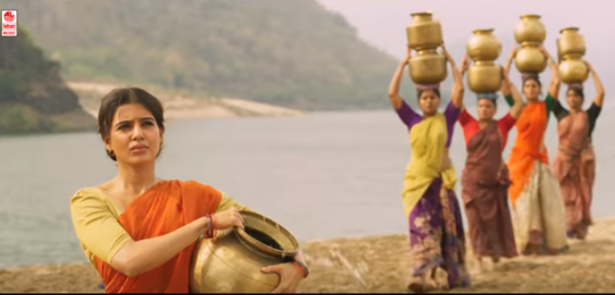
Chore 3 – Fetching Water

Slide 13
Mahabubabad – Iron Contamination
Nalgonda – Fluoride Contamination
"...I just fill one pot in one go and make around 2-3 trips per day. This is for drinking purposes. For washing, i either go to the lake or the borewell. This depends on availability of water in lake. In summer, lake is almost dried up and i have to make many trips to and from the borewell...“ - Nelavancha
"...Just a year back, we have got this piped connection in premises. Earlier, i would have to go to the village centre, which is far and exhausting...“ - Kongarigidda

Slide 14
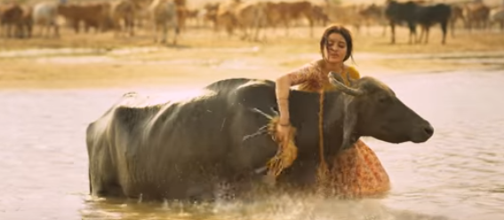
Chore 4 – Domestic Animals Care

Slide 15
"...We have 7 cows and I alone take care of them before going to work...”

Slide 16
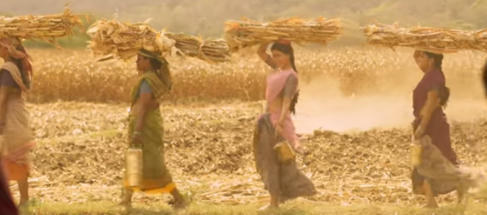
Chore 5 – Agri Labour/ Manual labour

Slide 17
"...We basically work in agriculture land but when we run out of water we collect stuff from forest and sell it or we go for labor work. Since we live in forest areas, we have many forest produces. The ones i am breaking are called 'ippa' seeds. They are there everywhere in this season. If we sell a bag of these to the merchant in town, he gives either Rs.20/- per bag or he gives us its oil of 1 litre. This oil is used for cooking. Those who don’t prefer its taste, give it to the shopkeeper in return for palmolive oil. Ippa seeds oil is used majorly in lighting lamps. But, these seeds are very heavy, must be 10-15kgs one bag, and i have to collect 2-3 bags for atleast one litre of oil.." said a woman surrounded by 10 other women who were busy breaking the shells of these seeds.

Slide 18
Perception on Most Strenuous work
"...agricultural work is very tiring. sowing is very difficult as we have to get into the muddy soil, bend and work. Harvesting is also very exhausting as we have to cut, tie into heaps and walk around with loads...“
"...housework only is very tiring. what should i say which work! Maybe washing clothes, that is very tiring. Also, running around with kids..."

Slide 19
Health Complaints
" ...I have become very weak since 3 years. I also have thyroid. Knee pain, back pain is common, we all have it. Full body pains, ask me which part doesn't ache." said a 35 year old woman from Kongarigidda village
"...I have lower back pain especially during my periods...", said a 27 year old woman from Nelavancha.

Slide 20
Coping Mechanisms
" ...I just take some rest and the pain goes away by itself. I don’t use any tablets or oils..." said a 30 yr old woman from Gudapur village
" ...bed rest, then it becomes okay. it is only because of stress so all it needs it rest, why doctor and all..." said a 20 year old woman from Jamasthanpalli village
"...It is of course difficult if you focus on it, otherwise life goes on. Just bear with the pain and continue..." said a 60 year old woman from Kongarigidda village

Slide 21
" ...We get painkillers from the RMP. Some days, we also get injections when, but only when its worse..." said a 55 year old woman from Kongarigidda village
"...When i fall sick I go to the RMP in my village and follow whatever he says..." said a 35 year old woman from Kongarigidda village.

Slide 22
" ...I go to hospital in munugode block for me. But, for my daughter and son, we go to Nalgonda district headquarters hospital..." said a 30 year old woman from jamasthanpalli village
".. if high fever, we take injections. and carry on with our lives. For normal pains, as you can see, i have applied this seed oil. It is called jeedi seed, and its oil has healing properties. I have applied it on my stomach, neck and ankles today..." said a 35 year old woman in Mahabubabad

Slide 23
"...We saw the ad on TV and all 4 of us wanted some cure for our unbearable knee pains. We pitched in Rs.4000 for two small boxes of 100 gms each. We shared it amongst us. The company was very nice. They came all the way to our disconnected village to deliver this medicine..." - Nelavancha women

Slide 24
Hospitalization history
" One day, i was feeling very weak, which usually happens now and then like with everyone. So, i decided to rest. And i dint wake up for a very long time. People rushed me to hospital and they said i have a wound in brain. But they also said i had dengue. They took me to big hospital in mahbubabad. This was 2-3 years back" said a 35 year old woman from Kongarigidda while casually massaging the seed oil onto her body parts.

Slide 25
Perception on causes behind health issues
"...I never thought it that way, do you think it could be because of them. I thought maybe turning old has these additional burdens naturally...", says a 55 year old woman from Kongarigidda.
"...No. I dont think so. Because working hard is not new for me. It is never due to work. These body pains just come like that. But, wait a second, are you implying it could all be because of my work! I feel the pains since my operation only. Especially mornings, it is extremely difficult to bend and work. Sweeping is a nightmare. and these days even knees are cracking...", said a 60 year old woman from Nelavancha

Slide 26
"...I don’t know, may be the work. It is the agricultural work...", said a 30 year old woman from Gudapur
"...agricultural work is exhausting, we have to bend so much, that’s why...", said a 50 year old woman from Jamsthanpalli
"...I feel all my health problems are due to pesticides which are used to spray in the cultivation process and my knee joints are due to my daily works..."

Slide 27
Family’s reaction to Health complaints
"...None of my family members come to help. I take medicine and go on with my life..", says a 55 year old woman from Gudapur
"...He shouts at me also. But, I also shout back at him...", says a 50 yr old woman from Jamsthanpalli
“...My mother taunts me for my frequent illnessess. Even if I’m not feeling well sometimes I do all the daily work, but if it gets too severe I take rest that day...", says a 20 yr old woman from Nelavancha
"...if I don’t get up at all, they only do all the work...", remarked a woman from Gudapur

Slide 28
Conclusion and Discussions
85% living in everyday pain
Further research ~ software + hardware components
Help? Roles and responsibilities
Increasing gender inequality

