Slide 1
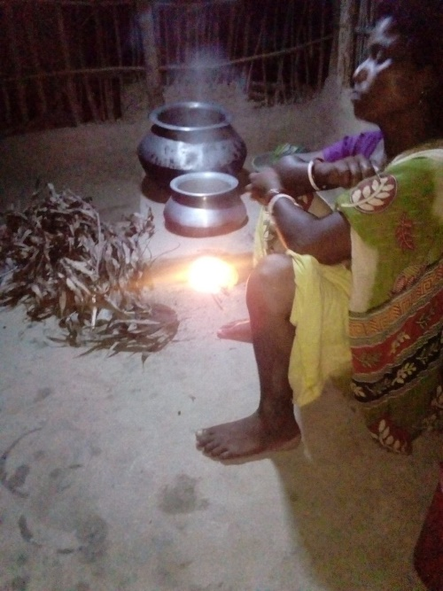
Experience of Women of Sundarban
Soma Majumder
The Researcher, Kolkata

Slide 2
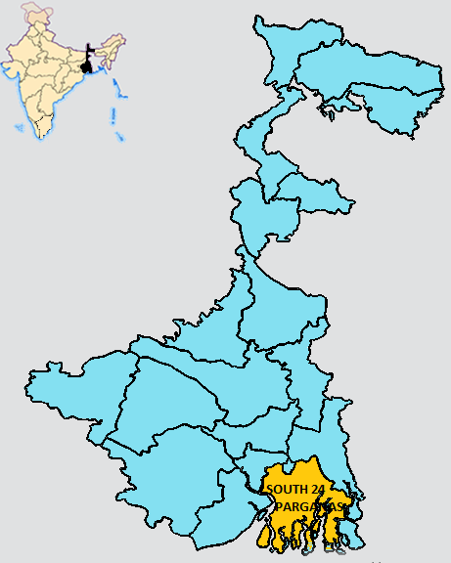
Sundarban
Comprised of islands which are separated from the main land of West Bengal.
Road connectivity with towns is not yet developed.
Many villages in the islands are partially electrified.
Livelihood options are very limited and unsecured due to its typical geographical location.
Male members use to migrate in search of better livelihood opportunity. So women have taken up cultivation along with other daily drudgeries.

Slide 3
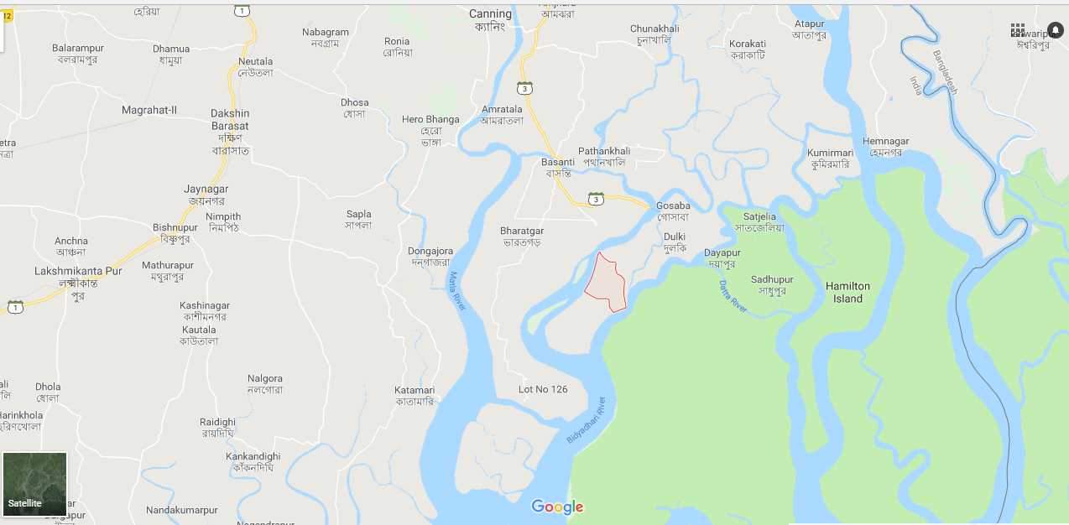
Bali island of Gosaba block – the study location
Separated by rivers from Block head quarter.
Nearest town is approximately 52 km from the island and only accessible by ferry service.
No health care facility.
Families depend upon agriculture, honey collection from the forest, fishing, crab catching, fish-pin collection, apart from other manual jobs, most of which are seasonal.
Both men and women are engaged in these livelihood practices
“… Water, water, everywhere, / Nor any drop to drink.”

Slide 4
Methodology
Study conducted in 4 villages.
Only married or widowed women, in the age group of 18-70 were randomly selected.
Total 100 women were interviewed, 25 from each village.
A mobile app was developed with the questions and used during the interviews.
Educated local girls were trained for administering the app based questionnaire.

Slide 5
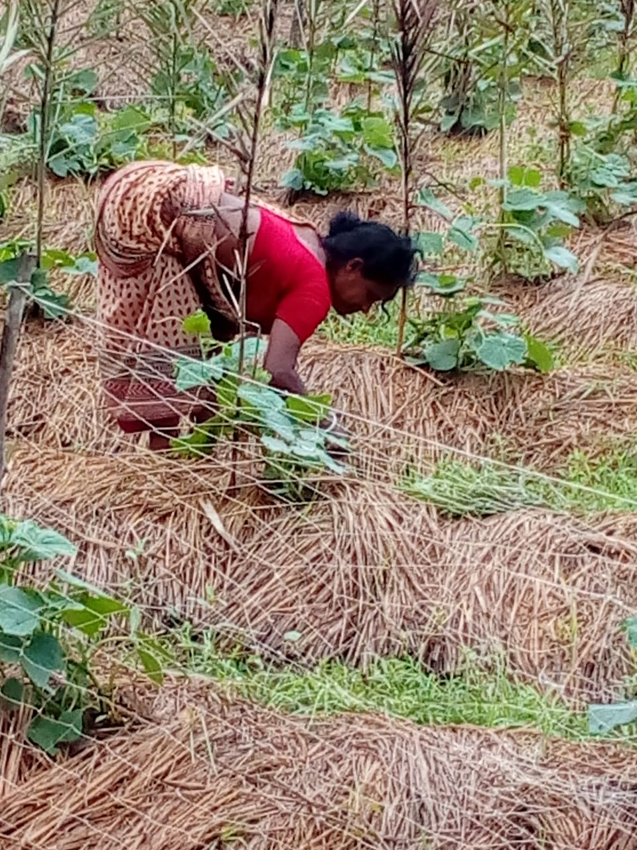
Findings

Slide 6
Socio Economic Status of respondents
33% of the respondents reported that their households are yet to get an electricity connection.
Many women of this area used to go to the jungle to bring fire-wood.
Women in this region on an average wake up at around 5 am in the morning.
18% of the respondents go to the nearest canal or river to collect fish-pin.

Slide 7
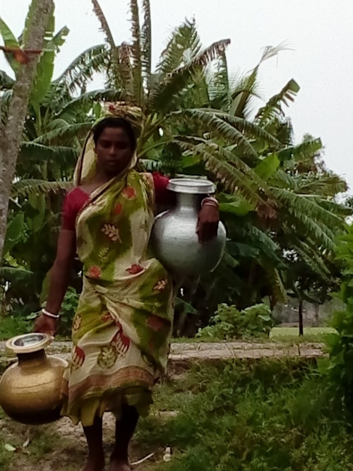
Hardship in domestic chores
46% of the respondents use only firewood as their cooking fuel.

Slide 8
Hardship in domestic chores
Average distance of primary water source 436 meters.
Average distance of secondary water 935.5 meters.
90% of the respondents undertake multiple trips (2-6) to carry water from a distance.
Those undertaking multiple trips carry an average of 20 litres of water per trip and cover an average distance of around 400 meters per trip.
Trips Per Day | Number of Respondents | Average volume of water Carried Per Trip | Average Distance from Primary Water Source
0 | 1 | - | -
1 | 10 | 19 | 625
2 | 27 | 21 | 483
3 | 31 | 21 | 398
4 | 22 | 21 | 375
5 | 6 | 17 | 483
6 | 3 | 17 | 217
“While carrying water, one of the water pots rests in my waist while the other one is carried by hand. It is a hard work for me”

Slide 9
Chronic diseases and hospitalization
The number of strenuous works that the women in this region undertake in the whole day causes several problems to their health.
59 percent of the respondents suffer from one or more chronic diseases.
Among these women 51 percent have some kinds of musculoskeletal disorders (MSDs).
57% were admitted to hospital at some point of time for various health problems.
7 % reported to have undergone hysterectomy operation.
Average expenditure during hospitalization has been more than 10,000 INR.

Slide 10
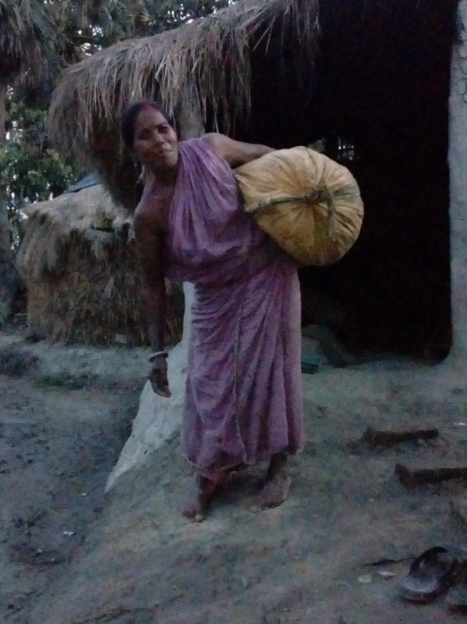
Respondents suffering from different ailments and hours of strenuous works they are performing
Kind of disease | Total persons affected (the numbers include multiple responses) | Avg. hours of work in bending position (in hours) | Avg. hours of weight carrying (in hours)
Musculoskeletal disorders | 51 | 3.3 | 4.1
Gynaecological problems | 15 | 2.5 | 4.3
Other problems | 36 | 2.8 | 3.7
women working in a bending position for a longer time and carrying greater weight tend to suffer from MSD related diseases.
Basic factors responsible for these ailments are the strenuous daily chores undertaken by the rural women, especially working in bending position for a long period and carrying weight several times a day.
Rural women from backward socio-economic backgrounds are more prone to suffer from the diseases mentioned above mainly because of their involvement in strenuous domestic chores.

Slide 11
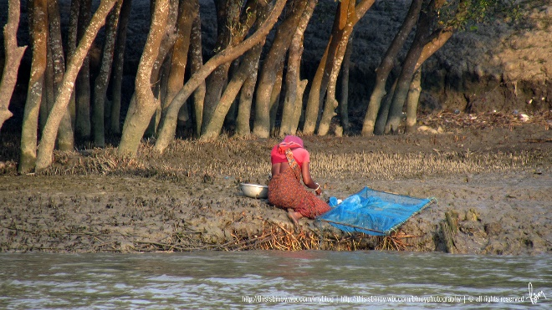
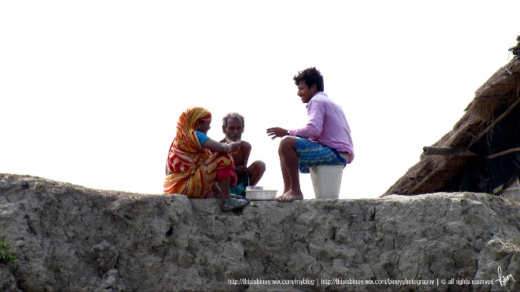
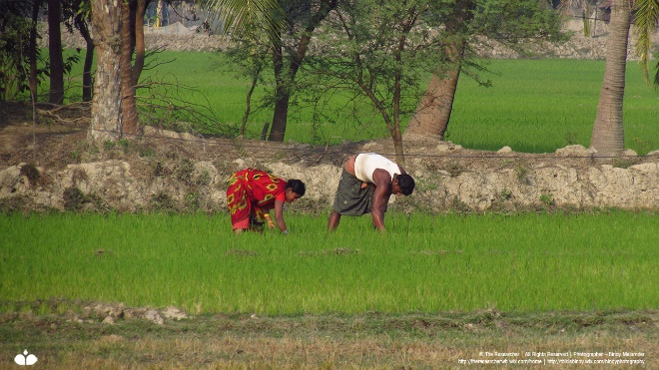
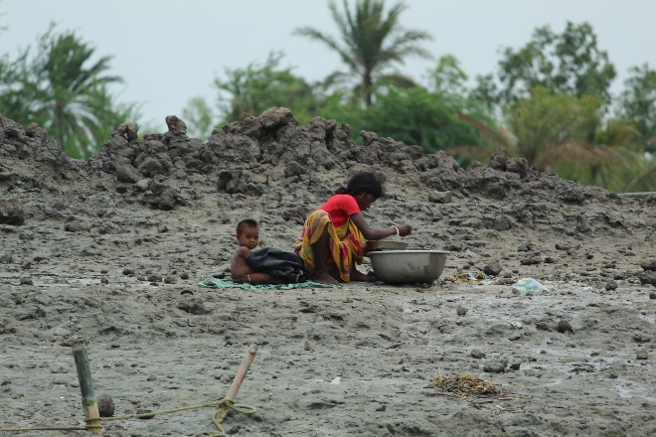
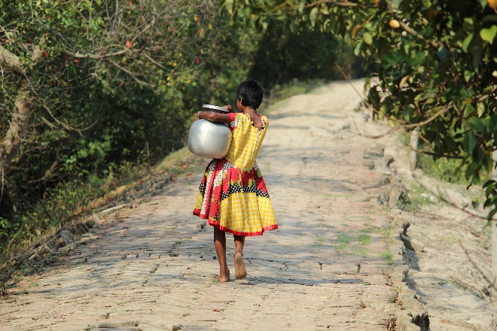
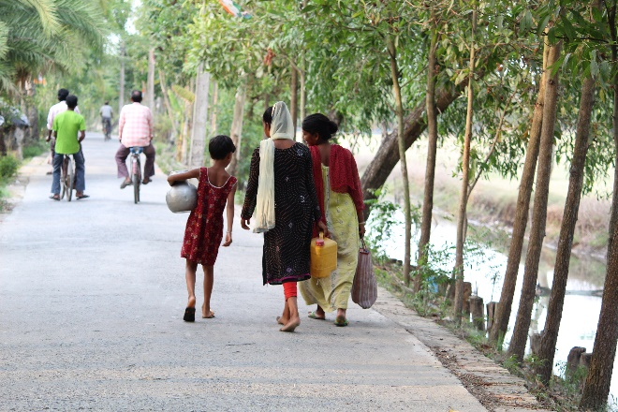
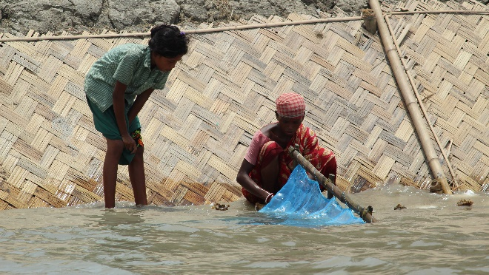
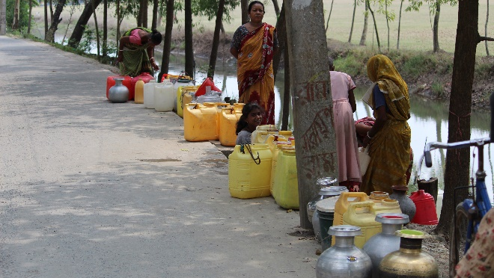
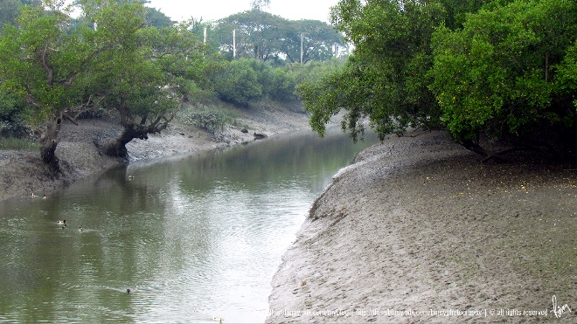

Slide 12
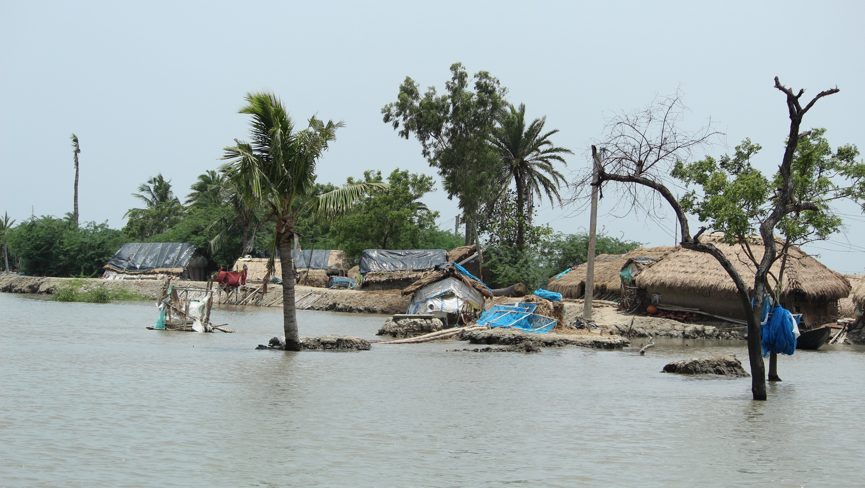
Thank you.

