Slide 1
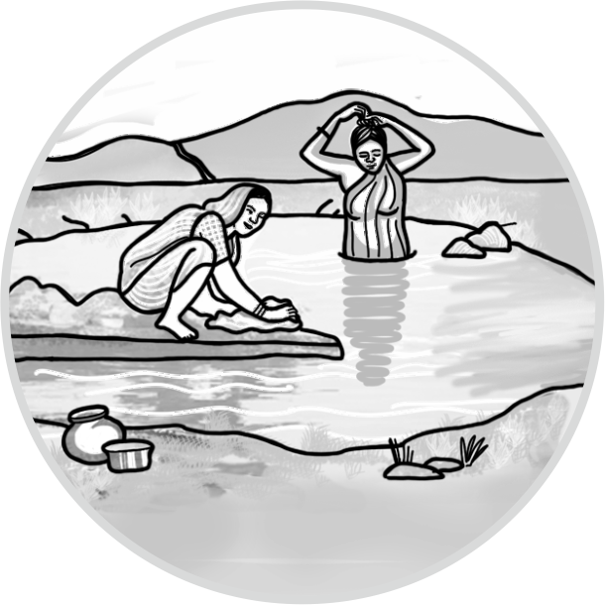
Social and Economic Impacts of Doha Model
28th August, 2018
Parallel Session 2, Hall 2
Shashank Deora
Gyanesh Nanore

Slide 2
OBJECTIVE
Impact assessment of the Doha Model as a water harvesting structure
Agriculture, Livestock, Domestic water use

Slide 3
STUDY AREA and Methodology
STUDY AREA
Jalna District
SAMPLING
Purposive sampling methodology.
68 farmer households sampling from four villages,
Division of farmer households is into the treatment and the control groups
DATA COLLECTION
Questionnaire
Focus Group Discussion
.
Notes:
Villages under study are Akola Deo, Papal, Shirala and Rohanwadi

Slide 4
DATA ANALYSIS
Difference-in-Differences (DID) method
Incremental changes across the treatment and the control group samples.
Cost-benefit analysis comparing incremental benefits of the intervention with its costs.
agriculture,
livestock and
domestic water requirements.

Slide 5
Findings
Cropping Intensity

Slide 6
Comparison of percentage changes in kharif crop yields post-intervention across for treatment and control groups
Notes:
The crop which require irrigation aftr monsoon shown increase in yield

Slide 7
Comparison of percentage changes in rabi crop yields post-intervention across for treatment and control groups

Slide 8
Crop Diversity
Notes:
Herfindahl index of crop diversity shows a marginal change in the crop diversities for both the treatment and the control groups, post-intervention.
It shows that cropping diversity has reduced in case of the treatment group respondents and increased for the control group respondents – a lower value of Herfindahl index indicates a higher crop diversification.

Slide 9
Commercial seed crop cultivation
Notes:
One specific trend which came out from discussions and is also evident from analysis is the growing land under commercial seed crop cultivation.
As a comparison of the seed crop yields is not feasible, given a variety of crops, therefore this study compares increase in the land under commercial seed production and increase in the number of farmers cultivating seed crop across the treatment and the control group respondents.
It finds out the increase in the cropping area as a percentage of the total cropping area and increase in the number of farmers as a percentage of the total number of respondents in both the respondent categories.

Slide 10
Impact of Doha
Water availability for domestic requirements
Water level changes in the dug wells
Reduced physical drudgery
Water level changes in the drinking water sources
Livestock
Livestock ownership and income
Post-intervention number of livestock farming households has increased significantly.
An analysis of the incremental income from livestock to the treatment group respondents shows that it has increased by Rs.3,46,000 annually.
Feed and water availability
Notes:
In the treatment group, there was a change in the water level or an increased retention of water in their dug-wells
All respondents except one from both the treatment and the control groups perceive Doha Model intervention as the reason for an increase in the water level of their dug-wells.
In Akola Deo and Papal, FGD participants perceive that the Doha Model intervention has led to reduction in their physical drudgery in fetching water for the domestic use.
In Papal FGD, participants shared arranging water through private water tankers in the pre-intervention phase. Post-intervention, with the assured water availability through wells, several households have installed a dedicated pipeline to supply water directly to their homes after this intervention.
Discussions revealed a positive impact on the water availability for domestic use. Post-intervention, treatment group respondents reported round the year availability of water for domestic use. Participants reported the cost of one water tanker of 5000 litres capacity at Rs. 2000. They also reported that one tanker would last for 10 to 15 days for a household. This study calculates the saved opportunity cost of these water tankers.
FGDs with men revealed that, a significant fraction of farmers in the study area cultivate sorghum primarily as a livestock feed and the crop produce would be a secondary product; post-intervention, it has received a push with assured irrigation.

Slide 11
Cost-benefit analysis
The cost-benefit analysis yields an internal rate of return of 40% .
Cost-benefit analysis considers the life of the intervention as five years.
As the years of intervention are 2013 and 2014, and the year of study is 2018, analysis calculates both costs and benefits at 2013 prices, using annual inflation rate of 8%.
Costs |  |  | Benefits |  |  | IRR
Doha intervention | Incremental capital costs - agriculture | Incremental capital cost - dairy animals | Net incremental benefits - agriculture | Opportunity cost of water saved | Incremental income -dairy | IRR
₹ 4351851.85 | ₹ 99,25,518.52 | ₹ 18,14,814.81 | ₹ 3,74,39,594.22 | ₹ 4,31,212.68 | ₹ 14,91,995.89 | 40%

Slide 12
Conclusion and Way Forward
Results speak in favour of the Doha Model intervention
However, the study also shows specific challenges and limitations to this intervention
Increasing participation of farmer households in the process of design and implementation of the Doha Model intervention
Notes:
Study results indicate a positive impact on agriculture post-intervention.
Study shows an increase in the overall cropping intensity and a significant increase in the crop yields for cotton, wheat and sorghum.
An increase in the number of farmers and the area under the cost-intensive commercial seed crop cultivation also reflects an increased irrigation support post-intervention.
Livestock rearing has also received a push post-intervention, both in numbers and through water and feed availability for livestock.
A cost-benefit analysis comparing costs of the intervention with the agricultural benefit from the Doha Model intervention also yields an IRR of 40%.
One significant challenge is the equity in distribution of the benefits. Impacts of the Doha Model intervention are limited to the land area in the vicinity of the stream and lowland primarily.
Analysis of cropping intensity and crop yield for different landholding categories shows that semi-medium and medium landholders receive the most significant share of agricultural benefits post-intervention and small and marginal landholders are not the primary focus of the intervention.
Limited community participation in the process of implementation and maintenance of the intervention is yet another challenge along with the hydrogeological concern.

