Slide 1
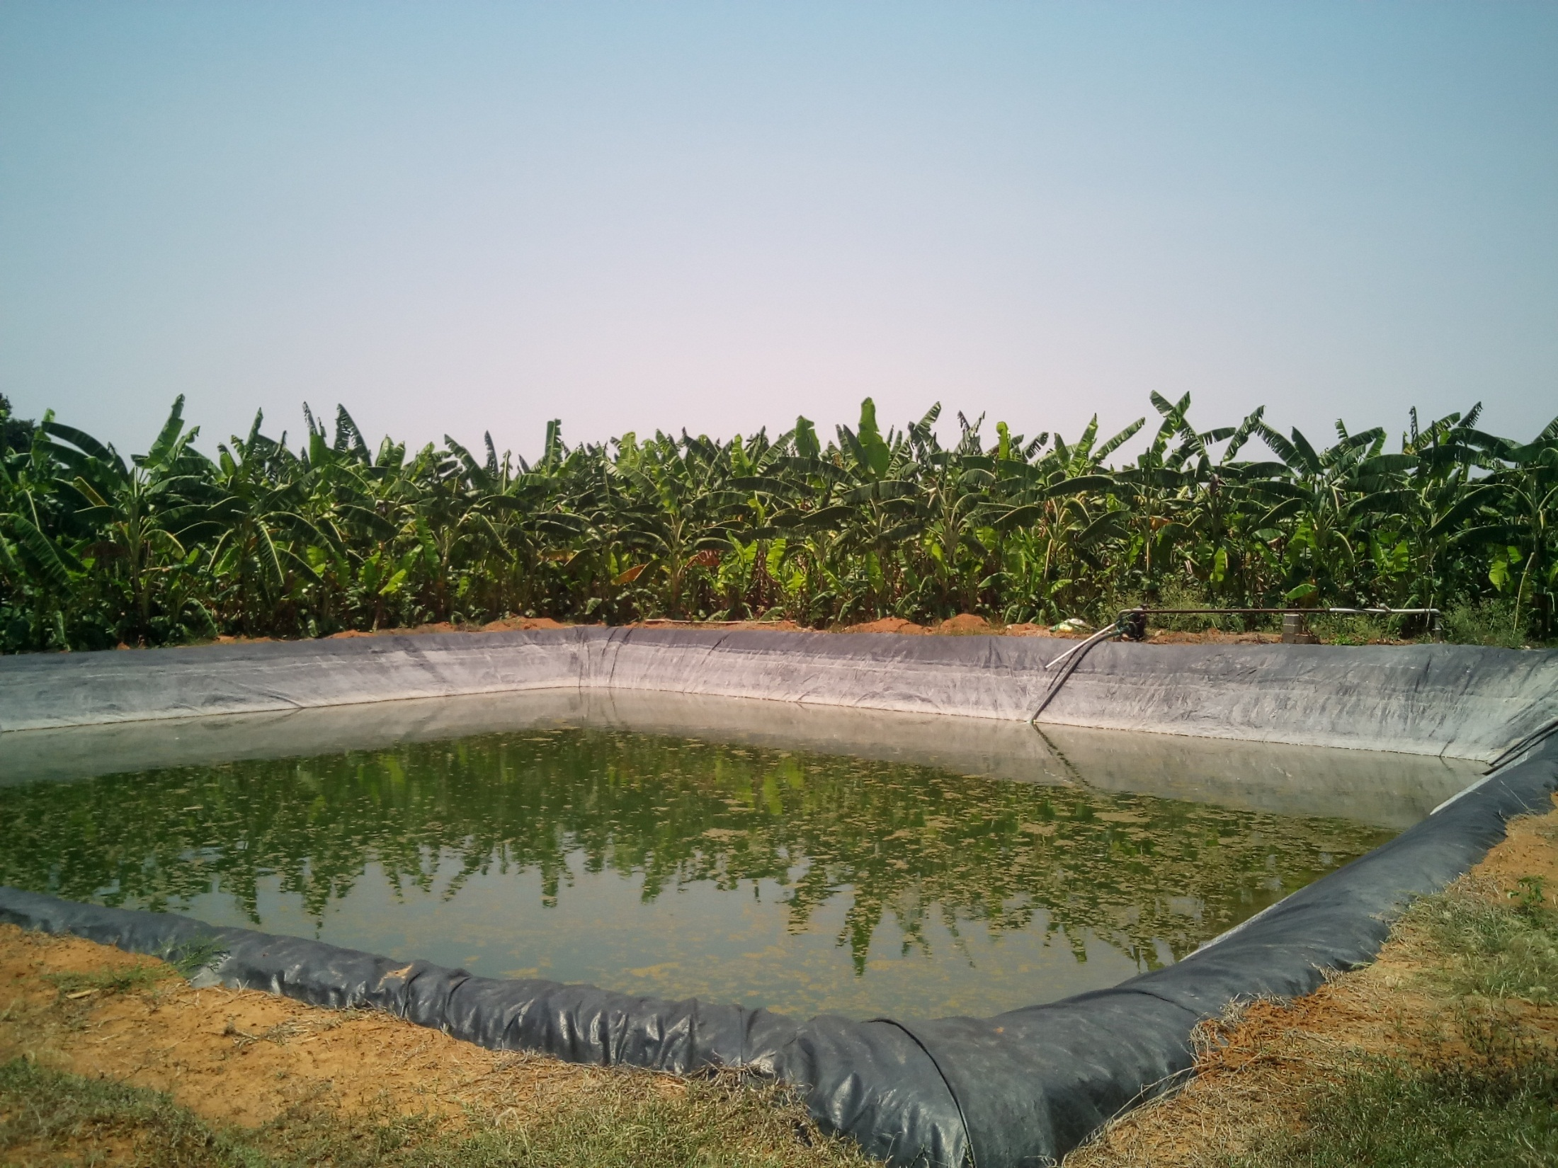
Impact of farm ponds on lives and livelihoods of farmers
A case study of Chikkaballapura District, Karnataka
Kiran Kumar Sen

Slide 2
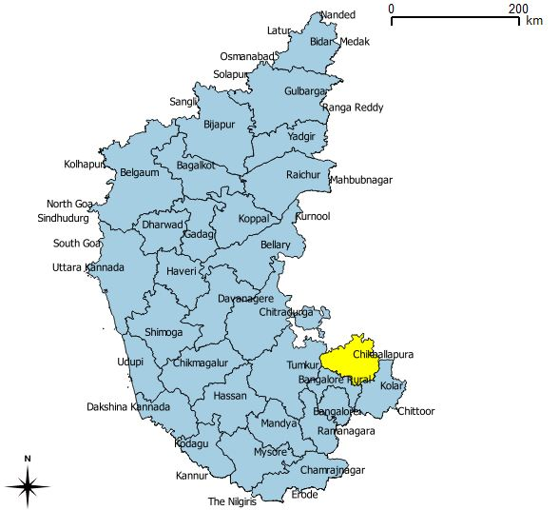
The Study Region

Slide 3
Why Chikkaballapura?
No perennial rivers flowing in the district.
Chikkaballapura falls under the eastern dry agro climatic zone.
The net irrigated area is 26 % lower than state average (36%).
In the absence of surface irrigation system, groundwater is the main source of irrigation.
Various reports about dwindling groundwater resource in the district. (1500 ft)
To tackle water scarcity and accelerate agricultural productivity, schemes to promote on-farm water conservation had been announced in the state.
Comparing rainfall between Karnataka and Chikkaballapura district. Computed by author. Source- Annual Report of KSNMDC, 2016

Slide 4
Study Methodology
A total of 42 farmers comprising of 30 farm pond owners and 12 non- farm pond owners were selected for a detailed field survey.
To ascertain the impact, 30 farm pond owners were considered as the “treatment group” and 12 non-farm pond owners were taken as the “control group”.
The farm pond owners were selected across 14 villages spread across 6 taluks by using random sampling procedure. Snowball sampling was used to identify the next farm pond owner.
The primary data was collected through survey method using a questionnaire.
Difference of Difference (DD) method is used to calculate the impact of the treatment.
Relevant data from government and non-governmental agencies in the form of articles, presentations and reports were referred under the study

Slide 5
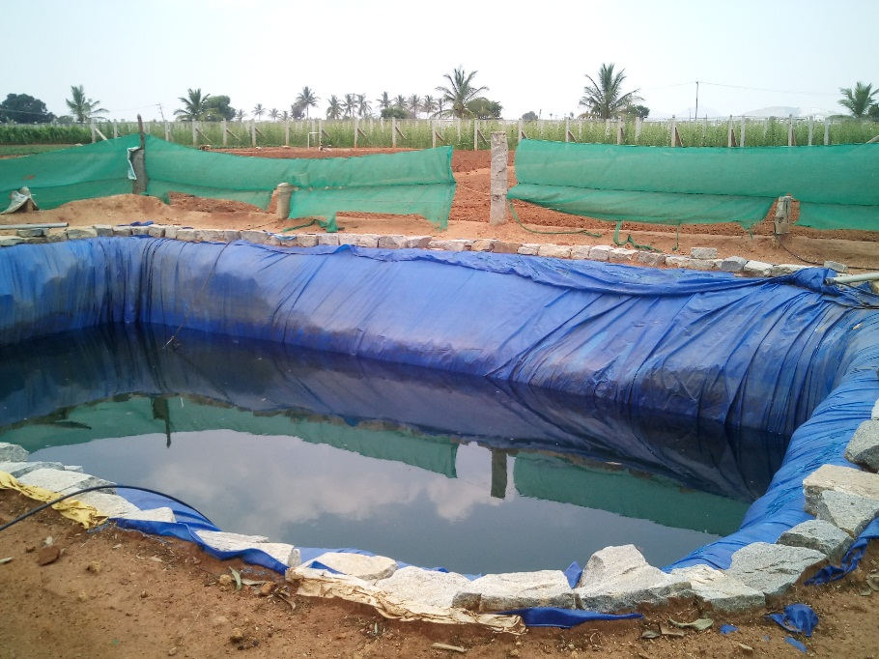
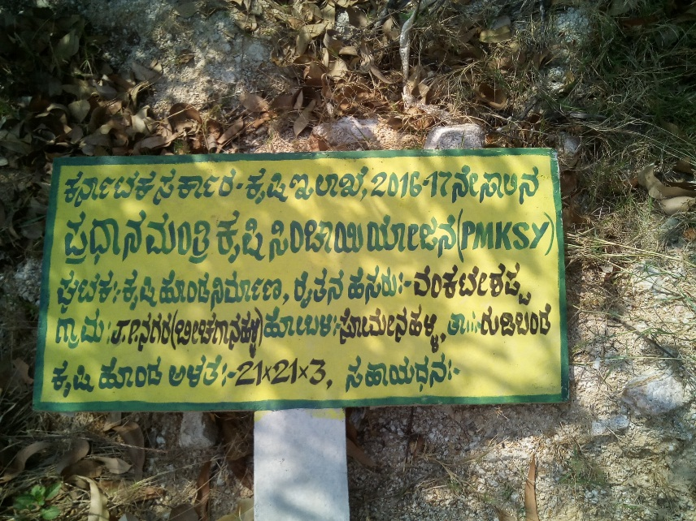
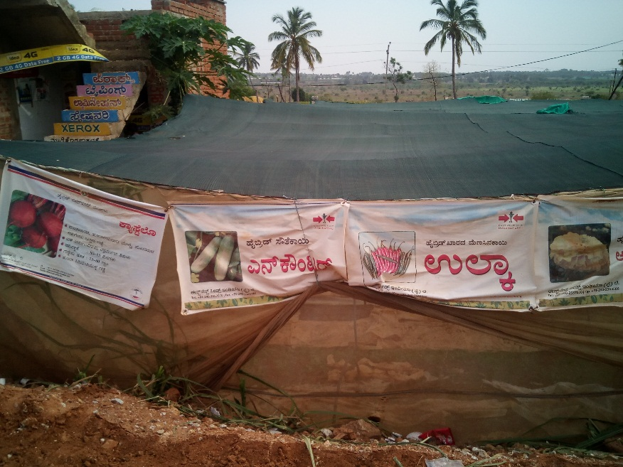
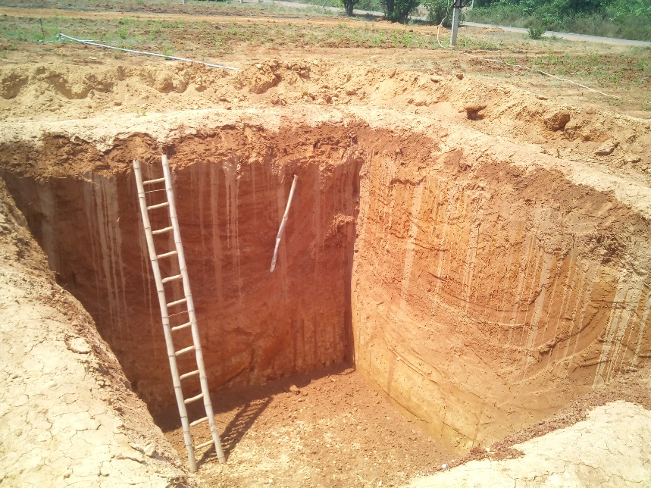
FINDINGS OF THE STUDY

Slide 6
Characteristics of the region
The south eastern belts with districts like Kolar, Chikkaballapura, Bangalore Rural and Tumkur have no major irrigation projects and historically relied upon tanks for irrigation.
Thus, the concept of farm ponds in that sense is not new in these regions. Tanks - community benefits, Farm ponds - private gains.
The social group of the respondents include Gollas, Bhovis and Vokkaligas who formed major numbers alongside few Dhobis, Gowdas, Kurubas, Nayakas and Togatas.
Under Krushi Bhagya scheme, farmer can avail subsidy of upto 95 % based on the caste and land size.
Only 4 farmers reported they invested on their own and didn’t obtain subsidy.

Slide 7
Impact on crop production…1
The water stored in the farm ponds enable farmers to provide supplemental irrigation during extended periods of non-rainy days during monsoon.
Farmers say that drip irrigation works better with storage provided in farm ponds.
6 farmers reported planting 4 crops throughout the year versus only 3 farmers reporting the same before intervention.
Venkatesh says “Farm pond has helped in increasing the irrigated area by 0.5 acre. It has helped to cultivate more crops and provide water even in summer season”.
Farmers have switched to short term, but water intensive crops like Fruits, vegetables, flowers and mulberry.
Anandappa, says, “Farm ponds have provided a mode to store water and spread water throughout the field. This helps in increasing the cropped area. Increasing in cropped area, means more crops. More crops means more chances for better income”.

Slide 8
Impact on Crop Production…2
Parameter Average values | Before Intervention | With Farm Pond intervention | Non-farm Pond Owners (Present) | Non-farm Pond Owners (Before)
Total Land Owned (in Acre) | 5.26 | 5.26 | 3.26 | 3.26
Gross cropped area (in Acre) | 4.28 | 4.56 | 2.96 | 3.02
Cropping Intensity (in decimals) | 0.94 | 1.03 | 1.11 | 1.19
Cropping Intensity (In %) | 94.6 | 102.6 | 111 | 119
Total Cost of cultivation (in INR) | 76240 | 151733 | 135083 | 65167
Total Sale from Agriculture Produce ( in INR) | 90650 | 537887 | 100275 | 27513
Net Return from Agriculture (in INR) | 14410 | 386153 | -34808 | -37654
4 farm pond owners have reported more than 10 lakh INR in income from crops. If removed, net return drops from 386153 INR to 50870 INR.
Anandappa from Gauribidanur- 2012 farm pond- 5 acre land- sold 5000 boxes of tomoato @1200 rs/box- 60 lakh INR.

Slide 9
Impact on Livestock
Given the strong presence of dairy cooperatives, milk from cows/buffaloes is sold which contributes to revenues from the livestock
But maintaining livestock requires considerable investments in their food and healthcare due to high milk yielding varieties.
Prior to the intervention, farmers reported greater numbers of livestock. The traditional occupation of the Gollas and Kurubas is associated with shepherding. However, they reported the proportion of livestock has decreased over years.
The availability of water post intervention has allowed farmers to grow maize which is used as fodder for livestock and reduced some expenses.

Slide 10
Impact on lives of farmers
With fair stability in the earnings, farmers have invested in assets which have impacted their social life.
Farmers own color TVs, some even LED TVs compared to bulky Black and White TVs they possessed earlier.
The keypad phones have given way to smart ‘touch’ phones.
Some farmers responded that they have built homes, educated their children and married their daughters post intervention.
The value of such changes can’t be put down in numbers.
Venkatappa mentioned earlier he made losses for his tomato crop and says farm ponds can increase the area of irrigation and he can grow more crops. He feels confident and patient about his ability to clear his loans.

Slide 11
Labour and Migration
Labour come from surrounding villages and are informally remunerated on cash basis.
Weeding, trimming, application of fertilizers, plucking harvest etc. are managed by women earning between 150-250 INR a day.
Farmers report that men are called for heavy manual work like digging which earns them 350-400 INR each day.
When not as farm labourers, the young and middle aged men migrate to towns like Chikkaballapura, Hindupur, Anantapur, Bangalore or Hyderabad for better avenues
Gender | Average labour used/farmer | Average amount paid/day (in INR)
Male | 18 | 376
Female | 38 | 219
Migration | Farm Ponds owners | Non-farm pond owners
Present | 20 % | 33%
Absent | 80% | 67%

Slide 12
Challenges faced by farmers
The discussions on net returns among farm pond owners suggest that they are mostly happy about the benefits from farm ponds, then it is far from the truth.
Farmers interviewed were bitter about the intermittent supply of power. Karnataka receive six hours of power for agriculture, which is lowest in south India .
Sometimes, power is supplied at nights when shifts changes. Night irrigation posed inconvenience as they had to irrigate at odd times and danger of wandering on fields.
Due to instability of crop prices, farmers did not receive adequate prices incurring losses and were unable to repay their loans.
A farmer from Chintamani says “farmers usually don’t get the proper amount for their produce. This increases our vulnerability to losses. Production is heavily dependent upon high input costs like fertilizers. Market don’t fetch good prices for their produce. In addition, crop diseases are affecting crop production.
As a result, the economic benefits is not uniform amongst all the farm pond owners

