Slide 1
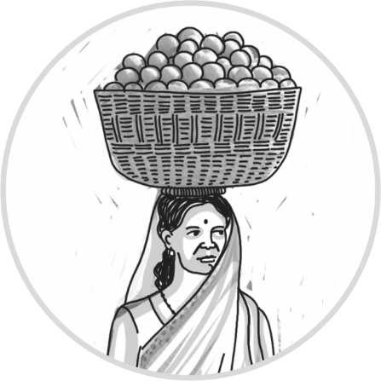
Measuring the rural drudgery- a study from rural Rajasthan
29th August, 2018
Dr. Abhijeet Jadhav
Senior researcher- Vikas Anvesh Foundation

Slide 2
Background
Women’s hard-work towards family responsibility is often noticed, talked about but has rarely been explored scientifically from public health perspective.
Access to most of the basic amenities is compromised in rural areas which get translated into the women’s hard work to meet the ends at the household level.
Many of these physical activities are strenuous and doing those daily, for years, may have deleterious effects on the body. Understanding the physical activities, quantifying them for further studies and measuring its health impacts is important.

Slide 3
Methodology-
This is a cross-sectional study done in 13 villages around Udaipur city.
Trained female students of first year of Post-graduate program from IIM-Udaipur helped in the study through data collection. These students were posted in these villages in the group of five to six per village for 10 days. Each girl student was supposed to collect data from at least 10 women from her village and each student was allotted different areas of village.
This was a community based data collection. Sample selection was stratified random with village areas as strata. From each of the five strata (areas of a village) at least 10 participates were chosen randomly for the study.
The inclusion criteria were- age above 18 years, not doing any formal job or any regular paid work, permanent resident of the village and willing to participate in the survey.
Tool was a structured, pre-tested questionnaire to be filled by these trained students.
From each of the 13 villages 40 to 60 participants were taken making a total of 565 women participants. Verbal consent was taken after explaining everything related to the study.

Slide 4
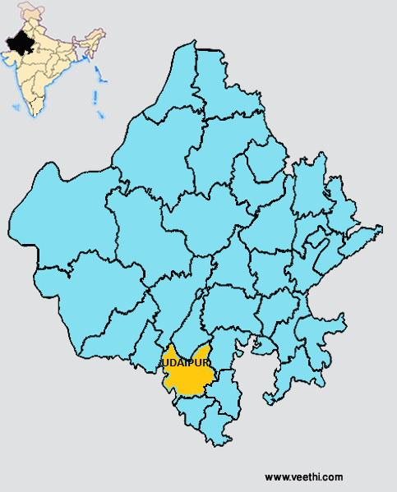
Sr. no | Village name | District (block) | Number of participants
1 | Budhiya | Udaipur (Kotra) | 60
2 | Vali | Udaipur (Girwa) | 53
3 | Dhoya | Udaipur (Gonenda) | 51
4 | Sultanji ka Khera | Udaipur (Jhadol) | 50
5 | Sathpur Meenan | Udaipur (Girwa) | 50
6 | Samiter | Udaipur (Kherwara) | 60
7 | Magrawali Thori | Udaipur (Sarada) | 50
8 | Bhilwara | Udaipur (Girwa) | 04
9 | Amiwada | Udaipur (Jhadol) | 45
10 | Gejvi | Udaipur (Jhadol) | 40
11 | Jardaya | Rajasmand (Kumbhalgarh) | 42
12 | Jardaya Khaas | Rajasmand (Kumbhalgarh) | 10
13 | Galdhar | Banswara (Khushalgarh) | 50
 | Total |  | 565

Slide 5
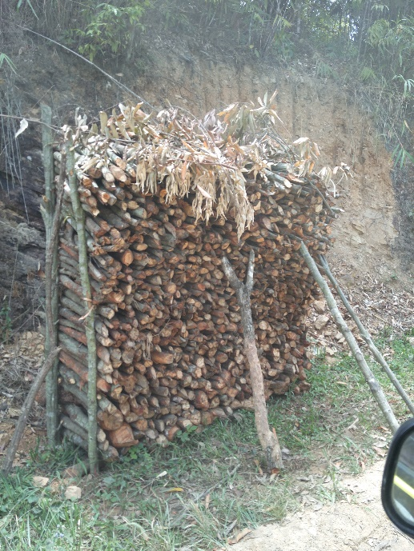
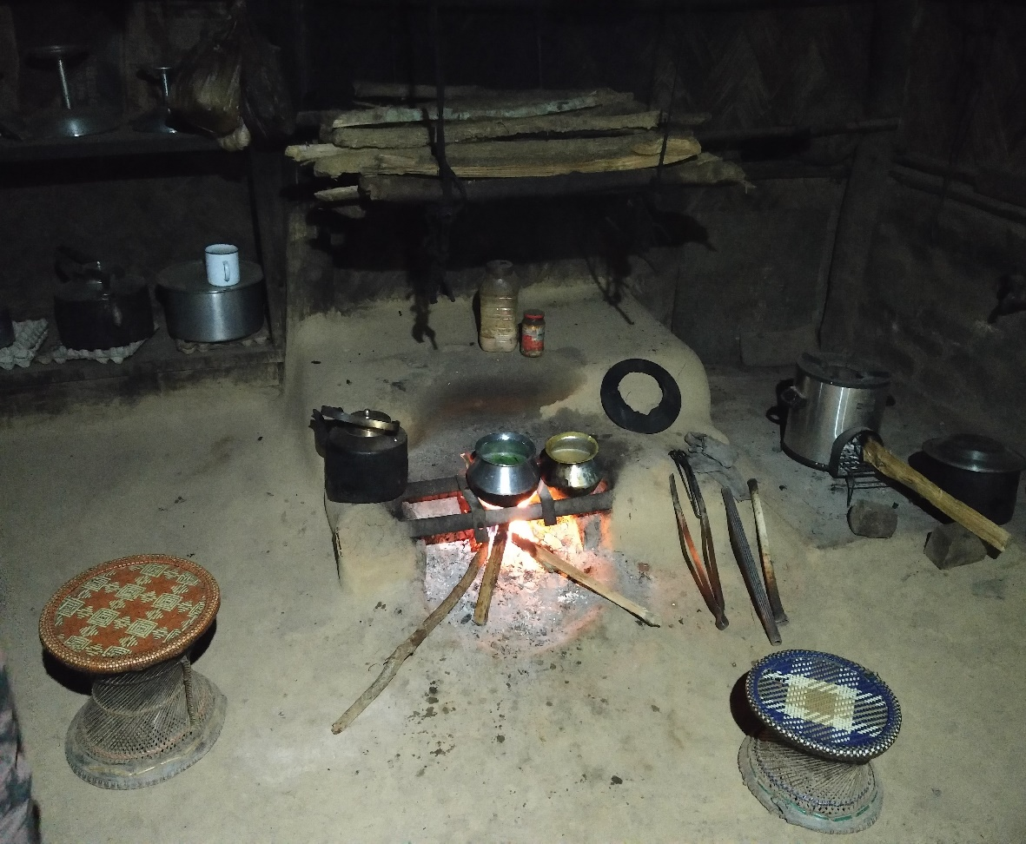
Access to basic facilities
Sr no | Facility | Yes N (%) | No N (%)
1 | Pakka house | 161 (28.50) | 404 (71.50)
2 | Electricity | 387 (68.50) | 178 (31.50)
3 | Water tap at household | 95 (16.81) | 470 (83.18)
4 | Toilet | 323 (57.17) | 242 (42.83)
5 | Bathroom | 271 (47.96) | 294 (52.03)
6 | Drainage | 141 (24.95) | 424 (75.04)
7 | LPG/ Biogas | 91 (16.11) [49 (8.67)- connection only] | 425 (75.22)

Slide 6
Physical activity | Mean duration- in hrs (S.D.) | Range
Work inside of your house | 3.90 (2.81) | 0- 15
Work in house premises | 3.05 (2.56) | 0- 13
Work outside of house premises | 4.02 (2.58) | 0- 14
Total duration of walking | 3.15 (2.50) | 0- 14
Total duration of carrying any sort of weight | 2.07 (1.69) | 0- 12
Total duration you work in bending position | 2.61 (2.62) | 0- 12
Fetching water | 1.10 (1.16) | 0- 10
Bringing fodder/ preparing forage | 1.17 (1.14) | 0- 11
Bringing firewood | 1.70 (1.33) | 0- 8
Working in your farm | 2.64 (2.18) | 0- 14
Watching TV | 0.23 (0.65) | 0- 4
Talking with friends/ neighbours | 0.76 (0.87) | 0-8
Taking rest in day time | 0.80 (1.18) | 0- 7
Location
This differential time mapping helps us identifying the distribution of work across the different domains and also to help identifying areas where interventions are needed.
Physical activity
Tasks
Recreational activities

Slide 7
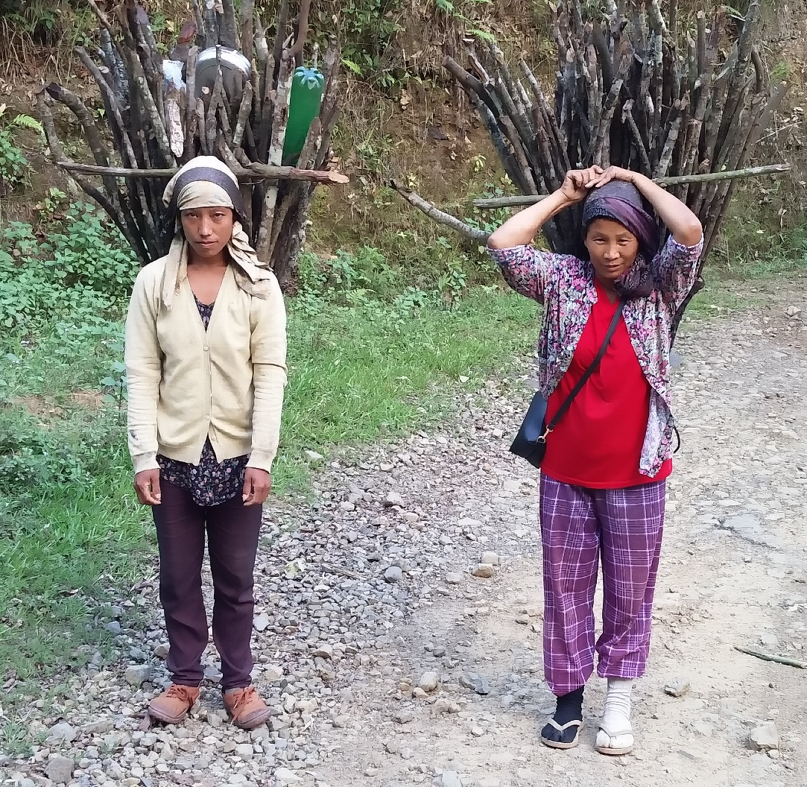
Self-reported chronic (more than 3 months) pain/ disorders, at the time
Musculo-skeletal Disorder | Number of people reporting (Percentage within MSD ) | Percentage out of total sample
Low Back Pain (LBP) | 165 (54.64 %) | 29.20 %
Shoulder/ upper arm pain | 24 (7.95 %) | 04.25 %
Leg/ knee pain | 57 (18.87 %) | 10.09 %
Other musculo-skeletal problem | 56 (18.54 %) | 09.91 %
Total | 302 (100 %) | 53.45 %

Slide 8
Health seeking and reasons
Disorder | Visited doctor in last one year n (%) | Taken medication in last one year n (%)
Musculo-skeletal problem | 70 (12.39 %) | 96 (16.99 %)
Gynaecological problem | 42 (07.43 %) | 30 (05.31 %)
Obstetrics reasons | 18 (03.19 %) | 14 (02.48 %)
Other | 223 (39.47 %) | 215 (38.05 %)
None | 212 (37.52 %) | 210 (37.17 %)
Total | 565 (100 %) | 565 (100 %)

Slide 9
Reasons of major hospitalizations (ever)
Though figures for MSD & Hysterectomies do not look big in whole population, among hospitalized these two constitute ¼ th of the number.
Not all the MSDs and hysterectomies are due to weight bearing, it is a major contributor to the pathology.
Reason for last hospitalization | Frequency | Percentage (out of total) | Percentage (out of hospitalized)
MSD | 16 | 2.83 | 09.47
Hysterectomy | 24 | 4.25 | 14.20
Obstetrics | 42 | 7.43 | 24.85
Infective causes | 35 | 6.19 | 20.71
Trivial causes | 48 | 8.50 | 28.40
Worst outcomes of pregnancy | 4 | 0.71 | 02.37
Total | 169 | 29.91 | 100

Slide 10
Discussion and conclusions
The burden of MSDs, as well as uterine prolapse, is higher in the rural women and it is likely to be contributed by continuous strenuous physical work.
At least 2.8 hours of strenuous physical activity per women per day can be reduced with the provision of the basic facility of LPG and water at the doorstep.
If electricity and animal forage is provided, at least two hours’ drudgery can be reduced further.
There is a scope to reduce this drudgery considerably. This will also make the lives of women less burdensome and will create a scope to utilize it for the individual as well as social development and improving livelihoods.
However, the disability burden due to domestic work on rural women needs to be studied further in order to have effective measures to reduce it.

Slide 11
Poverty & lack of employment
Social norms
e.g.- Women’s role
Lack of basic facilities
e.g- Water, LPG
Lack of access to health & education-
No awareness
Excessive Physical activities
Lack of energy & time
Adverse health impacts
No possibility of developmental activities
Excessive suffering, low QOL

Slide 12
Need for employment & entrepreneurship
Need of formal & informal education, sensitization
Push for policy reach, Promotion of basic rights
Poverty & lack of employment
Work on prevention or mitigation
Social norms
Lack of basic facilities
Lack of access to health & education
Excessive Physical activities
Lack of energy & time
Adverse health impacts
No possibility of developmental activities
Excessive suffering, low QOL

Slide 13
Thank you

