Slide 1
REVIVING INDIA’S WATER HARVESTING STRUCTURES TO ACHIEVE DROUGHT RESILIENCE
Results from Initiatives in Four States of India
Harikrishnan Santhosh, Manisha Shah, and Shilp Verma

Slide 2
DROUGHTS IN RURAL INDIA
INCREASING GROUNDWATER STRESS
UNDERMINING OF GW’S ROLE IN DROUGHT RESILIENCE
RAINFALL ERRATIC AND IRREGULAR
IRRIGATION BECOMING LESS ACCESSIBLE AND MORE EXPENSIVE
5 MAJOR DROUGHTS IN LAST 2 DECADES
DRINKING WATER AND LIVESTOCK AFFECTED LARGELY
INCREASING SURFACE WATER STORAGE THROUGH TANKS TO CREATE DROUGHT-RESILIENCE IN SEMI-ARID AREAS

Slide 3
TANKS IN PENINSULAR AND WESTERN INDIA
RICH TRADITIONAL AND CULTURAL SIGNIFICANCE IN HISTORY – USED PRIMARILY FOR IRRIGATION, DRINKING WATER, BATHING AND RITUALS
NEGLIGENCE OF TANKS STARTED OWING TO SHIFT TOWARDS GROUNDWATER IRRIGATION
WELLS IN TANK COMMANDS RECHARGED THROUGH TANKS ARE USED INSTEAD OF FLOW DIRECTLY FROM TANKS
ACCUMULATION OF SILT, ENCROACHMENT ON TANKS BEDS, CLOGGING OF FEEDER CHANNELS HAVE RENDERED TANKS NON-FUNCTIONAL
STATE GOVTS. MAKING EFFORTS FOR REVIVAL

Slide 4
ABOUT THE PAPER
Studies on Chief Minister’s Tank Revival Interventions from 4 states (Gujarat, Maharashtra, Telangana and Rajasthan)
Synthesis of multiple ITP studies on structure, implementation and effectiveness of the programs
Comparison of programs and recommendations for sustaining benefits

Slide 5
METHODOLOGY
Different data collection methods in different states
State/ Program | Sample | Tool for data collection | Study Year
Gujarat - Sujalam Sufalam | 26 villages | Village questionnaire | 2015/2018
Maharashtra – Gaalmukt Dharan Gaalyukt Shivar | 30 villages | FGD, Interviews | 2017-2018
Telangana – Mission Kakatiya | 25+37+15 tanks (3 studies) | FGD, Questionnaire survey, Interviews | 2015-2017
Rajasthan – Mukhyamantri Jal Swavlamban Abhiyan | 87 villages | Village level questionnaire, FGD | 2018
Groundwater Impacts
Irrigation Improvement
Productivity
Local governance
Cropping Intensity
Community Participation
VARIABLES OF INTEREST

Slide 6
GROUNDWATER MANAGEMENT IN GUJARAT
1) SUJALAM SUFALAM JAL ABHIYAN (2018)
Month long drive to capture rainwater and catalyse groundwater recharge
Desiltation of 13,000 ponds, 200 reservoirs, 1500 checkdams and cleaning of 3400km of riverbeds
Additional activities like Deepening of ponds, Planting of trees, Revival of small streams and forest ponds, Increasing awareness etc. Departments involved include – Irrigation Dept. with peoples participation, DRDA, Nagar Palika
Projected Budget – Rs. 345 crore where 50% contribution from NGOs/Community Participation and 50% from government
Likely benefits: Increase in overall water capacity, community and NGO participation, use of accumulated silt to increase agricultural productivity
ORGANOGRAM
Chief Secretary
Secretary (Urban Dev)
Secretary (Water Supply)
Secretary (Water Conservation)
Chairman
Member
Members
Commissioner & Secretary (Rural Dev)
Addl. Chief Secretary (Forest & Env)

Slide 7
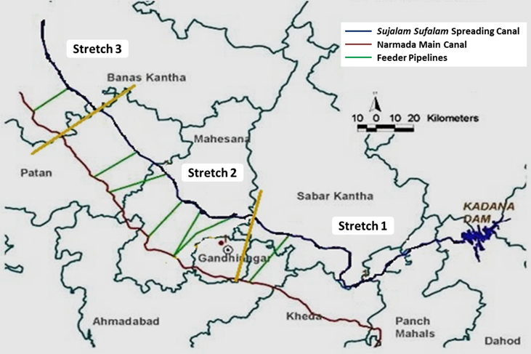
2) SUJALAM SUFALAM YOJANA (2004)
Objective: To use surplus water from Narmada and Mahi to fill reservoirs and recharge aquifers in 10 water-scarce districts of north Gujarat.
Scheme Components:
Pump water from Narmada canal to fill 9 surface reservoirs in north Gujarat
337km long unlined spreading canal linking Kadana Dam on Mahi river to Banas river
Construction of 200,000 farm ponds along spreading canal to enhance groundwater recharge
IMPACT
Rise in GW level by 2 to 4 m near recharge structures
Revival of dry dugwells (0.5 to 2km from spreading canal)
Increase in irrigated area & cropping intensity
Reduction in energy use for pumping water

Slide 8
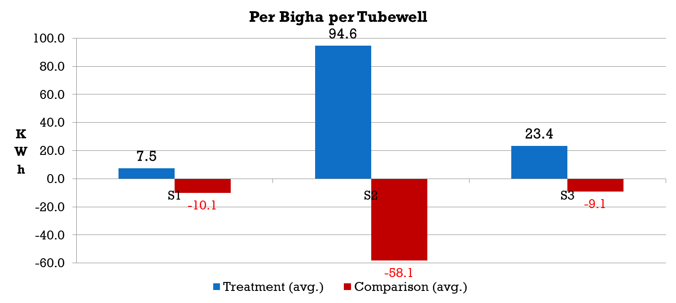
Depth of tubewells in villages along the Sujalam Sufalam spreading canal
Irrigated area in treatment and comparison villages along the spreading canal
Gross Value of Output in treatment and comparison villages along the spreading canal
Net energy savings in treatment and comparison villages along the spreading canal

Slide 9
3) MANAGED AQUIFER RECHARGE (2008)
Four-pronged strategy to manage groundwater in the state
Recharging with surface water
Recharging with rain water
Incentivising accelerated recharge by communities
Introducing policies for groundwater demand management
Implementation plan recommended by the committee included construction of 21,200 percolation tanks, 22,400 recharge wells, 23,600 check dams and modification of 42,000 existing wells
Success of community-driven movements indicate that the mass de-siltation program to improve water harvesting capacity in Gujarat has a good prognosis.

Slide 10
GAALMUKT DHARAN AND GAALYUKT SHIVAR in MAHARASHTRA
“Silt-free tanks and Silt-enriched farms”
Launched in2017 to drought-proof Maharashtra by 2019
Data collected on Processes followed in extraction of silt, allocation to farmers, transportation of silt and awareness practices; Farmers’ perception regarding the quality of silt extracted and its intended benefits
Excavation cost/diesel cost of machinery paid by the government
Plan to desilt 31,459 small dams and tanks containing 5.18 lakh TCM of silt
ITP conducted study in 30 villages of Marathwada Region
Relies on assured participation by farmers to transport the excavated silt to 6.91 lakh ha of farmland to increase productivity
Focus to quantify impacts on village water security and agrarian livelihoods

Slide 11
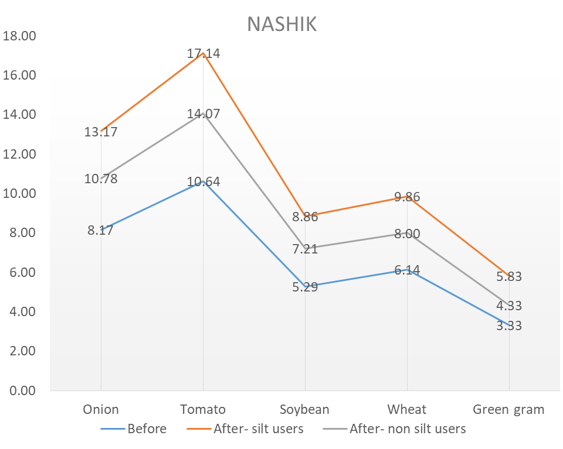
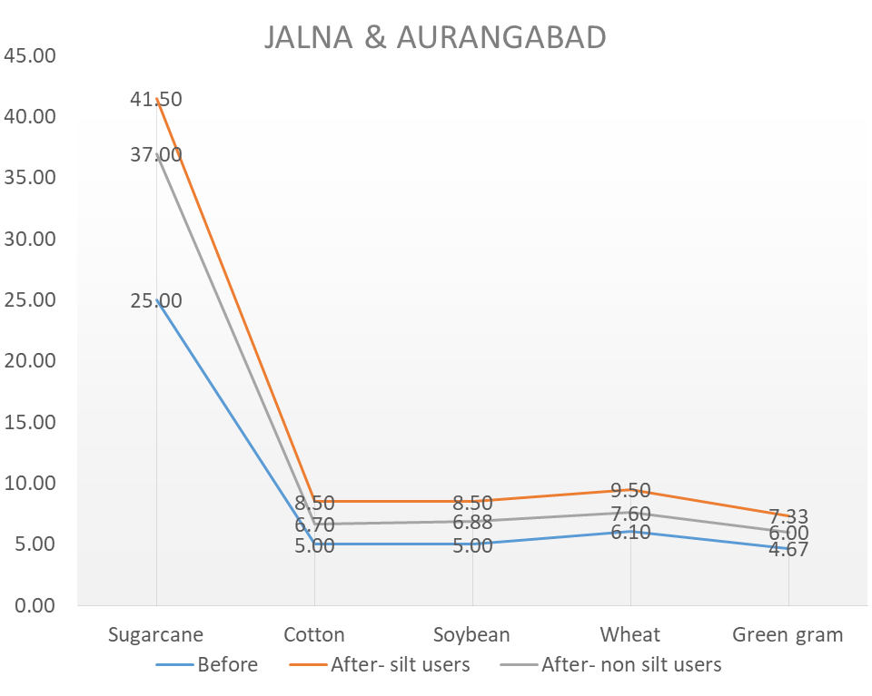
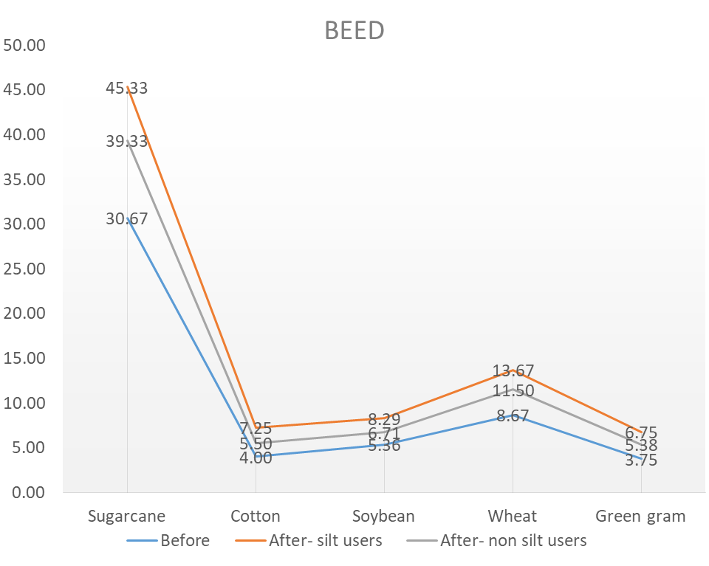
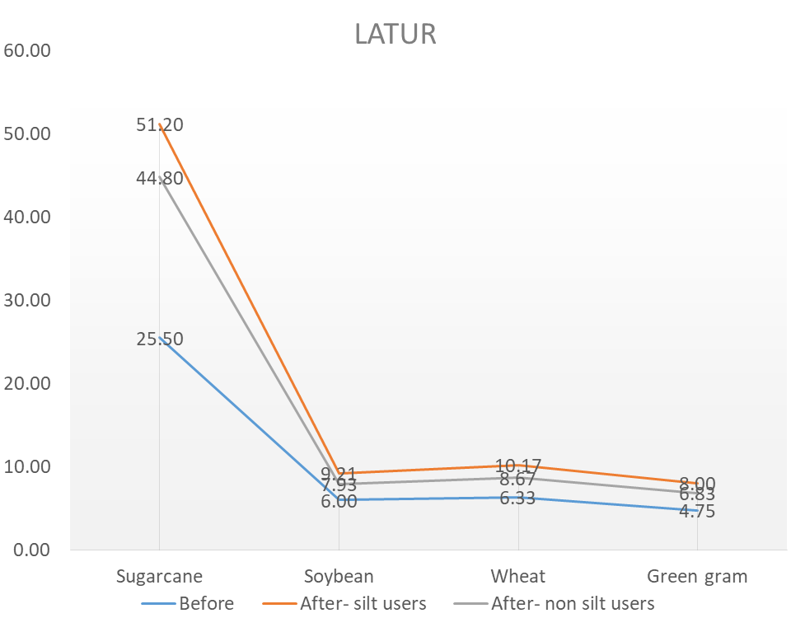
Impact Observed on Average Yield Per Acre

Slide 12

Mission Kakatiya in Telangana
Mana Ooru, Mana Cheruvu (Our Village, Our Tank)
Objectives
  To restore all 46,531 “Kakatiya Tanks” to retrieve the lost glory of minor irrigation in the state with community participation for ensuring sustainable water security
  To fill gap ayacut of 10 lakh acres under MI tanks by utilizing 7.5 BCM water allocated for minor irrigation in Godavari and Krishna basins to irrigate two million acres
Focus Areas
  Desiltation of tank beds to increase water storage capacity and improve fertility
  Repair of dilapidated sluices, feeder channels, irrigation channels and weirs
  Tank bund strengthening
  INR 6,500 crores provisioned for four annual phases, INR 3,200 crores actually spent on 15,500 tanks (Approx. INR 2 million per tank)
  Loan from NABARD, Funding from GoI under RRR Scheme and departmental funds
Funding
  I&CAD is the nodal department with engineers to co-ordinate with line departments
  Agriculture department for silt quality testing and motivating farmers through AES
  Forest Department to increase green cover, around tanks to increase sustainable sources of livelihoods; Fisheries for promoting aquaculture in tanks
  Other Departments: Revenue, Rural Development, Groundwater and Public Relations
Agencies
Notes:
80% farmer suicides on integrated AP was in Telangana region
Droughts were frequent and migration of vulnerable population to urban areas was a matter of grave concern

Slide 13
Methodology
Details of ITP Studies
Kumar and Kumar (2015)
  12 villages in Warangal and Rangareddy
    Gathered data through largely qualitative enquiry and open-ended discussion
    Focus: Technical and Insitutional challenges on ground, Community enthusiasm and Participation, Legal challenges of enroachment
Bharti (2016)
  25 tanks in Warangal and Karimnagar
    Collected data from 90 respondents in 5 villages through interviews; conducted FGDs in Bala Vikasa revived tank commands
    Focus: Comparison of implementation protocols of BV with MK; Challenges
Aryan et. al (2017)
  37 tanks in Nirmal (old Adilabad) and Warangal districts
    Purposive sampling to study impacts of ‘best’ implemented tanks under the program through FGDs (base year: 2014-15)
    Focus: Impact on irrigation, cropping pattern, water availability, groundwater and livelihoods
Shah et. al (2017)
  15 tanks in Nirmal, Warangal, Karimnagar and Naldonda districts
    Randomly selected tanks completed in Phase 1/2; Conducted FGDs with farmers in tank commands
    Focus: Components repaired, AES provided, Community participation, Traditional Insitutions

Slide 14
Findings
Impact on irrigated agriculture
196% in Kharif
<10 per cent of the increase in Kharif area and less than 50 per cent of the increase in Rabi area can be explained by additional tank storage
The high figures figures can be explained by:
[a] deficit rainfall in base year, 2014-15;
[b] repairs preventing any leakage to render floodplains around tanks cultivable; and
[c] these numbers do not represent the “average” scenario as their sample was purposively biased.
Mainly due to expansion of paddy cultivation in both seasons
159% in Rabi

Slide 15
Findings
Impact on soil productivity and cultivation cost
The average percentage change in productivity is lowest for paddy (13.5%) and highest for chillies (25.6%),which is consistent with farmers’ preference for silt application.
 | Cost of chemical fertiliser (Rs.) |  |  |  |  | Profit (Rs.)
Crop | Without silt | With silt | Cost Reduction | Cost of silt transport and application | Increase in productivity (quintal/acre) | 2014 | 2016
Paddy | 4130 | 2215 | 1915 | 6000 | 2.87 | 12968 | 14827
Cotton | 7620 | 4130 | 3490 | 9000 | 3.53 | 12900 | 19060
Incorporating cost of transportation of silt and enhanced productivity, a farmer’s profit after Mission Kakatiya is calculated to be higher by 14% for paddy and 48% for cotton.

Slide 16
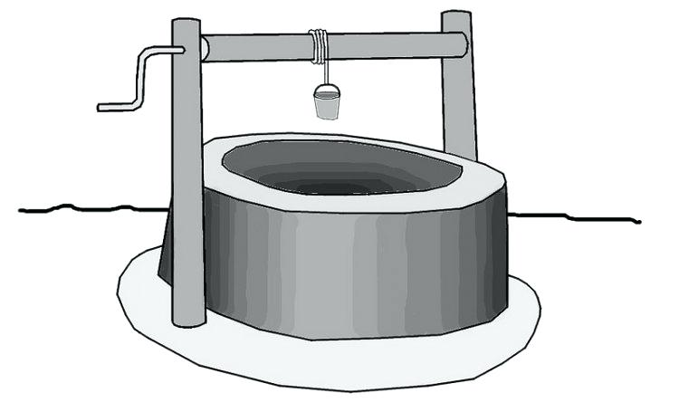
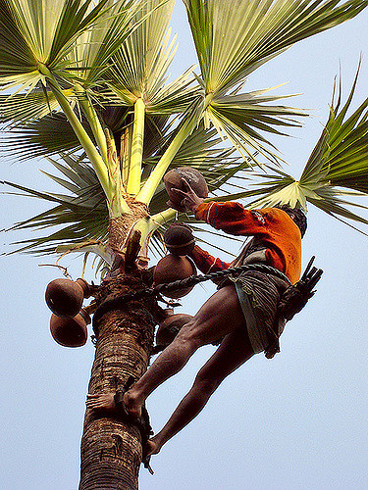
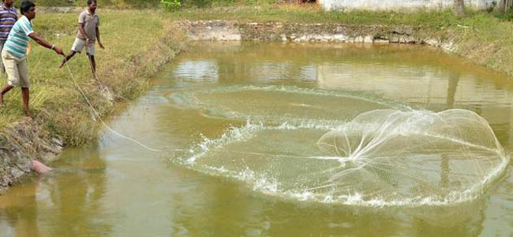
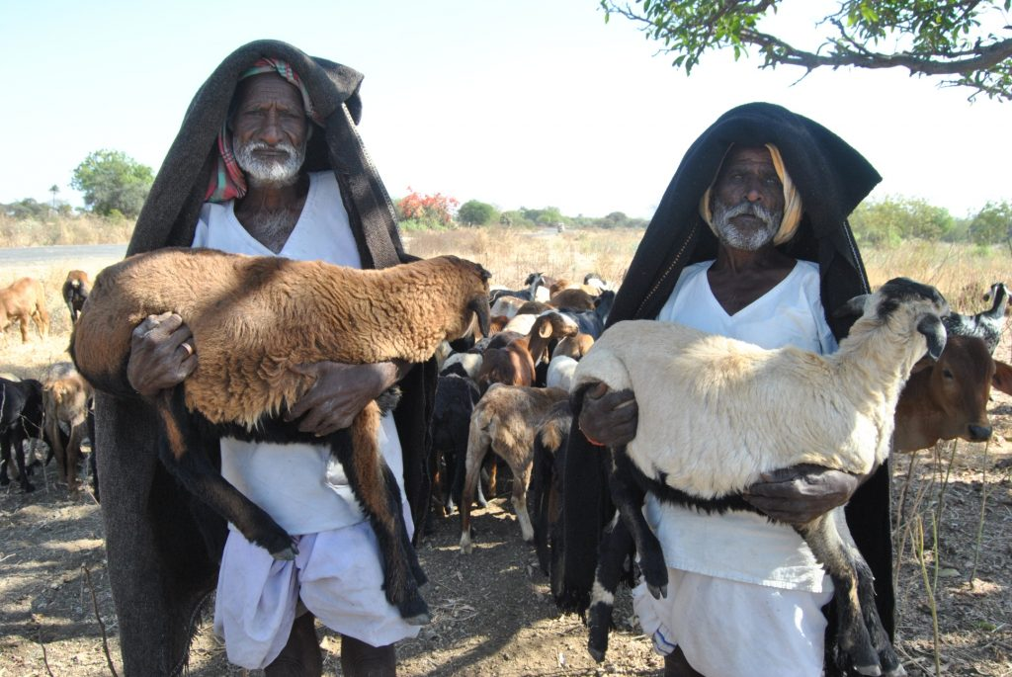
Findings
Impact on groundwater and livelihoods
Post-monsoon water level increase of 2.7 m
Pre-monsoon water level decline of 4.5 m
3-5 additional months of water availability in wells of farmers in the ayacut
Groundwater Levels
62% increase in fish production in tanks
        NABCONS (2017)
Toddy Tapping around tanks “Haritha Haram”
Distribution of fingerlings in rehabilitated tanks
Sheep and Goat distribution

Slide 17
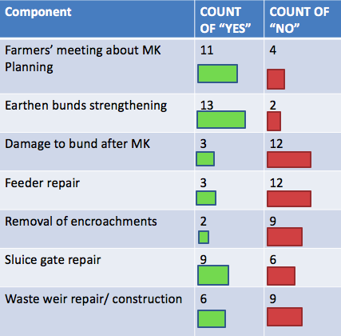
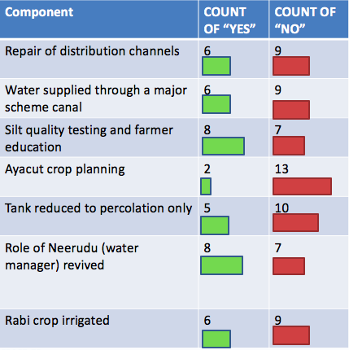
Checklist Answers in 15 tanks

Slide 18

Mukhyamantri Jal Swavlamban Abhiyan
Making every village water self-reliant in Rajasthan
5.2% OF TOTAL POPULATION
ONLY 1.6% OF WATER RESOURCES
10% OF INDIA’S AREA
227 OF 295 BLOCKS DECLARED AS DARK ZONE BY CGWB
ONLY ONE PERENNIAL RIVER - CHAMBAL
ILLEGAL WATER EXTRACTION RAMPANT
FAILURE OF PAST PROGRAMS WHICH WERE EITHER TOO TECHNICAL OR ONLY DEPENDENT ON COMMUNITY PAVED WAY FOR MJSA DESIGN

Slide 19
Objectives Of The Program
Self reliant villages
Groundwater level increase
Availability of drinking water
Increase in irrigated/ cultivated area
Change in cropping pattern
Water harvesting
Development of forest, land, water and fauna
To be achieved using Four-Water Approach (Ground, Surface, Soil moisture and Rainwater) by building low cost water harvesting structures through watershed approach.

Slide 20
Organogram
Rajasthan River Basin & WR Planning Authority
Chief Minister
Water Resource Department
Watershed Development & Soil Conservation
Rural Development & Panchayati Raj
Agriculture Dept.
Horticulture Mission
Forest Dept.
Groundwater Dept.
Public Health Dept.
Planning and Monitoring Committee at District Level
Directional Committee and Task Group at State Level
Minister-in-charge of the district
All MLAs
Zila Pramukh
District Collector
Senior most dept. officials of all line depts.
Technical Specifications
Block Level Committee headed by Sub-Divisional Officer
Village Level Action Committee

Slide 21
Financial Status
 | DPR | Financial Sanction | Works completed (cost) | Donations (CSR/Individual)
Phase – I | ₹1,714 crore | ₹1,710 crore | ₹1,602 crore | ₹38.6 crore
Phase – II | ₹1,746 crore | ₹1,611 crore | ₹1,556 crore | ₹22.8 crore
Phase – III | ₹1,999 crore | ₹1,292 crore | ₹6.84 crore | ₹6.3 crore
- 33% funds from Watershed Dept
- 24% from MNREGS
- Remaining from other departmental funds, crowdsourcing and CSR donations
3,529 villages covered
95,192 water conservation works completed
Avg cost per structure INR 1.7 lakh

Slide 22
Study Design And Methodology
Selection of districts
Two districts each selected from most drought-prone categories and one each from lesser drought prone category
 | Frequency of Drought (Once every xx years)
3 years | 4 years | 5 years | 6 years | 8 years
Barmer, Jaisalmer, Jalore, Jodhpur, Sirohi | Ajmer, Bikaner, Bundi, Dungarpur, Sri Ganganagar, Nagaur, Hanumangarh, Churu | Alwar, Banswara, Bhilwara, Jaipur, Jhunjhunu, Pali, Sawai Madhopur, Sikar, Dausa, Karauli | Chittorgarh, Jhalawar, Kota, Udaipur, Pratapgarh, Tonk, Rajsamand, Baran | Bharatpur and Dholpur
DISTRICT | SIROHI | AJMER | DUNGARPUR | PALI | TANK | JALOR | TOTAL
SAMPLE SIZE | 16 | 15 | 20 | 8 | 13 | 15 | 87
SAMPLING TECHNIQUE USED: STRATIFIED RANDOM SAMPLING
Village-level questionnaire used for data collection through FGDs

Slide 23
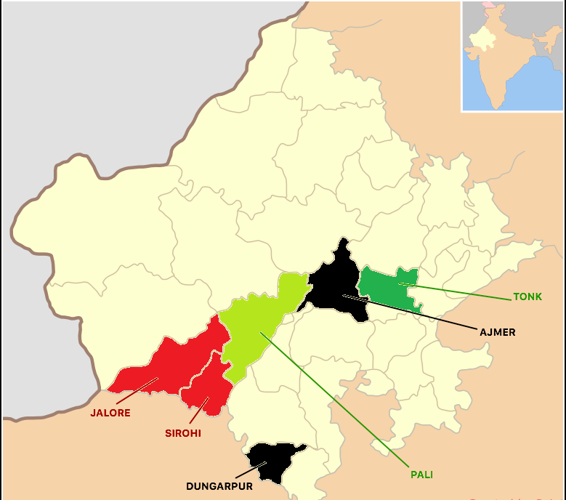
Study Area
Seasons/ Years selected for data collection
Pre-Intervention: 2015-16 [Kharif 2015, Rabi 15-16 and Summer 2016]
Intervention+1 year: 2016-17 [Kharif 2016, Rabi 16-17 and Summer 2017]
Intervention+2 years: 2017-18 [Kharif 2017, Rabi 17-18 and Summer 2018]

Slide 24
Observed Impacts
Groundwater
YEAR | RAINFALL (ON A SCALE OF 1-3)
2015 | AVERAGE/BAD (2.3)
2016 | AVERAGE (2)
2017 | GOOD/AVERAGE (1.6)
Net Increase in Post Monsoon Water Level: 11.6 ft (3.5 mt)
(not accounting for variation in rainfall)
All 6 districts reported an increase in groundwater levels.
Officially reported impact: Using piezometers installed across the state, it was recorded that out of 21 non-desert districts, 16 districts showed rise in groundwater levels with average rise being 4.66 ft.

Slide 25
Observed Impacts
Drinking Water
DECLINE IN DEMAND FOR TANKERS FOR DRINKING WATER
AVERAGE TANKERS/DAY PER VILLAGE
2015-16 | 2016-17 | 2017-18
65 | 64 | 64
ON AN AVERAGE (WEIGHTED) 20% OF SAMPLED VILLAGES REPORTED DECLINE IN DEMAND FOR TANKERS FOR DRINKING WATER
Official report suggested a reduction of 14.3% in Transportation of Water Supply (ToW) during summer 2017 against summer of 2016
We did not collect number of days of tanker supply required, which may have resulted in recall data being the maximum tankers in any day rather than an average value

Slide 26
Observed Impacts
Irrigated Area
Increase in Kharif area due to better rainfall
12% increase in Rabi area in 2017 and 18% increase in 2018, both with base year as 2016
Increase in rabi area due to increased water availability
Cropping intensity has increased from 1.54 to 1.65.
80% villages had no access to canal water.
Summer crops are grown in very few acres (negligible compared to total cultivated area)

Slide 27
Observed Impacts
Dairy Productivity
Analysis is inconclusive but qualitative insights collected revealed that villagers found it easier to rear cattle with enough surface water available now

Slide 28
Observed Impacts
On Improvement In Vegetation
An objective of the program is to improve vegetation by distribution of free saplings to increase green cover and further slow down the flow of water and is led by the forestry department. A total of 28 lakh trees were reported planted in Phase-1 of MJSA
State-Wide Average %
8%
61%
31%
A large proportion of villages reported improvement in vegetation with MJSA implementation
ALL villages where work on tanks was done reported positive vegetation increase

Slide 29
Observations and Policy Implications
 | Gujarat | Maharashtra | Telangana | Rajasthan
Inclusion of demand management | Conceptually yes, but in practice, limited to promotion of micro irrigation | Limited to awareness creation about water conservation | No focus on GW demand management | Limited to promotion of micro irrigation
Community Engagement and Participation | Community role envisaged in GW recharge | Communities manage silt lifting, transport and application | Communities manage silt lifting, transport and field application | Little community engagement and participation
Emphasis on training and CB of local institutions | Low | Medium | Low | Low – Medium
Focus on long-term sustainability | Low | Low | Low | Low
Key Strengths | Strong political commitment; Community participation; Integrated planning | Strong awareness and high CSR participation | Works implemented in mission mode on large scale | Strong convergence potential; low-cost small structures
Key Weaknesses | Recharge interventions planned based on water and storage availability, not based on need | Questionable whether the momentum will sustain beyond the life cycle of the project | Continuity of positive outcomes doubtful beyond life of the mission | Limited funding beyond usual departmental budgets

Slide 30
Questions and Feedback Please.

