Slide 1
Changing baskets of consumption
Rural Markets : Blossoming in Neglect
SAROJ KUMAR MOHANTA
ECOCIATE CONSULTANTS

Slide 2
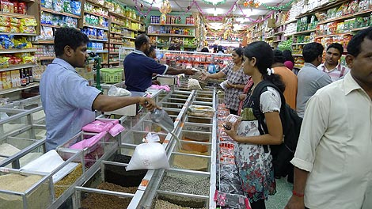
GROWING FMCG SEGMENT

Slide 3
Swachh Bharat : 12 Mn Toilets in rural India ; project cost $20Bn
Potential Business for Toilet Cleaner : Rs.700 Cr
Harpic growing at 11%
Toilet related Product / Services by 2021 : $ 62 Bn

Slide 4
PRODUCT IDEA

Slide 5
Exploring Toilets
Ethnography on use of Harpic & Benefits
Tier III Towns
SEC B & C Households

Slide 6
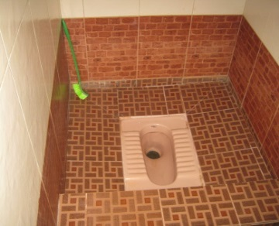
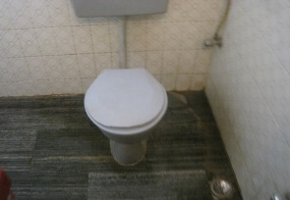
Construct quality toilets
Use Cleaning agents (Also Harpic)
Tiled Floor & Wall, Need to clean Toilet & Bathrooms

Slide 7
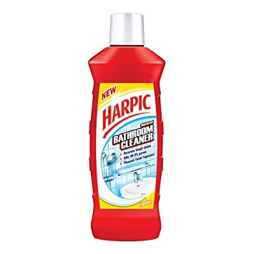
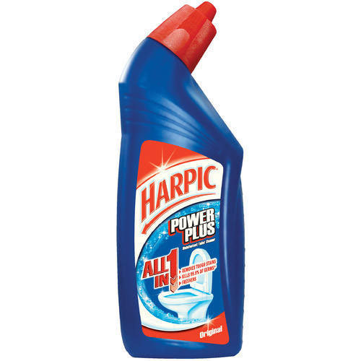
New Product Opportunity
Bathroom Cleaner

Slide 8
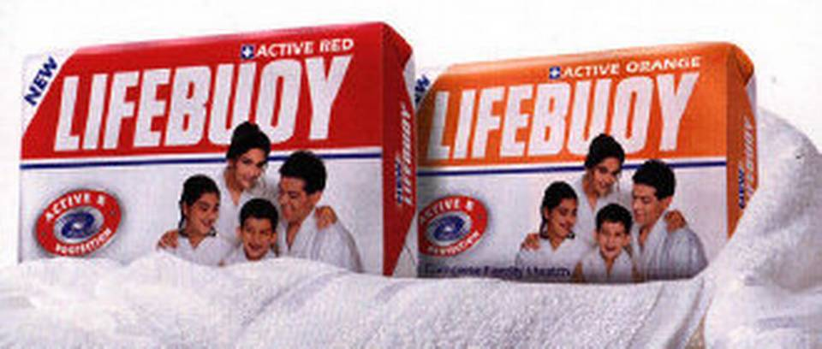

Slide 9
Market Discovery
Project Shakti Y 2000 -2001
Washing hand with soap was not a behaviour in Rural Households
No understanding of Germs or Bacteria
No association of ‘Unclean Hands’ with Diarrhoea or other Health Issues

Slide 10
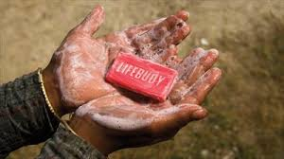
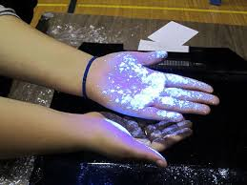
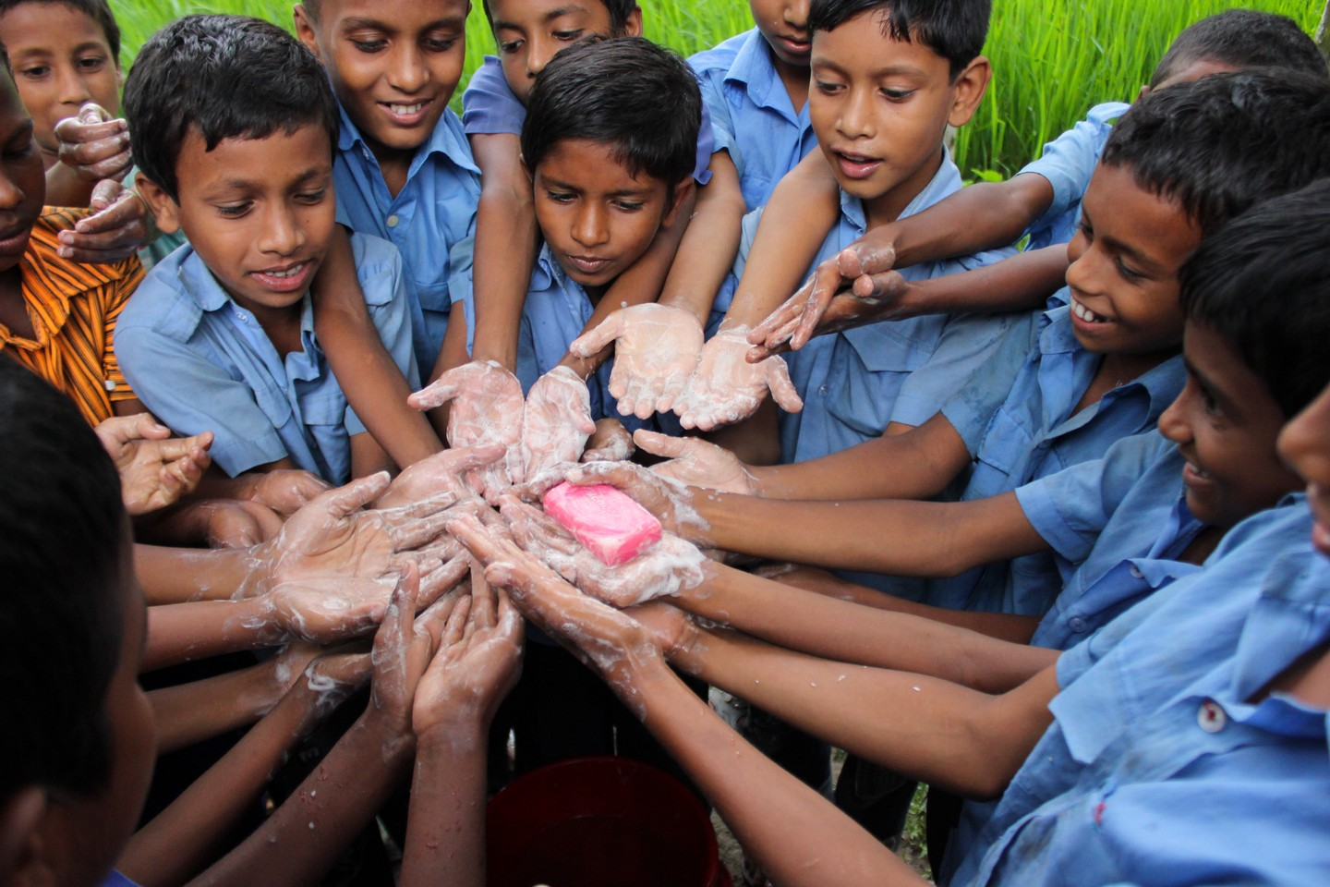
Campaign Reached
Households
School Children

Slide 11
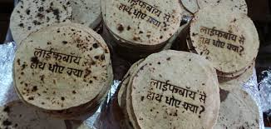
Campaigns Designed to
Trigger ‘Call to Action’
Recall of Message

Slide 12
Lifebuoy & Handwash
Dettol : School Program
Campaign Rural Reach 86 Mn in 48000 Villages by 2010 … Reach another 119 Mn by 2017
Announced Reach to Next 1 Bn Consumers in Asia, Africa, Latin America
Soap Category Rs10000 Cr
Lifebuoy Rs1200 Cr

Slide 13
Business Model Process
Market Discovery
Insights & Jobs to be Done
Pilot & Scale
Create Business Infra- structure

Slide 14
Thank You
Ecociate Consultants Pvt. Ltd.
B – 160, Sector 51, Noida – 201301
Uttar Pradesh, India
Tele: +91 120 4977964
Mob : +91 9313328231
Email – saroj@ecociate.com
www.ecociateconsultants.com

