Slide 1
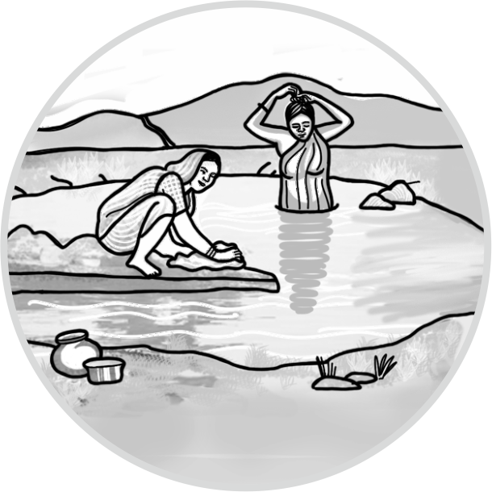
Social and Economic Impacts of water harvesting structures
28th August, 2018
Parallel Session 2, Hall No. 2
Session Chaired by Dr. Tushaar Shah,
Senior Fellow, IWMI
Session Moderated by Anirban Ghosh,
Executive Director, TRIF

Slide 2
About the study
Studies across seven different states
On socio-economic impact of small water harvesting structures
On impact of tank revival
Aspects looked at
Agriculture – cropping pattern, yield, income
Livestock and fisheries
Availability of water for domestic use
Groundwater recharge
Impact of these structures on women

Slide 3
Findings and inferences
Agriculture
Increase in irrigated area
Increased cropping intensity – ranging from 5% to125%
Increased crop yield – ranging from 21% to 92%
Crop diversity increased
Herfindahl Index of crop diversification increased
Vegetable growing farmers increased
Cultivation of horticulture crops started
Introduction of capital intensive commercial seed crop production
Increased risk governed by market price fluctuations
Increased income from agriculture

Slide 4
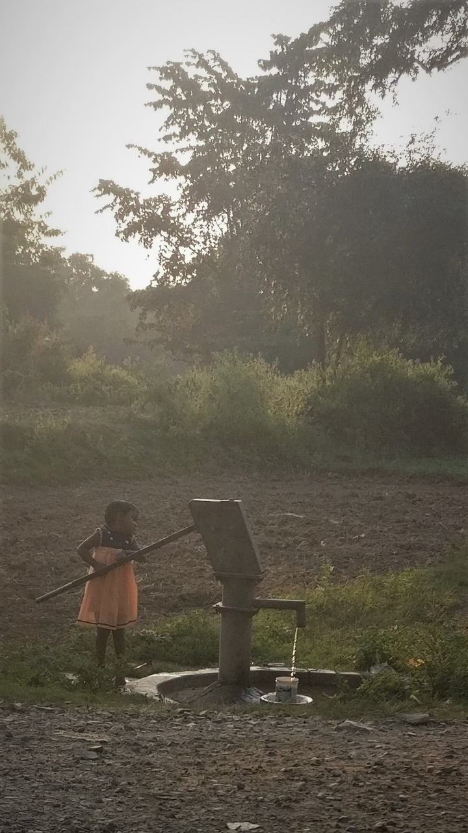
Findings and inferences
Livestock and Fisheries
Increased ownership
Increased fodder production
Livestock breed improvement
Cost-benefit analysis
Positive IRR ranging from 21% to 90%
Groundwater recharge
Reduced depth of tube-wells
Increased water level in wells
Reduced number of defunct tube-wells and handpumps
Notes:
Increased ownership- Bankura, Jalna, Gumla and Karnataka. No direct association can be made.
Increased fodder and increased fodder improvement- Karnataka and Jalna(Maize In karnatak and Sorghum in Jalna) Which helped
Cost benefit analysis- In three study, cost benefit analysis was studied. Costs- cost of intervention, the cost on irrigation and cost on agricultural inputs and benefits from agriculture, livestock and fisheries
Across four states, In tank revival study, we saw a clear positive impact on groundwater recharge.

Slide 5
Impact on Women
Reduced physical drudgery
Easy access to water for livestock
No impact on agency of women except at one study site
Low participation in decision making
Lack of control over the additional income
Increased physical drudgery with additional livelihoods
Silver lining in Jharkhand

Slide 6
Discussion
Surface area lost for utilization of water
Geographical suitability of a structure
Topographical location and rainfall affecting the capacity utilization
Opportunity cost of land
Structures on upland acting as percolation structures
Geohydrological consideration not taken care of
Low community participation
Lack of equity in benefit distribution
Silting

Slide 7
Thank You!

