Slide 1
Water Sector: Collaborating with the Government
Pooja Prasad
Centre for Technology Alternatives for Rural Areas (CTARA)
IIT Bombay, Mumbai
28th August 2018

Slide 2
Outline
Introduction to CTARA
Water sector: current situation
University as a knowledge partner
Examples from Rural water supply and Jalyukta Shivar Abhiyan
Conclusions

Slide 3
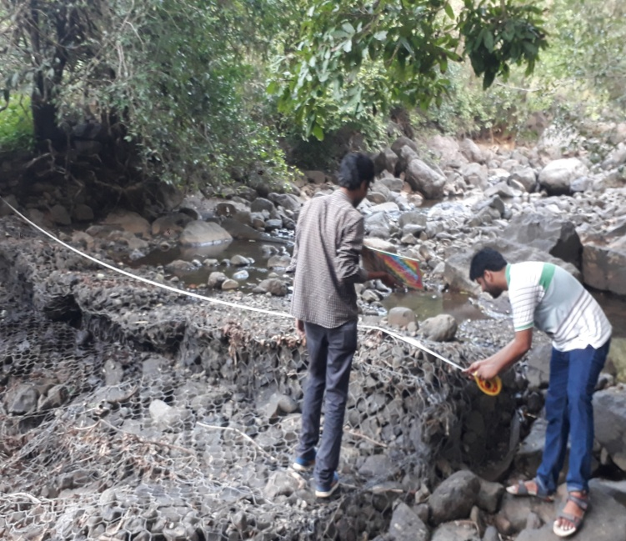
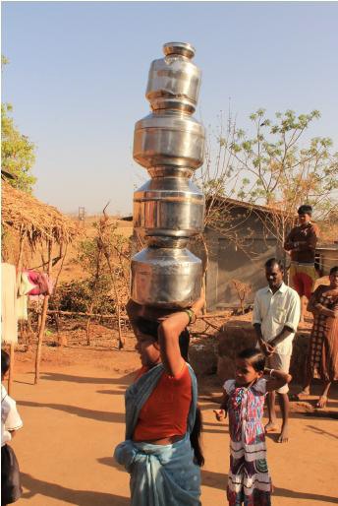
Centre for Technology Alternatives for Rural Areas (CTARA)
Academic centre of IIT Bombay
Technology and Development
Research areas:
Water, agriculture, livelihoods, energy, environment planning, development plans etc.
Core values:
Bottom 80%: households, habitations, GPs, villages, towns, cities
Core areas: soil, water, energy, health, livelihoods etc.
Concrete stakeholder and concrete deliverable: Government agencies, local colleges, elected representatives etc. As close to implementation as possible
Extensive field work

Slide 4
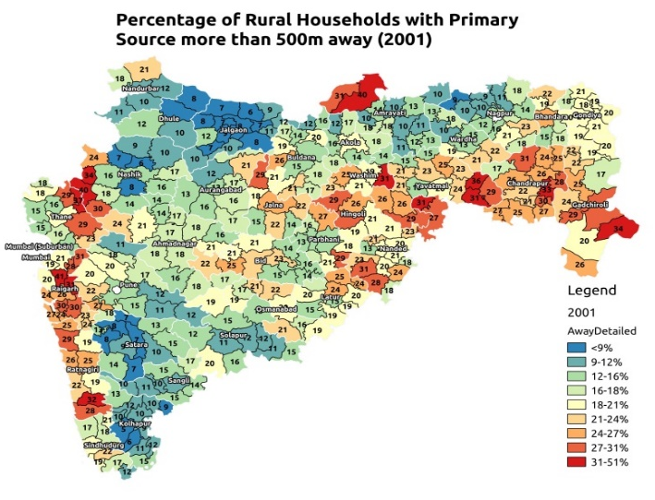
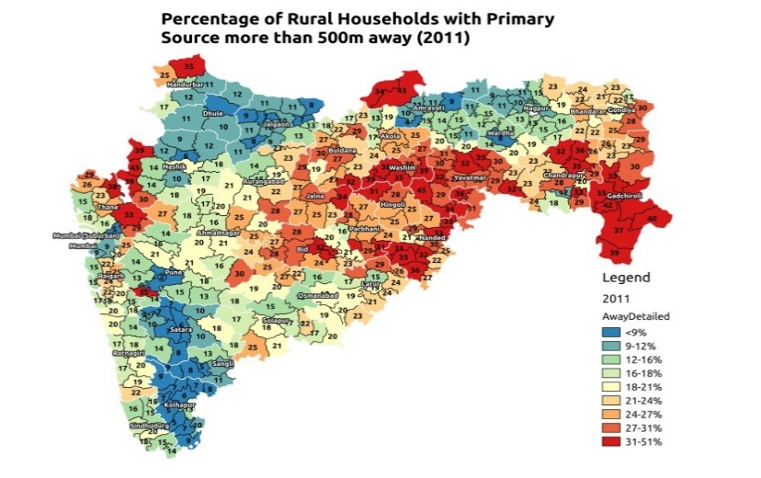
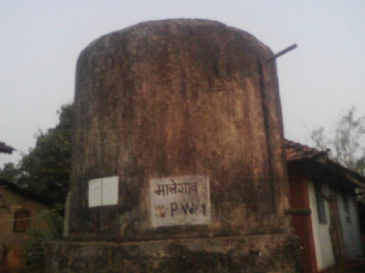
Emerging situation: drinking water
Worsening drinking water situation
High failure of drinking water schemes
Poor design & operation of piped water schemes
Ground water failure
Notes:
The collector wants to know- “what is the status of PWS schemes in my district?”
GP wants to know – “Is it feasible for our village be part of the regional PWS scheme”?
DW department asks– “how can we design schemes better?”

Slide 5
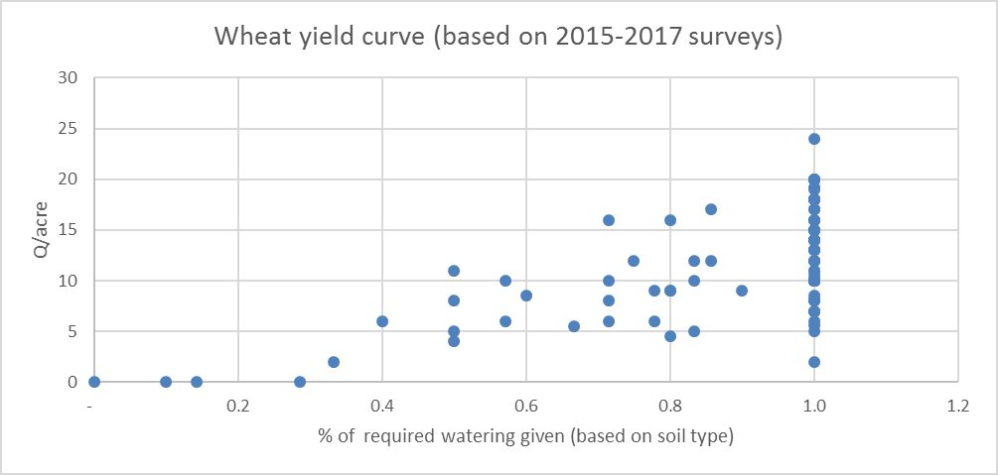
Emerging situation: agriculture
Large drought prone and rain-fed areas
Dry spells, large variation in yields
Need for protective irrigation
At the same time, rise in horticulture and need for assured water
Competing demands, dwindling/uncertain resource, lack of holistic plans

Slide 6
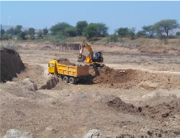
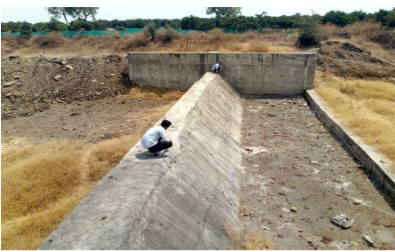
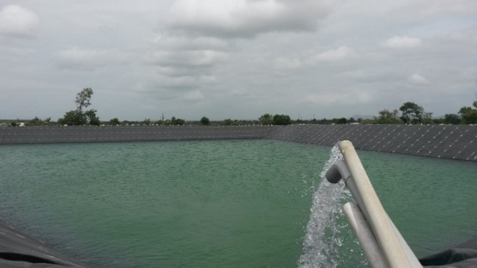
Analysis
State agencies face knowledge deficit and manpower shortage poor practices and poor output
Many government programs
Jalyukta Shivar, Galmukta dharan, Project on Climate Resilient Agriculture (PoCRA), PMKSY, Farmponds, NHM
But not clear if they are meeting their objectives Claims and counter-claims
Farmpond debate
PIL in high court on Jalyukta Shivar
Notes:
Are they meeting their objectives? What is the cost-benefit? How should the programs be assessed?
How can they be improved? How can they be better designed?

Slide 7
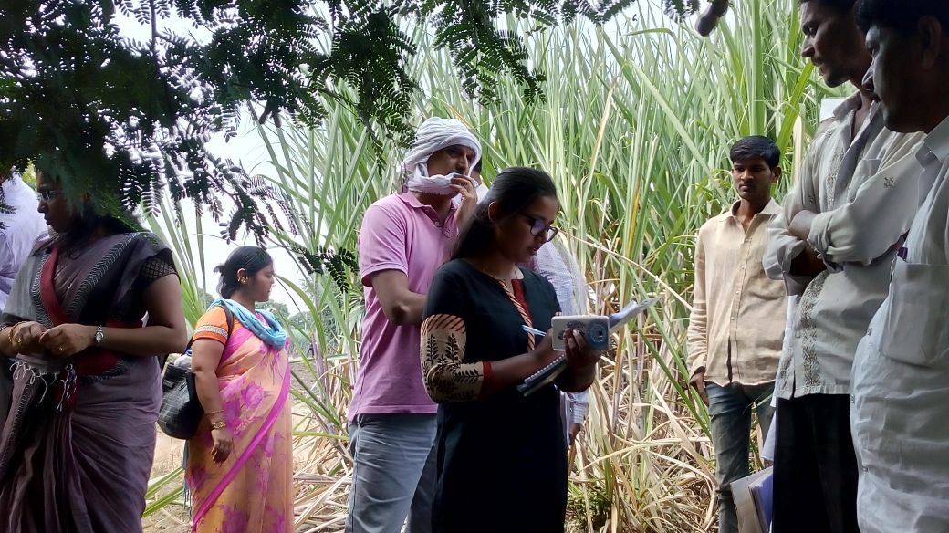
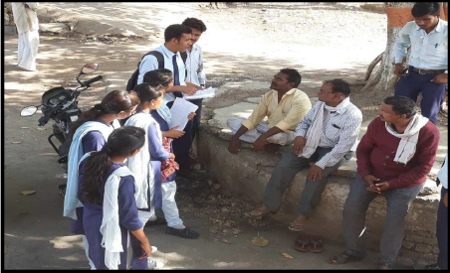
Knowledge institution: CTARA’s goals
To be a knowledge partner for the government and other development agencies
Develop case studies ; Templates for analysis, assessment protocols; Design and research
Work through a Memorandum of Understanding (MoU)
To create development professionals
Create a network of colleges who can execute assessment protocols and become regional knowledge partners development engineering course, field work
Notes:
To create a curriculum rooted in understanding and analyzing the lived realities of the bottom 80% development engineering course,

Slide 8
Mechanisms: T&D Solutions cell
Addresses development consultancy / solutions requirements of regional bodies like municipal corporations and GPs
Payment model!
Incubation of development professionals
Development of protocols, case studies and training modules for dissemination to regional colleges
Backed by CTARA faculty and researchers

Slide 9
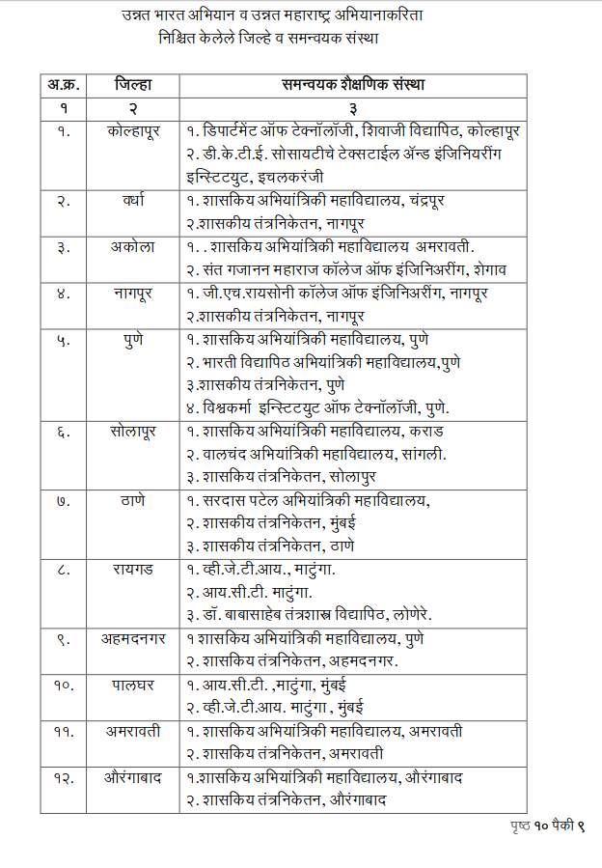
Mechanisms: Unnat Maharashtra Abhiyan
Project of the Ministry of Higher and Technical Education
Mandate to build an independent and public knowledge infrastructure for the state of Maharashtra focusing on development needs of the bottom 80%
Empaneled colleges
CTARA as nodal agency
Training and project support
Focus areas such as audit of govt schemes
http://www.ctara.iitb.ac.in/en/uma

Slide 10
Sample work

Slide 11
Training program and execution of Rural Water Supply (RWS) audit
Partners: Unicef, IRAP Hyderabad, TDSC CTARA
Preparation of training manuals on planning, design, O&M and evaluation of RWS schemes
Training of college teachers from 15 UMA colleges
Each college conducted assessment of two RWS schemes in their district; identified concrete interventions for improvement
All training material is open source
http://www.ctara.iitb.ac.in/en/uma_rws_audit_training
Maharashtra Chief Minister releasing the training compendium

Slide 12
Jalyukta Shivar Engagement
Flagship program of Govt of Maharashtra to make all villages in Maharashtra drought free
Soil and water conservation activities
5000 villages every year since 2015
Water budget: key planning tool
Initial planning based on surface runoff alone
Request from Secretary, Water conservation department to develop a revised holistic water budget
WB developed by CTARA being used for all 5000 villages in 2017-18
Large scale trainings in all divisions of the state: district collectors, soil and water conservation department officers, taluka level agricultural officers

Slide 13
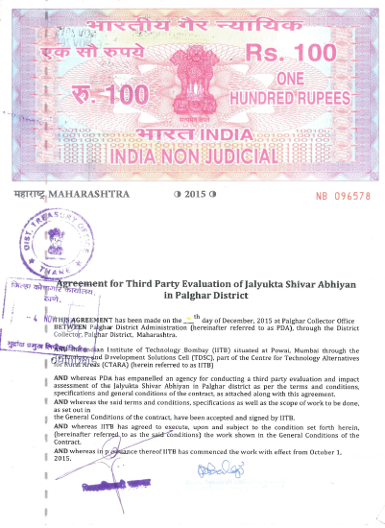
JYS Assessment: Palghar district
MoU between Palghar Collector and CTARA TDSC
Scope: Technical evaluation, social impact assessment, process improvement suggestions
All 50 JYS villages in 2015-16
Expected outcome
Success indicators and methodology of assessment
Data collection tool and GIS support
Technical evaluation of assets
Impact assessment report

Slide 14
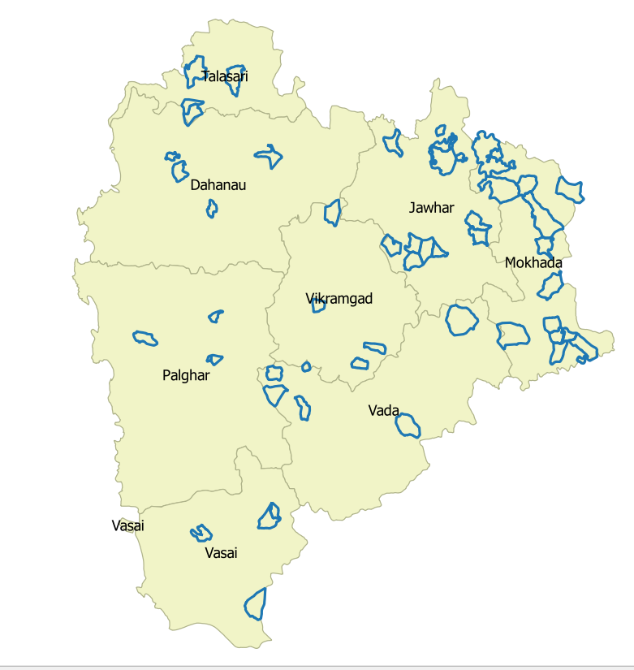
Villages of Jalyukta Shivar Abhiyan 2015-16
Taluka name | No. of villages | No. of works (Rs. In Lakhs)
Jawhar | 11 | 879 (865)
Mokhada | 14 | 596 (1812)
Vikramgad | 4 | 169 (378)
Wada | 5 | 240 (571)
Palghar | 4 | 117 (557)
Vasai | 4 | 64 (66)
Talasari | 4 | 60 (225)
Dahanu | 4 | 116 (520)
Total | 50 | 2241 (4994)

Slide 15
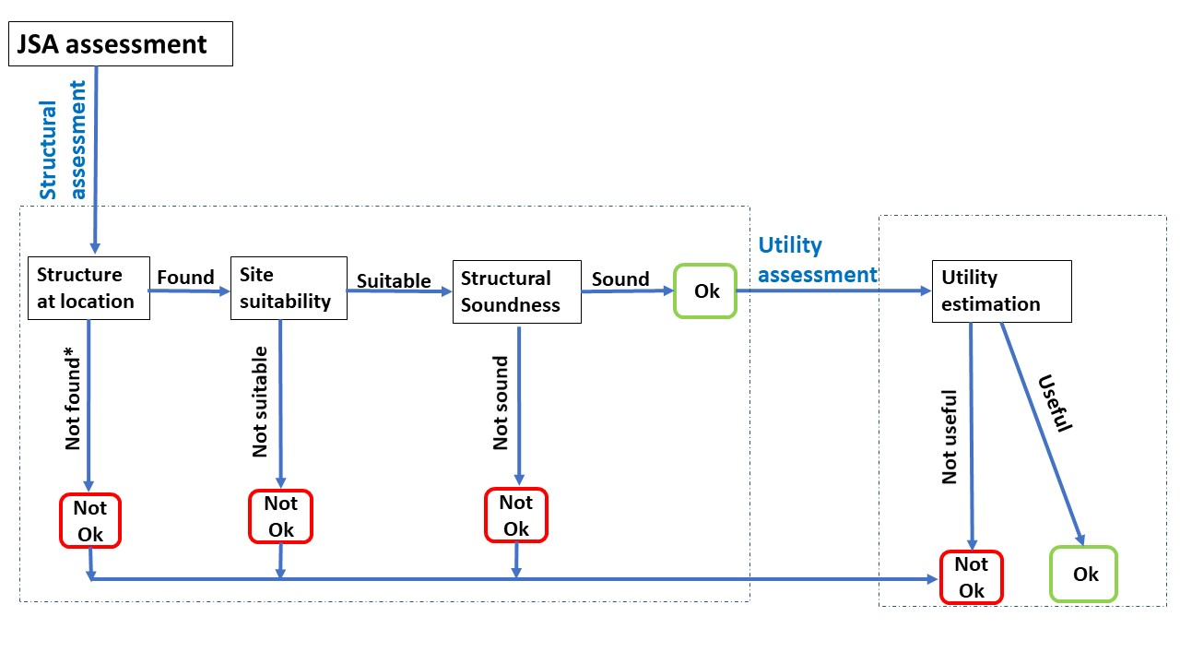
Methodology of assessment
Three day JYS assessment protocol
Rapid assessment protocol
Design of asset tests, survey formats, tools
* Assumed Not OK since structure could not be located by officer and TDSC engineer.
Formats are open-source: https://www.iitb.ac.in/ctara/en/tdsc_current-projects

Slide 16
Structural assessment for the district
Structural failure: Rs. 1127 Lakhs (23% of total expenditure)
Structural failure of CNBs and farm ponds: Rs. 668 lakhs (13% of total expenditure)
CNB issues: geographic locations, leakages, grade of concrete, absence of apron.
Farm pond issues: locations, broken berms and bunds, inadequate depths and compaction of embankment.
Notes:
376 out of 2271 structurally Not OK.

Slide 17
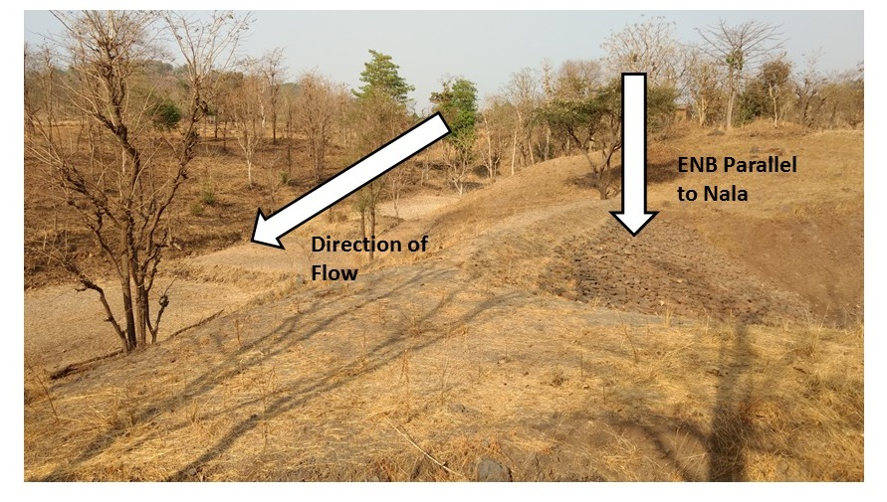
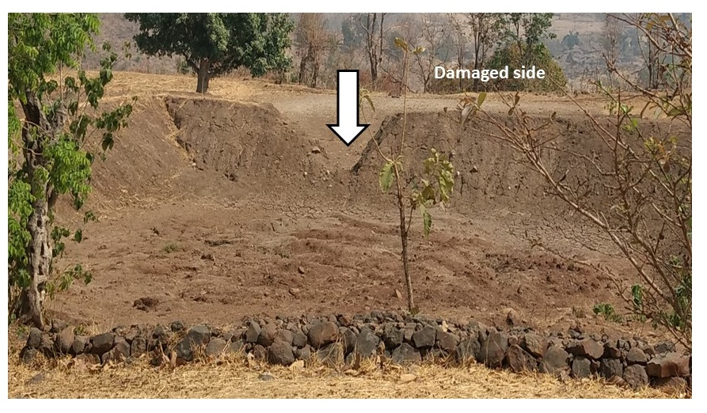
Some failed structures
ENB parallel to Nala
Damaged side
of farm pond

Slide 18
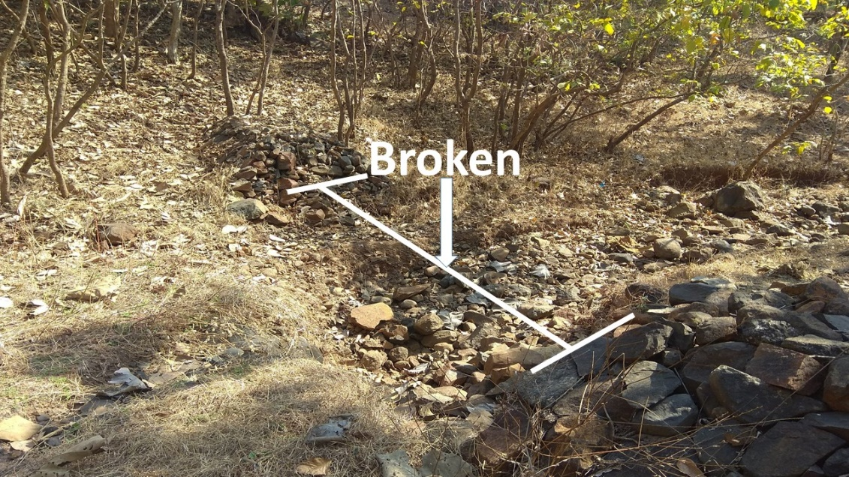
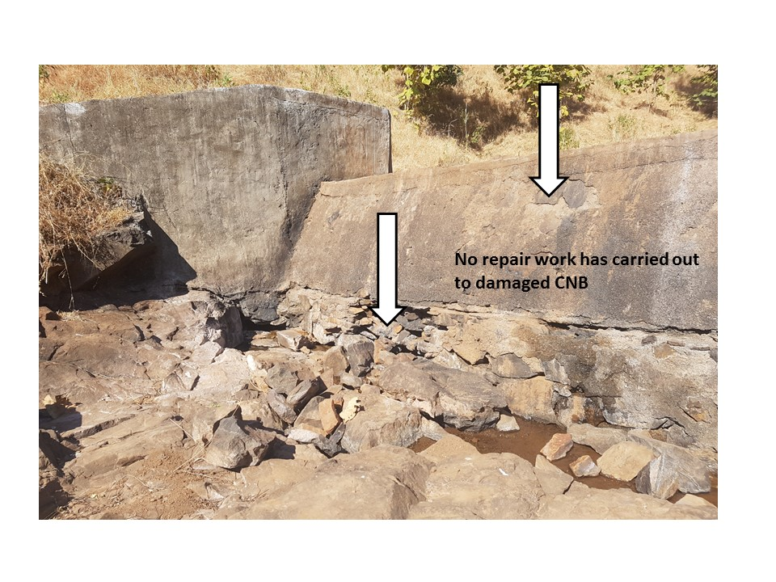
Some failed structures
Broken LBS
Damaged CNB

Slide 19
Utility assessment
Utility failure:
CNBs: Rs. 738.24 lakhs (40% of subset assessed)
Farm ponds: Rs. 181.38 lakhs (53% of subset assessed)

Slide 20
Important findings
Planning issues
Inaccurate estimation of drinking water requirement, crop water requirement
Incorrect estimation of runoff (20-40% compared to 75%)
Inappropriate structures: large scale failure of farm ponds
Missing public awareness
JYS plans not approved in many gram sabhas
Area treatment, sub-surface bunds found useful
Need for guidelines that address unique characteristics of Palghar district
Follow up
Taluka level training for all talukas in Palghar on preparation of water budget and village plan
Engagement with 12 colleges Maharashtra wide; training and coordination of JYS assessment in their region
Continued collaboration with GoM especially on water balance

Slide 21
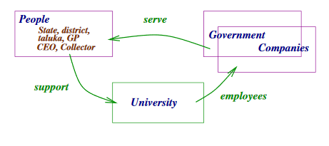
To conclude
Government departments value constructive engagement knowledge deficit, shortage of manpower
Need to prepare institutions to become regional knowledge resources
The old way

Slide 22
To conclude
Government departments value constructive engagement knowledge deficit, shortage of manpower
Need to prepare institutions to become regional knowledge resources
What we need…

Slide 23
To conclude
Government departments value constructive engagement knowledge deficit, shortage of manpower
To prepare institutions to become regional knowledge resources
What NGOs/CSOs can do
Utilize students and faculty as resource
Partner in field access, training and field research
Support development of regional case studies, regional research, support to institutions
Important partners in formalization of the development agenda

Slide 24
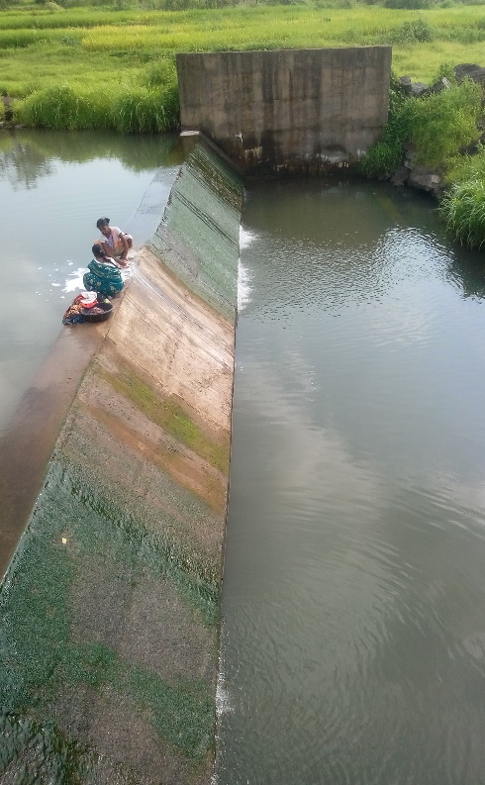
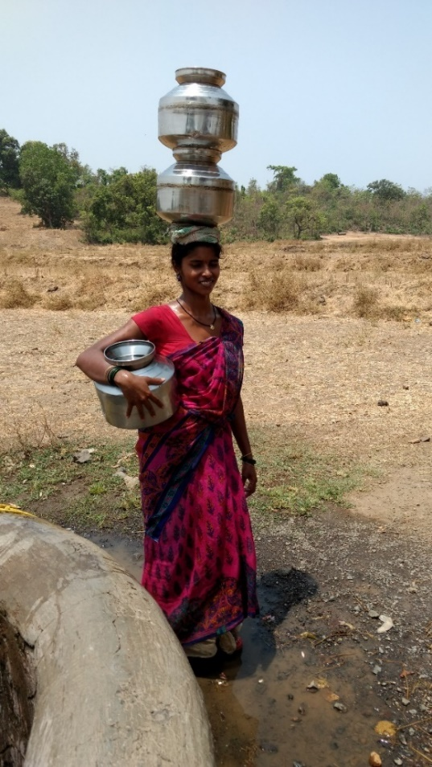
THANK YOU!

