Slide 1
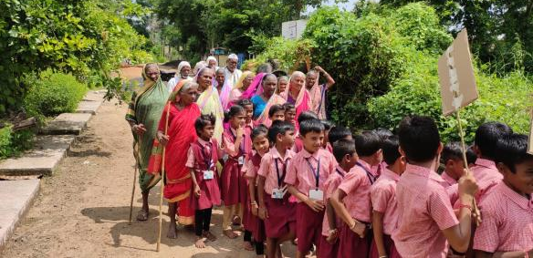

A Field Report on Comprehensive Elderly Care Program for Rural Population

Slide 2
Current Work
New opportunities
Keonjhar (Showcasing old age home with minimum standards) – Expected support from district funds
Sector Development
Response System for elderly (14567)
Digital Platform
Central and State Governments
Urban programme @ Bhubaneshwar
Maharashtra
Odisha
Rural Programme @ Chandrapur (Expanding to all 14 blocks of Chandrapur)
Rural Programme @ Nandurbar (through NSE Foundation)
Telangana
Possibility of setting up Activity centre in Mumbai through Rotary and BMC
Response System for elderly (Phase I)
Digital Platform Pilot
Rural Programme @ Medak
Urban Programme @ Hyderabad (through TASL & Exhibition Society)
Karnataka
Rural Programme @ Yadgir

Slide 3
Comprehensive Elderly Care Program
Objective :
Support state governments in implementing NPHCE by working with the public health system and the community, and thereby improve the health of the elderly
Support convergence of different departments / stakeholders for health and wellness of elderly persons
Improve the quality of life of elderly persons in the rural areas
Coverage :
One district, in 2 states of Chandrapur in Maharashtra and Medak in Telangana.
Yadgir block, Yadgir district of Karnataka

Slide 4
Comprehensive Elderly Care Program
Strengthening Health system
Capacity building of existing personnel and hiring new personnel
Dedicated services for the elderly through public health system
Screening for NCD’s and comprehensive geriatric assessment (CGA)
Regular supply of medication
Physiotherapy and counselling services
Social support
Focusing more on preventive and promotive health through:
  Village level activity centre
  Sensitisation and awareness building
  Creating group of volunteers in the villages
Connecting regularly with highly vulnerable elderly and bedridden elderly persons

Slide 5


Operationalization of NPHCE and its linkage with Social activities: Rural Pilot A Model
Training of Hospital Staff on various aspects of Elderly care
Linkage with Social-Component
CHC/RH/PHC
Health Component
Social activities Component
Elderly Clinics at the CHC/RH level
Multi-Activity Centre
(Village Based)
Treatment and follow-ups on Elderly clinic days at the PHC level.
Bi-weekly geriatric clinic with at CHC level
Walk in Center for the Community
Services Provided at the Support centers
Social involvement
Physical Activities and Exercises
Group Engagement activities
Intergenerational Bonding
Referrals to the Elderly Clinics
Awareness Campaigns on health issues, Elder Abuse, Welfare schemes etc.
Weekly geriatric clinic
Opportunistic NCD screening and Comprehensive Geriatric Assessment of the new elderly patients and treatment of common geriatric elements
Physiotherapy services
Counselling services
Follow up of cases
IEC activities for prevention of chronic diseases, falls, etc.
Operationalization of NPHCE
Elderly Clinics
(Once a week in the PHC)

Slide 6
Services provided July to Sept 19
SN | Activity | Chandrapur, Maharashtra (July 18-Sep 19) | Medak, Telangana (Aug 18-Sep 19) | Yadgir, Karnataka (Jun 19-Sep 19) | Total (N)
1 | Facilities conducting Geriatric clinics | 48 (72) | 20 (20) | 04 (20) | 72 (112)
2 | Number of geriatric clinics conducted | 507 | 981 | 51 | 1539
3 | Number of elderly Registered (New) | 13347 | 14751 | 1105 | 29203
4 | Total OP in GC (New+Old) | 25143 | 36880 | 1551 | 63574
5 | Activity center | 29 | 12 | 01 | 42
6 | Number of elderly registered in ACs | 586 | 247 | 28 | 861

Slide 7
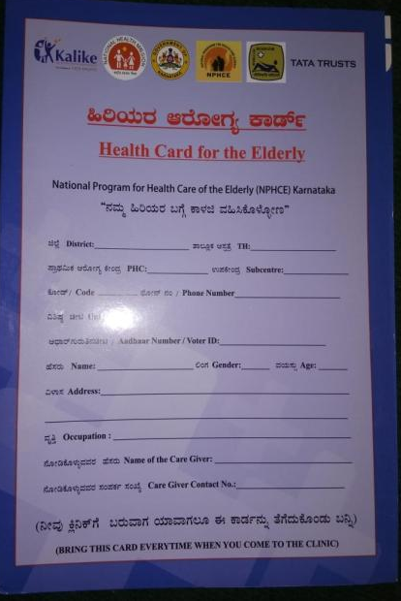
Health Card for the elderly
Demographic Details
Anthropometric Measurements
Medical History
Habits
Family History
Physical Check Up
  Hypertension, Diabetes (FBS, PPBS, RBS)
  Eye, Ear, Mouth
Health assessment
  Respiratory, Urinary systems and Functional assessments
Activities of Daily Living
Mental Health
  Mini-Cog Test, Geriatric Depression Scale (GDS-4)
Timed Up and Go Assessment (TUG TEST)
Other Investigations recommended
Medications
Subsequent Clinic Visit Record

Slide 8
Capacity Building
Orientation training of MOs, ANM, ASHAs and MLHPs
 | Chandrapur | Medak | Yadgir | Total
Medical Officers | 117 | 18 | 35 | 170
Staff Nurses / MLHP | 11 | 22 | 40 | 73
ANM | 698 | 35 | 49 | 782
ASHA | 297 | 58 | 60 | 415
Total | 1123 | 133 | 184 | 1442

Slide 9
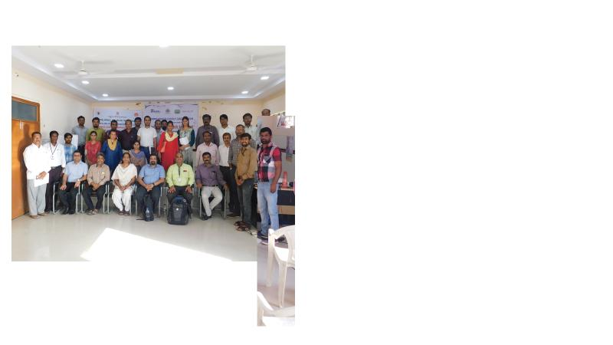
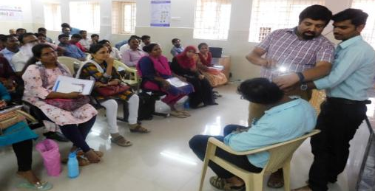
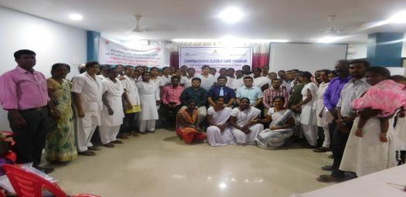
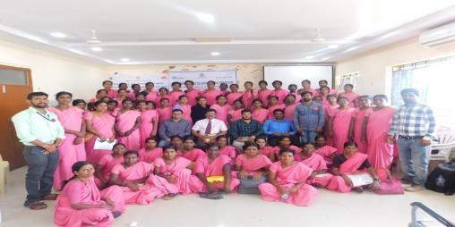
Capacity Building – Yadgir, karnataka
Medical Officers, MLHPs, ANM & ASHA training and exposure visit

Slide 10
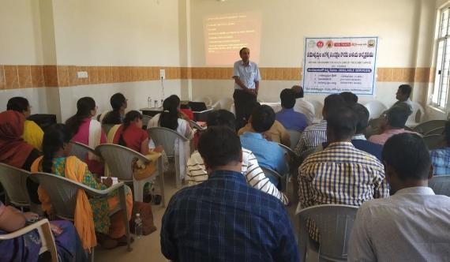
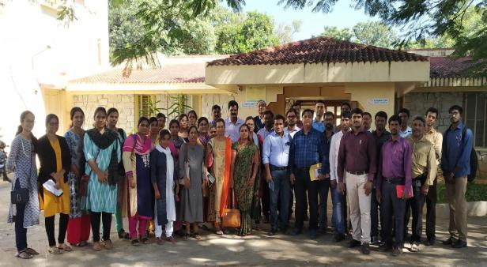
Capacity Building – Medak, Telangana
Medical Officers training and exposure visit

Slide 11
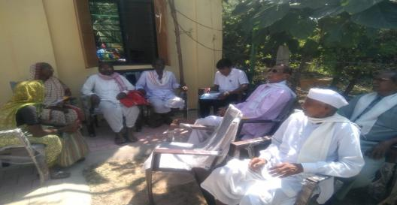
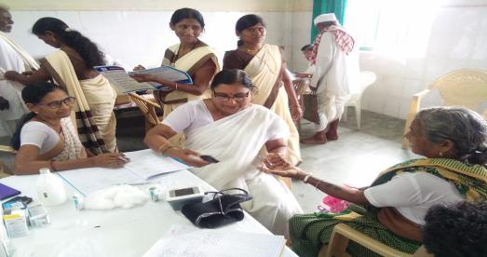
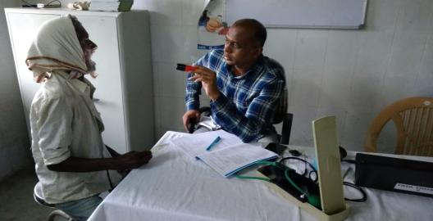
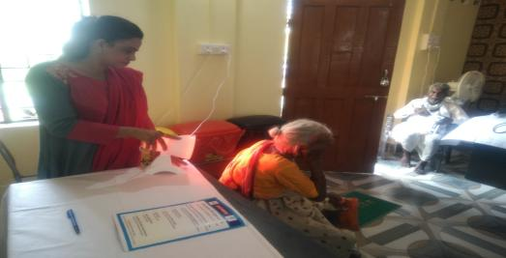
Geriatric clinics – Chandrapur, Maharashtra

Slide 12
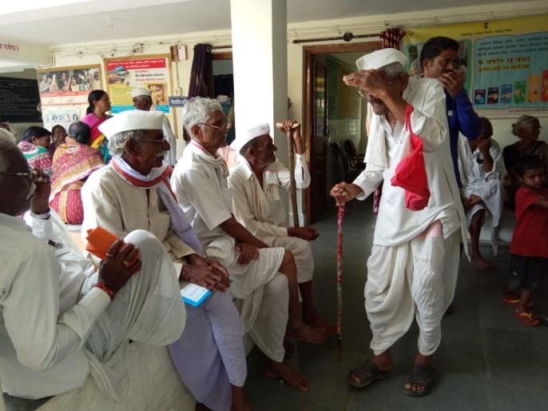
Geriatric clinics – Chandrapur, Maharashtra
Elderly waiting in Geriatric clinic

Slide 13
Trend in weekly clinics from five facilities of Chandrapur

Slide 14
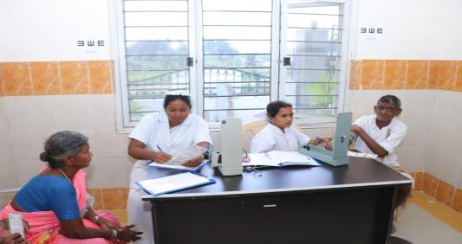
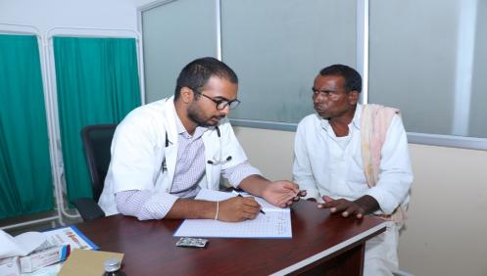
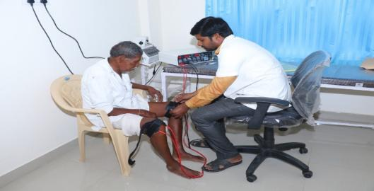
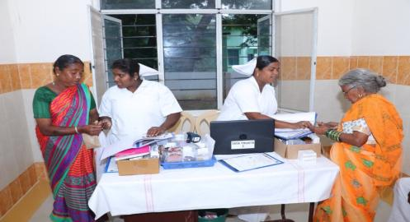
Geriatric clinics – Medak, Telangana

Slide 15
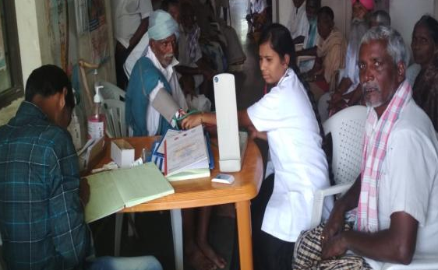
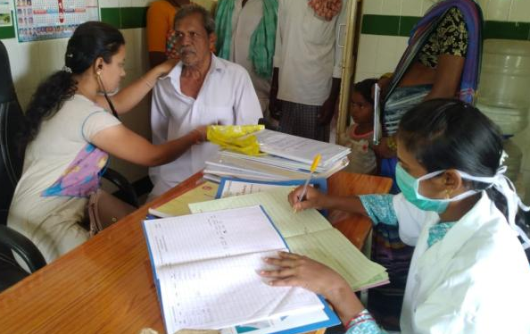
PHC level geriatric clinics at Medak

Slide 16
Medak daily Geriatric clinic – CHC Toopran

Slide 17
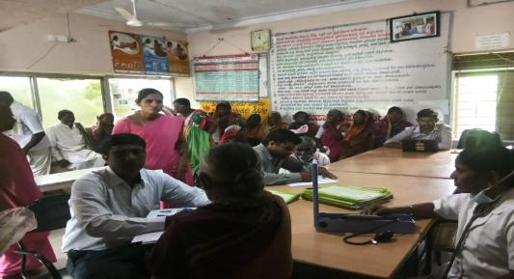
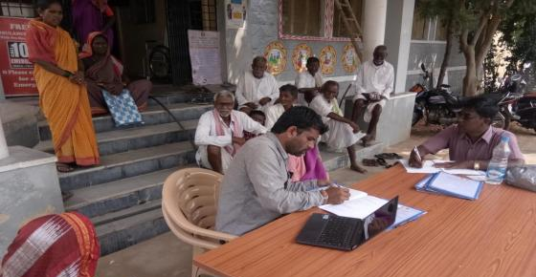
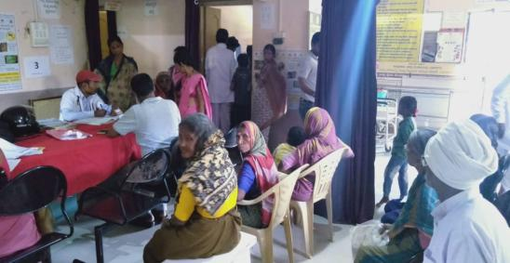
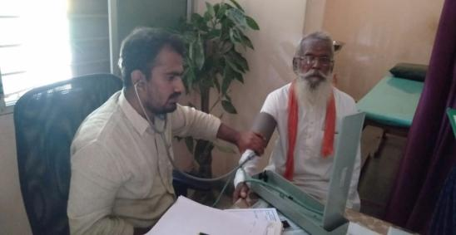
Geriatric clinics – Yadgir, Karnataka

Slide 18
Weekly geriatric clinics – four facilities in Yadgir

Slide 19
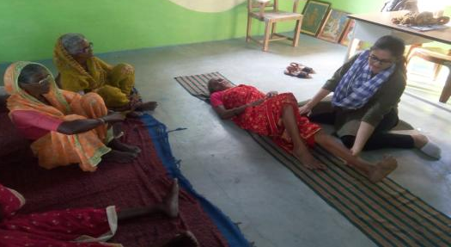
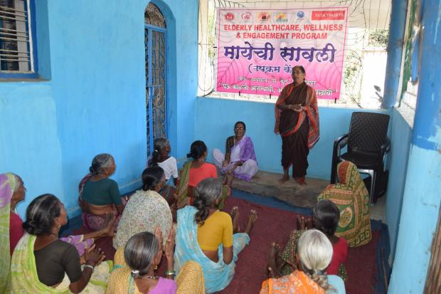
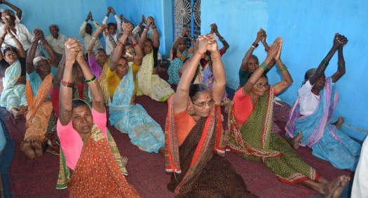
Activity centres @ Community level (1)

Slide 20
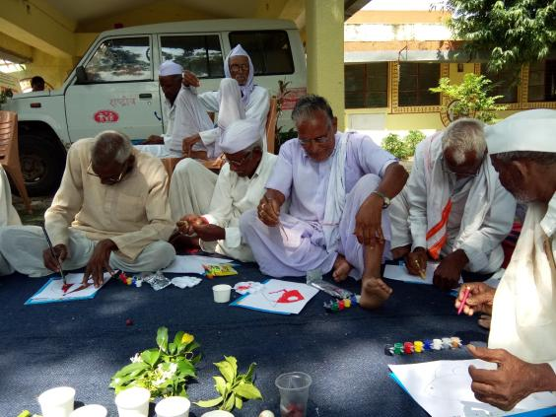
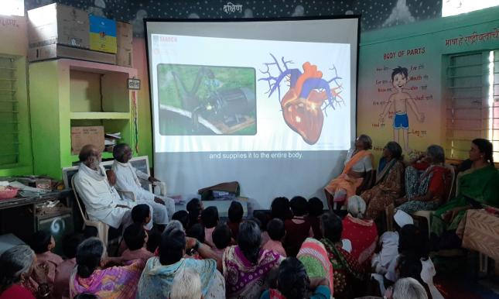
Activity centres @ Community level (2)

Slide 21
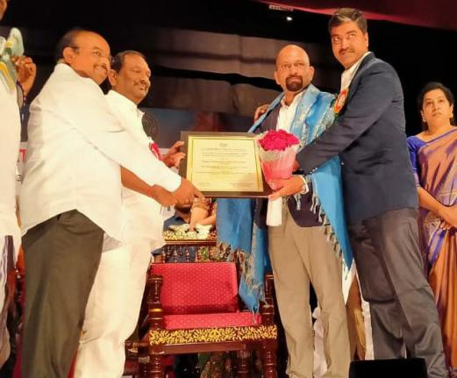
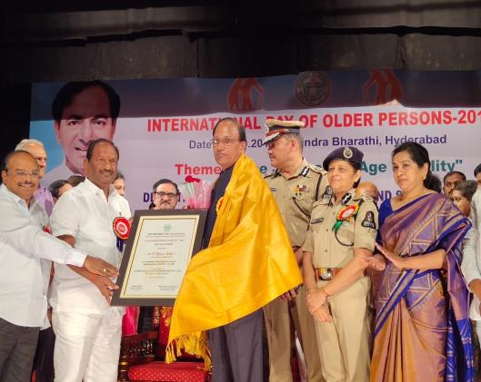
Recognition
“Vayoshreshtha Sanman – Tata Trusts”
Elder friendly district – Medak, Telangana

Slide 22
Thank you…

