Slide 1
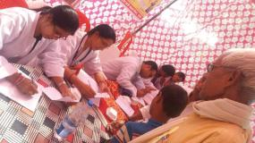
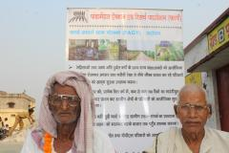
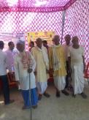
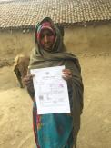
Healthcare access of Rural Elderly
A Case Study from Bhadohi (UP)

Slide 2
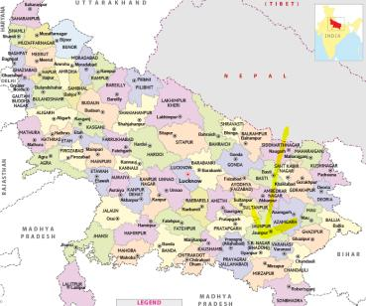
Socio Economic background
Uttar Pradesh
Bhadohi is smallest district by area in Uttar Pradesh
The district is situated in the plains of the Ganga river. Soil is fertile for agriculture purpose.
Agriculture is prime source of livelihood but most of the farmers are small farmers with land acres of less than 1 acre or negligible land
Bhadohi is also know for hand-knotted carpet and biggest carpet manufacturing centre in India.
Carpet industry in the Mirzapur-Bhadohi region engaging around 3.2 million people as their livelihood

Slide 3
Major elderly problems Across India
The elderly (population above 60 years) in India comprise 103.8 million or 8.6% of total population and 8% of them are confined to bed or home*
Size of elderly population from 5.6% in 1961 has increased to 8.6% in 2011. Out of these, 71% of elderly population resides in rural areas while 29% in urban areas
Very old people, due to their reduced mobility and debilitating disabilities, need other people to do things for them
Due to migration from rural to cities in search of job and increasing trend of nuclear family in the society, the care of older persons in the family gets increasingly difficult
Lack of literacy and complicated documentation are major hurdles for financial dependent rural elderly from accessing the government’s welfare schemes

Slide 4
Study objective
To know the awareness among the rural elderly about welfare scheme
To measure the access to healthcare among these elderly
To understand the perceptions of health care facilities among the elderly

Slide 5
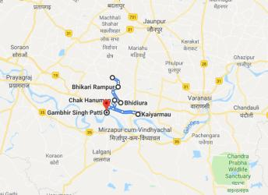
Methodology
This study was based on primary data collected from Bhadohi district (UP) with following participant details:
  6 Villages: Madepur & Gambhir Singh in Aurai block, Bhidiura & Raipur in Gyanpur block, Mahuapur and Bhikharirampur in Suriyawan block
  ~10 Elderly per Village
  Total 60 Elders (40 Male & 20 Female)
  Inclusion Criteria: Elderly (60+), Rural Village and BPL
Standard tools for data collection were used
  Survey contains questions of both quantitative & qualitative in nature
  Scoring Instruction from RAND 36-Item Health Survey were adopted (Link)

Slide 6
results
Major occupation: Labor/worker (61%); Agriculture (8%); Housewife ( 19%)
Marital Status: Married (85%); Widowed (12%); Unmarried (3%)
House: Kaccha (47%); Pakka(42%); Semi(10%)
Average Expense on health per month: 1000+ INR (overall);
  Highest monthly expenditure of 5000 INR by temporary ex Railway Mitra
  Except one pensioner none have Life Insurance
  No health insurance (neither private or Government’s Ayushman Yojana)

Slide 7
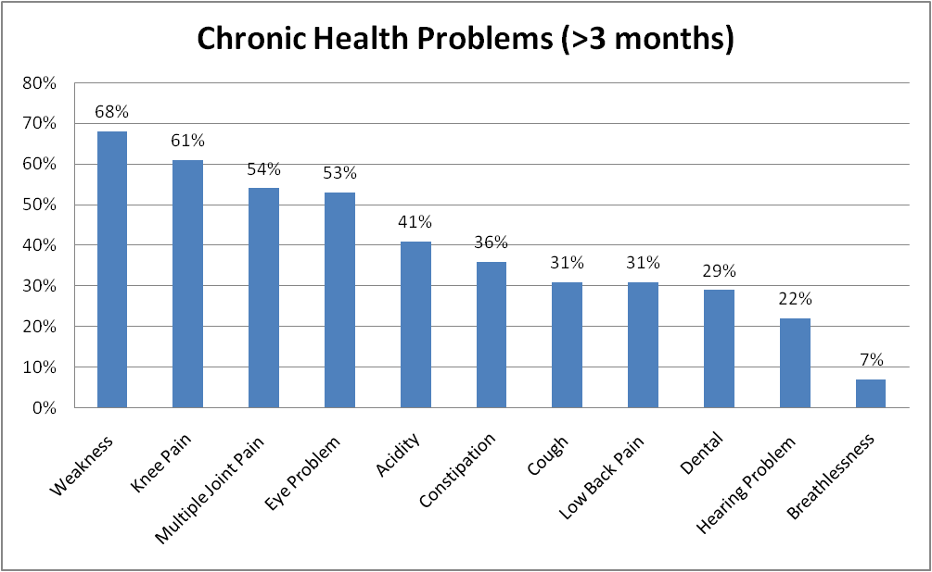
Chronic health problems

Slide 8
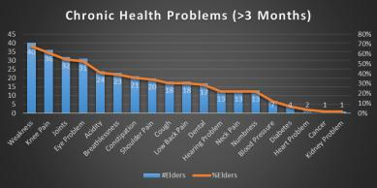
Results (Contd.)
Generally, all the elders have one or more chronic health problem but only 63% said that they are on regular medication.
56% elders are getting treatment in one of the hospital like district hospital, Community Health Centre (CHC) or Primary Health Centre.
44% elders are availing medical facility from any Private clinic in the village or private hospital in the nearest town.
Majority of the elders are cared by their family, but 17% elders have not any support from family
53% says that they have some saving or family members pays for their medication but around 47% elders or their family members are borrowing the money from others very often for medication expenses
There is lack of awareness about Government initiatives. E.g. 49% elders are not getting benefited by Old Age Pension, 47% are not aware to special clinic for elderly at PHC/CHC/District Hospital etc

Slide 9
Results (Contd.)
Quality of life were measure on 9 parameters
Energy/fatigue score was lowest to perform the daily routing works
General health is second lowest among all the parameters
Deteriorating health change is also major concern in the quality of life

Slide 10
Key Suggestions
Community Based Monitoring and Planning (CBMP) to be made & encouraged
Camps need to be organized to add all people who are still not covered under Ayushman Bharat Yojana
Most of the public welfare schemes are failed to reach the desired elders
More awareness campaigns need to be conducted on regular basis
Local common services centre needs to be incentivized to promote the Government welfare schemes in the villages

Slide 11
References
National Sample Survey Office, Ministry of Statistics and Programme Implementation, Report No. 507, Morbidity, Health Care and the Condition of the Aged, Jan-Jun 2004, Published 2006, New Delhi
Ware, J.E., Jr., & Sherbourne, C.D. “The MOS 36-Item Short-Form Health Survey (SF-36): I. Conceptual Framework and Item Selection,”. Medical Care, 30:473-483, 1992.
Hays, R.D., & Shapiro, M.F. “An Overview of Generic Health-Related Quality of Life Measures for HIV Research,” Quality of Life Research. 1:91-97, 1992.
https://mohfw.gov.in/sites/default/files/9147562941489753121.pdf
https://www.villagesquare.in/2019/06/28/up-youth-help-elderly-access-benefits/
https://www.villagesquare.in/2019/03/08/healthcare-of-elderly-suffer-with-youth-migration/

Slide 12
Welfare Schemes
National Health Policy 2017 announced and one of the main goal was the attainment well being for all at all ages
62.58% of our population has to pay for their own health and hospitalization expenses and are not covered through any form of health protection. Ayushman Bharat, a Pradhan Mantri Jan Arogya Yojana (PM-JAY) is launched on September 2018 with aim of universal access to good quality health care services without any financial hardship
The Indira Gandhi National Old Age Pension Scheme (IGNOAPS)
The Pradhan Mantri Vaya Vandana Yojana
National Programme for the Health Care of Elderly (NPHCE)
Rashtriya Vayoshri Yojana (RVY)
Integrated Programme for Older Persons (IPOP)

Slide 13

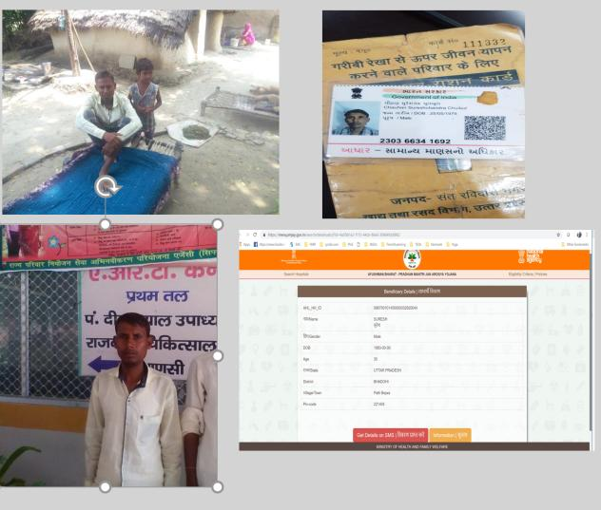
FARF’s Health Services-Case Study1
In September 2018, FARF came to know that one person called Mr. Suresh Chowhan (village – Patti Bejavn, Bhadohi, UP) has no money for his kidney dialysis from last 3-4 months and school fee for his two small children
FARF enquired at Bhadohi Govt Hospital but there was no facility available there for Kidney dialysis
FARF took Suresh to Varansi’s Din Dayal Govt hospital and not only admitted but provided three unit blood too at hospital.
There was waiting time for dialysis & Fistula installation service also not available
FARF wrote emails to Health Minister J P Nadda & Anupriya Patel but no reply
In last, FARF checked online for Aayushman Gold card and found that Suresh is eligible
Unfortunately, the day health card was getting ready, Suresh left us and died without proper treatment

Slide 14
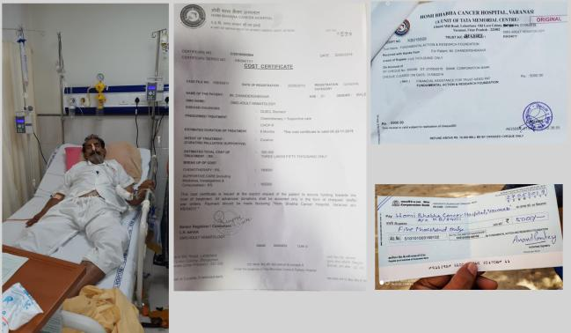
FARF’s Health Services-Case Study2
In May 2019, a person called Satya Narayan Upadhyay (Village – Sanathpur, District – Bhadohi (UP)) is diagnosed with Cancel and admitted in Homi Bhabhi Cancer Hospital, Varanasi.
The person was employed as Home Guard (on adhoc basis) and he was not covered under any health insurance including Ayushman Bharat Yojana.
There was extreme financial crunch to meet medical expenses and only option left was to go for crowd funding.
Treatment is still going on.

Slide 15

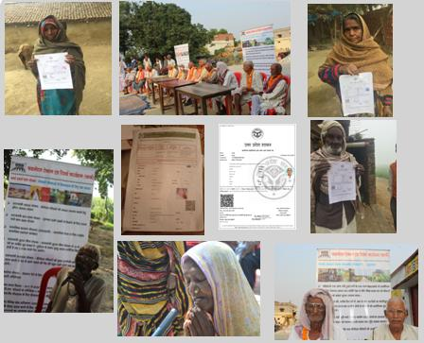
Digital Services: Helping in Social Welfare Schemes
Using own Common Service Centre, Sahaj eDistrict, FARF has prepared Income certificates, Domicile Certificates of more than 35 people so that Old age pension, Widow pensions etc can be applied for Poor people
We also helped in making affidavits and submitting the forms at Social welfare department
There is no charge for the services and expenses are self-funded by FARF

