Slide 1
Engagement and Wellness: Creating future possibilities for social inclusion and happy ageing
Dr Sharvari Shukla
Director and Professor
Symbiosis Statistical Institute, Pune
And
Biranchi Jena, Seema Gupta, Sugandhi Baliga

Slide 2
Background
United Nations (2007) aptly described the aging process as unprecedented in human history, a global phenomenon, affecting every man, woman and child
In Asia, ageing is an emerging issue as more and more countries are experiencing sharper fertility decline and increase in life expectancy
Getting reflected with a shift in age structure from young to old
At present 8.6% of India’s population comprises of the elderly
Odisha is no exception to the demographic transition of population ageing
The state of Odisha is in 9th position with respect to the senior citizen population
In Odisha, the elderly constitutes 9.5% of the state population

Slide 3
Background
The rapid increasing figures, drastic changes in the family structure, living and lifestyles, longevity of life, the need to live independently and with dignity; and issues concerning elders in general such as personal security, financial security, respect and role in family and society, etc.,
All these have impacted not only the elderly but also the families, community and the government greatly.

Slide 4
Rural India and Social inclusion
Social exclusion is seen as a process rather than a static condition
Social exclusion is as much a problem for rural communities as it is for urban areas (whose problems receive more attention), affecting substantial minorities in both
Differences between processes of exclusion in rural and urban contexts arise from a variety of historical and contextual factors.

Slide 5
Domains of social inclusion
Civic activities
voluntary work, meetings etc
Material resources
Income discomfort, prevent from doing things etc
Neighborhood
20 min walk, visits etc
Social relation
Living with anyone etc
Services
Access to facilities, medical care etc
Inclusion in
Social engagement is quite an essential ingredient for the physical, mental and psychological wellbeing of any individual.
Bringing in main stream

Slide 6
Objectives
To understand the current situation of elderly in Bhubaneshwar
To understand the current activities the elderly engaged with and identify the unmet needs of elderly in terms of regular activities so to make elderly feel they are valuable and assets to society
To assess the willingness of elderly in work engagement and provide opportunities to use their skills and experience with forum and exchange of information.

Slide 7
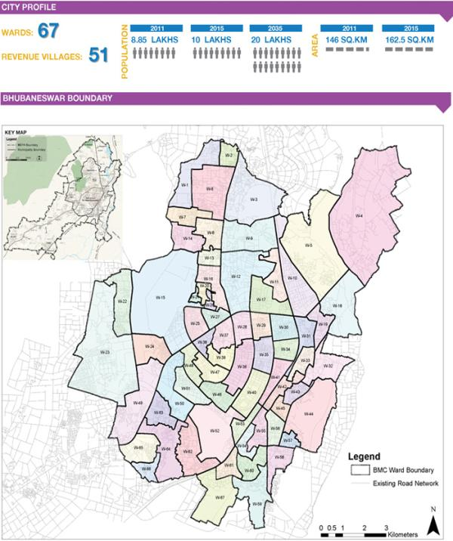
Study design and settings
The study was a cross-sectional survey, carried out during April-July 2018 in Bhubneshwar
A two-stage systematic random sample design was adopted to draw a sample from each cluster
This study collected data on the elderly personal information, work engagement, preference for various activities at activity center and, elderly health and wellness
Total 1117 elderly persons were interviewed.

Slide 8
Demographic Characteristics (n=1117)
Upto 8th Std=35%, 8-11th std=22%

Slide 9
Living arrangements
 | Male | Female | Total
Alone | 9 (1.5) | 20 (3.8) | 29 (2.6)
Only with spouse | 88 (14.9) | 38 (7.2) | 26 (11.3)
With spouse, children & grandchildren | 240 (40.7) | 147 (27.8) | 387 (34.6)
With spouse and children | 151 (25.6) | 48 (9.1) | 199 (17.8)
With children and grandchildren | 62 (10.5) | 212 (40.2) | 274 (24.5)
With spouse and grandchildren | 10 (1.7) | 6 (1.1) | 16 (1.4)
Only with children | 27 (4.6) | 51 (9.7) | 78 (7.0)
Alone with other relatives | 2 (0.3) | 6 (1.1) | 8 (0.7)
About 14% elderly are either living alone or only with spouse and 25% are living with children and grandchildren without spouse

Slide 10
Work and activity
Which main specific skill you accrued during your employment? | Male | Female | Total
Nothing | 235 (42.8) | 463 (89.7) | 698(65.5)
Legislators, Senior officials and Managers | 112 (20.4) | 8 (1.6) | 120 (11.3)
Professionals | 46 (8.4) | 5 (1.0) | 51 (4.8)
Technicians, associate professionals | 28 (5.1) | 2 (0.4) | 30 (2.8)
Clerks | 19 (3.5) | 2 (0.4) | 21 (2)
Service workers and Shop & Market Sales workers | 34 (6.2) | 5 (1.0) | 39 (3.7)
Skilled agricultural and fishery workers | 10 (1.8) | 3 (6.0) | 13 (1.2)
Plant and machine operators and assemblers | 7 (1.3) | 0 (0.0) | 7 (7.0)
Elementary occupations | 14 (2.6) | 3 (0.6) | 17 (1.6)
Workers not classified by occupations | 44 (8.0) | 25 (4.8) | 69 (6.5)

Slide 11
Work engagement
Given an opportunity would you like to work? | Male | Female | Total | P-value
Yes | 238 (40.4) | 129 (24.4) | 367 (32.9) | 0.0001
No | 351 (59.6) | 399 (15.6) | 750 (67.1)
Do you expect any compensation for above-mentioned activity?
Yes | 174 (73.1) | 91 (70.5) | 265 (72.2) | 0.6
No | 64 (26.9) | 38 (29.5) | 102 (27.8)
Monthly income expectation (Rs)
Up to 2000 Rs | 26 (15.0) | 15(16.5) | 41 (15.5) | 0.003
2000-5000 Rs | 72 (41.6) | 54 (59.3) | 126 (47.7)
5000-10000 Rs | 55 (31.8) | 21 (23.1) | 76 (28.8)
>10000 Rs | 20 (11.6) | 1 (1.1) | 21 (8.0)
Time: 4h per day or 3 days per week
Even though, half of the respondents prompted that old age discouraged them from taking up any of the activities or interests, given an opportunity, one third of the respondents were still interested to work. This was more evident with the younger old age groups (around 40 percent among 60-69 years) of the elderly and among men (40 percent).

Slide 12
Activity center: Activities of Interest
Spiritual, Yoga, packaging, help health camps, health talks and welfare activities, working in school and hospital

Slide 13
Activity center: Membership, distance, time
47% elderly would like to retrain them for some skill based training for performing activities
70% elderly would like to take membership in an activity center specially designed for elderly
On average they would like to pay 200 INR for membership
Almost half (48%) of the elderly preferred to commute only <1km distance to avail activities
And they will either prefer morning (39%) or evening (36%) time to spend at activity center.

Slide 14
Determinants of elderly activity engagement and willingness for skill retraining
 | Willing for work engagement
 | ß (95%CI) | p
Age: >70 | 1
<=70 | 1.44 (1.134-1.853) | 0.003
Literate | 2.726 (2.090-3.556) | 0.0001
Gender: Female | 1
Male | 1.833 (1.445-2.326) | 0.0001
Marital Status
Widow-Widower-Divorced-Separated | 1
Currently married | 1.907(1.483-2.452) | 0.0001
Income<=5000 | 1
Income>5000 | 1.968(1.531-2.529) | 0.0001
No income | 1.017(0.788-1.311) | 0.900
Currently working | 1
Currently not working | 1.268(0.940-1.710) | 0.120
Living alone/only with spouse | 1
Living with family | 1.037(0.738-1.456) | 0.835
Financial dependency
Not dependent | 1
Partially/fully depend on family | 2.200(1.688-2.867) | 0.0001

Slide 15
Summary
Male elderly (β=1.833, CI=1.445-2.326), who are currently married (β=1.907, CI=1.483-2.452) and literate (β=2.726, CI=2.090-3.556) with age less than 70 years (β=1.44, CI=1.134-1.853) are more willing to participate in work engagement
Also elderly who are partially or fully dependent on their family (β=2.200, CI=1.688-2.867) and who prefer to go out (β=1.565, CI=1.235-1.984) and don’t feel that their situation in household is redundant (β=3.406, CI=2.174-5.334) are about three times more willing to participate in work engagement compared to their counterparts
This is independent of their current working status and living arrangements

Slide 16
Suggestions
Attributes of aware of activity are: Male, Educated, Not economically dependent, pensioners
May be approached for activity center
Considering 48% of the elderly do not prefer to commute more than 1km
So setting up of decentralized activity centers around the city, based on the density of the elderly situated at
70% elderly would like to take membership in an activity center
About 31% of the elderly are willing to pay upto Rs.100-200 as membership fee.

Slide 17
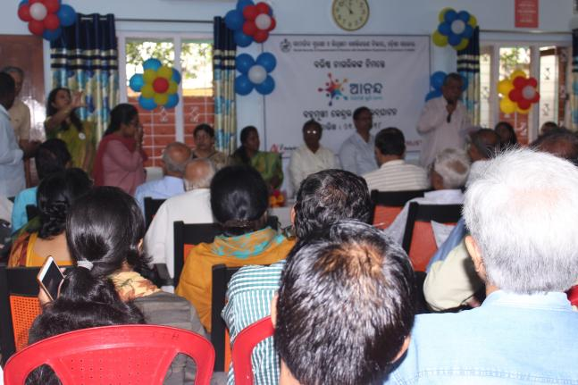
Translational Research to Intervention

Slide 18
Conclusions
As we step towards the better future we all want, ‘leaving no one behind’ will mean making space for the contributions of older persons.
By providing them platform to contribute and keeping oneself engaged
After identifing the unmet needs of elderly and to assess the willingness of elderly in work engagement and provide opportunities to use their skills and experience with forum and exchange of information.
Older adults’ contributions to our society are many, because they play multiple roles including critical contribution in workforce.
As stated by UN, our communities are stronger when everyone has the opportunity to contribute their talents.
Let us will promote the rights and ensure the full participation of older persons to build better societies for all ages.

Slide 19
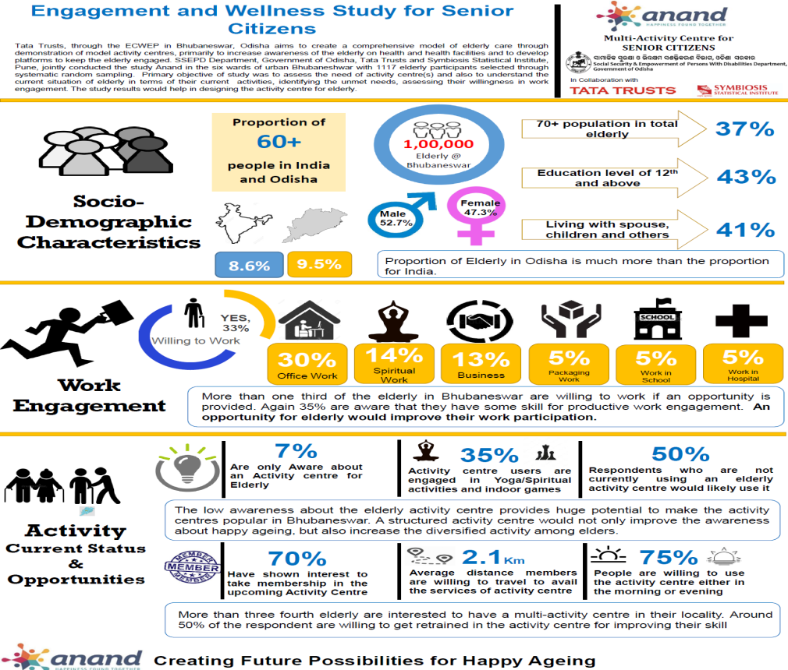

Slide 20
Acknowledgement

