Slide 1
Challenges to scaling-up of sustainable farming practices in Coastal Gujarat
Preliminary Findings

Slide 2
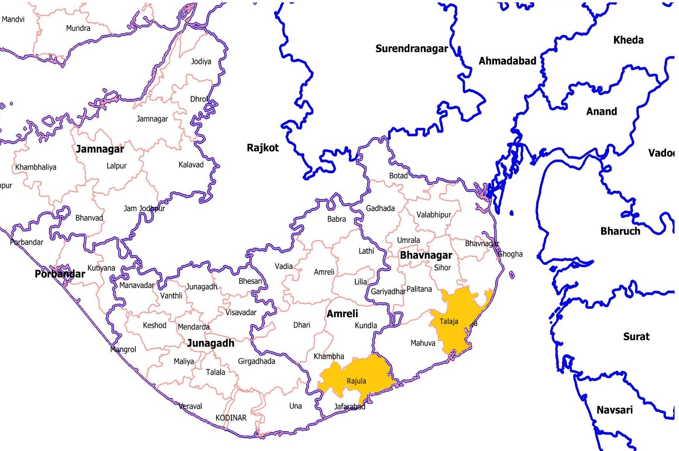
Location and Farmer’s Profile
100% are respondendents are men farmers
50% with above 40 age and 50% with Below 40 age
49% small and marginal farmers and 51% Medium Farmers
35% are Graduate and 30% High School and Higher secondary
54% farmers are involved in dairy business along with farming.
95% and 52% land are Fully irrigated in Kharif and Rabi respectively.
All the farmers are cultivating in kharif and Rabi season both.
Majority of the Farmers (93%) have a cattle.
81% farmers adopt the SFP since last 3 years.
Cotton, Groundnut, Wheat and Onion are major crops cultivated in this region.
Rajula Block,
Amreli Dist.
14 Village
42 SFP Farmers
Talaja Block,
Bhavnagar Dist.
14 Village
42 SFP Farmers
Notes:
Rajula Block, Amreli Dist
14 Village
42 SFP Farmers

Slide 3
Key Findings
Out of the practices promoted, 100% farmers adopted the Bio pesticides, and 93% farmers adopted composting and around 90% farmers using Insect traps and Cattle Urine/Decoctions and adoption was vermicomposting was found to be 49%.
There has been marginal decrease in cost of cultivation and marginal increase in drudgery with unaffected change in yield and price realization.
Major issues perceived by the farmers that motivated them to use of Sustainable Farming Practices were effects on Human Health (86%), followed by Soil Health (79%), while yield was less motivated to adopt the SFP.
Major challenges faced by Farmers are Marketing challenge (86%), Price realization (83%) and Weed Management (79%), While Animal Husbandry, Irrigation constraints and leased land are least challenges for the SFP adopted Farmers.
All the Men farmer’s acknowledge that women contributes majority of the laborious work involved in farming.
Major drudgery operations are Weeding, Harvesting and Post Harvest operations for Male and Female farmers.

Slide 4
Other Field Observations
It has been observed that adoption of Sustainable Farming practices has gained momentum in Last 3-4 years pertaining to efforts of Govt. and Non-Govt. organizations functioning in those areas.
Irrigation is the biggest consumer of fresh water which is contaminated due to non-judicious fertilizer and pesticides application. As per farmer’s observations, Sustainable agriculture increase the organic matter content of the top soil, thus raising its ability to retain and store water from rainfall.
Few interventions and practices involve drudgery and additional cost implications which impacts fast diffusion.
The investment capacities of farmers are different for inputs so standardizing outcomes of intervention is challenging.
Hindrance in upscaling due to perceived productivity loss in initial years.
Absence of dedicated marketing linkages of Sustainable produce.

Slide 5
Other Field Observations
Young Generations are migrating towards city with the hope of better livelihood.
Chemicals, pesticides, and fertilizers badly affect the local ecology as well as the population. Indiscriminate use of pesticides, improper storage etc. leads to health problems. Sustainable agriculture reduces the use of hazardous chemical and control pests.
Farmers might know about new "technologies" but often misuse them due to their inappropriateness application.

Slide 6
Future prospects
The way forward is to focus on Marketing and Value chain Management of the produce for income enhancement and improvement in quality of life indicators.
Farmer’s questionaries' form need to update with the experience of the pilot study.
Sustainable agriculture practices involve mixed cropping, thus increasing the diversity of crops produced and raising the diversity of insects and other animals and plants in and around the fields.
Attention of the government and its planners to provide facilities to promote agro-processing is needed in rural areas.
There is a need for scaling up diversification into new higher value crops; this can be achieved by the use of new and more efficient irrigation technology

Slide 7
Thank You! Any Suggestions?

