Slide 1
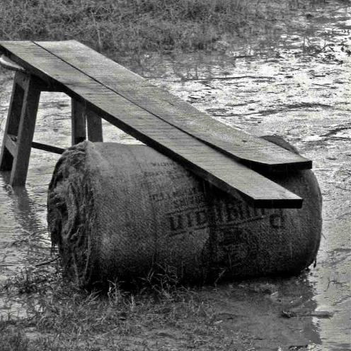
COMMON POOL RESOURCES AND RURAL LIVELIHOODS CONFERENCE ON RURAL INDIA : TOWARDS INCLUSION OF THE MARGINALIZED
Contribution of commons-based livelihoods to economies of rural household in diara kshetras Kosi river basin in Saharsa district, Bihar
November 7-9, 2019
Megh Pyne Abhiyan, New Delhi

Slide 2
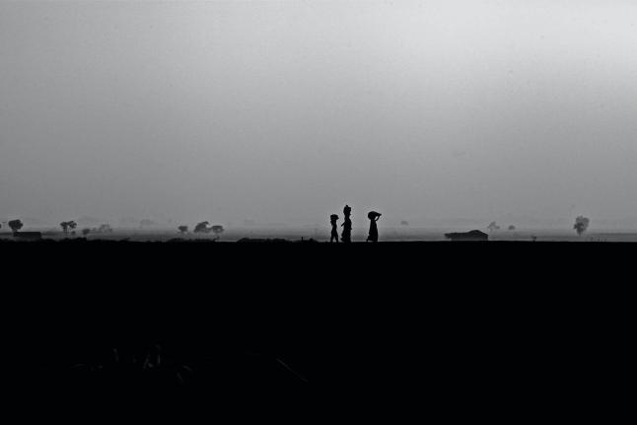
STUDY COVERAGE
Presentation Outline
Background
The Key Findings
Discussion
Issues to Engage With
Team
Common Pool Resources and Rural Livelihoods Conference on Rural India : Towards Inclusion of the Marginalized

Slide 3
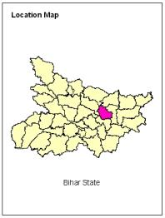
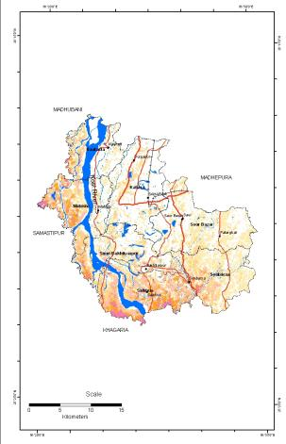
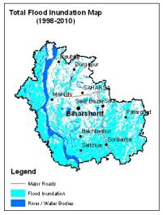
Background
Saharsa district
Is located in the north east alluvial plains of Bihar, categorized as Zone II of the state's agro-climatic setting, comprises largely of diara kshetra. The north east alluvial plains of Bihar, are particularly exposed to multiple hazards - floods and waterlogging, river bank erosion, high speed winds, earthquake Zone V and IV, shallow groundwater table and the changing landscape.
Common Pool Resources and Rural Livelihoods Conference on Rural India : Towards Inclusion of the Marginalized

Slide 4
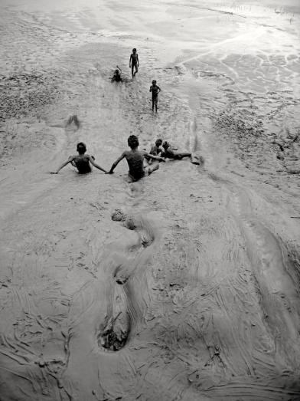
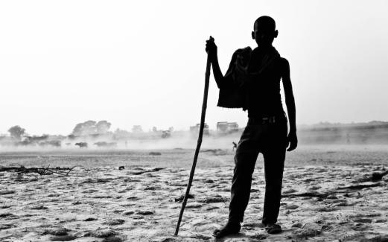
Diara Kshetra
The word 'diara' comes from 'dia' i.e. bowl-like land system on either side of the river. Diara kshetra is defined as
Area which is adjacent to or surrounded by perennial river and is subject to the alluvial action of that river
Marked by its inaccessibility to and from the habitations and
Development interventions in the region are not concurrent
Common Pool Resources and Rural Livelihoods Conference on Rural India : Towards Inclusion of the Marginalized

Slide 5
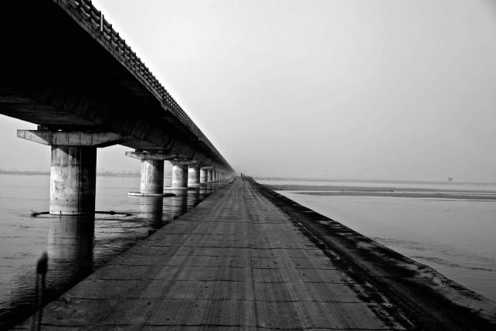
Common Pool Resources and Rural Livelihoods Conference on Rural India : Towards Inclusion of the Marginalized
The Key Findings
Four different forms of commons - Sattaur Panchayat, Nawhatta block; Aina panchayat, Mahishi block; Birgaon panchayat, Mahishi block; Telaba Pashchimi panchayat, Mahishi block
Kharhoir (jungle of khar or wild grass )
Chaap (Land inundated with flood water, with varying levels)
Pokhar (Village Pond)
Nadi (River)

Slide 6
Kharhoir
Chaap
Within the periphery of the village
Accessing the land without permission in the months of May and June
Khar is for a collective good
Access without permission from July till November
Community use
Use without any capital investment
Community’s right to use
Each have reasons to be considered as a common
Pokhar
Nadi
Selected traditional community rights
Pond use benefiting the society
Traditional community rights
Khule darbar ki tarah sab ka aadhikar hai
Use without any investment
Common Pool Resources and Rural Livelihoods Conference on Rural India : Towards Inclusion of the Marginalized

Slide 7
Kharhoir
Chaap
Construction and repair of the house
Fodder for the livestock
Fuelwood
Fisheries
Sorkha (wild fruit growing in still water bodies)
Maize cultivation
Common use of the commons
Pokhar
Nadi
Irrigation
Fisheries
Direct irrigation
Irrigation through private service providers
Cleaning of livestock
Bathing
Common Pool Resources and Rural Livelihoods Conference on Rural India : Towards Inclusion of the Marginalized

Slide 8
Kharhoir
Chaap
Construction and repair of the house
Fodder for the livestock
Fisheries
Sorkha
Use of the commons for livelihood (household level)
Pokhar
Nadi
Irrigation
Direct irrigation
Irrigation through private service providers
Cleaning of livestock
Common Pool Resources and Rural Livelihoods Conference on Rural India : Towards Inclusion of the Marginalized

Slide 9
Kharhoir
Chaap
The area under kharhoir has increased because of deposition by river
Dependence on fuelwood from kharhoir has decreased
Dependence on grasses from kharhoir to build houses gradually decreasing
Sattaur village, Sattaur Panchayat, Nawhatta block
Erosion by the river has reduced the area under kharhoir, reducing access and availability of the resource to the people
Aina village, Aina panchayat, Mahishi block
The depth and expanse of the chaap has reduced therefore time of its inundation as well. This has allowed for increased agricultural activity on the land, which was not possible 15-20 years ago
Sohagpur Aina habitation, Aina village, Aina panchayat, Mahishi block
Sedimentation by river Kosi has raised habitations above the height of the chaap which was earlier on par with the habitation
Birgaon village, Birgaon panchayat, Mahishi block
Agriculture impacted from increase in depth of chaap. Water remains in the system as sedimentaion has affected drainage systems. This has caused wild water grass to grow, because of which rice cultivation (of local flood-resilient Dasariya paddy variety) has got impacted
Birgaon village, Birgaon panchayat, Mahishi block
Transformations in the state of commons
Pokhar
Nadi
The area under pokhar has come down because of encroachment, which has also brought down the income collected by the community at the yearly auction for fisheries rights in the pond
Sohagpur Aina habitation, Aina village, Aina panchayat, Mahishi block
Shifting course of the river slightly nearer to the village
Sohagpur Aina habitation, Aina village, Aina panchayat, Mahishi block
Periods of inundation by river has decreased Birgaon panchayat, Mahishi block
The river has widened since 1986, and the increase in the flow of the river post the construction of the Gandol bridge has impacted all forms of commons
Telaba and Hulasdih village, Telaba Pashchimi panchayat, Mahishi block
Common Pool Resources and Rural Livelihoods Conference on Rural India : Towards Inclusion of the Marginalized

Slide 10
Sattaur Panchayat
Homestead land – 150 households are residing on Kabir Mat’s land; Remaining are either on their own or raiyati land
Farmland – Self owned
Aina panchayat
Homestead land – 110 households reside on the periphery of the pokhar
Farmland – Self owned
Land ownership
Birgaon panchayat
Telaba Pashchimi panchayat
Homestead land – Self-owned
Farmland – Self-owned
Homestead land – 20 households are on residing on Bihar government’s land
Farmland – 10 households have encroached a defunct Angreziya pokhar for agricultural purpose, whereas the remaining are self-owned
Common Pool Resources and Rural Livelihoods Conference on Rural India : Towards Inclusion of the Marginalized

Slide 11
Kharhoir
Sattaur
Dispute regarding the ownership of land after the river changed its course, resulting in the emergence of the land. Three villages (Kundah, Jori and Sattuar) were stating their claim on the land. Traditional approach towards conflict resolution was adopted (Panch-Amin—People)
Aina
Caste based hostility to gain control over the commons and the benefits
Conflict
Common Pool Resources and Rural Livelihoods Conference on Rural India : Towards Inclusion of the Marginalized

Slide 12
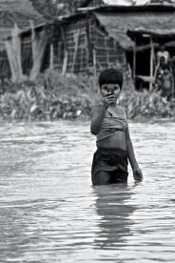
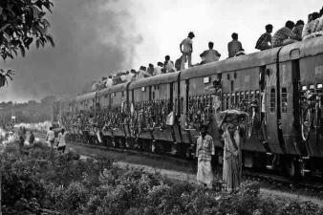
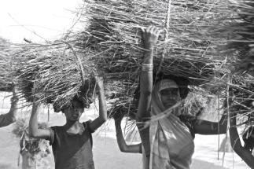
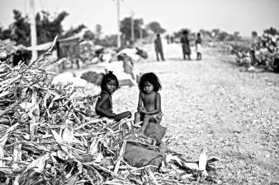
Common Pool Resources and Rural Livelihoods Conference on Rural India : Towards Inclusion of the Marginalized
Issues to engage with in the diara kshetra
Profiling of the commons of different river systems and their role in local livelihoods
Interrelationship between migration and commons
Impact of human intervention/s on commons

Slide 13
Practitioners and Young Researchers
Kumod Kumar Das
Eklavya Prasad
Aparna Unni
Trinayani Sen and
Pradeep Poddar
Megh Pyne Abhiyan’s team
Common Pool Resources and Rural Livelihoods Conference on Rural India : Towards Inclusion of the Marginalized

