Slide 1
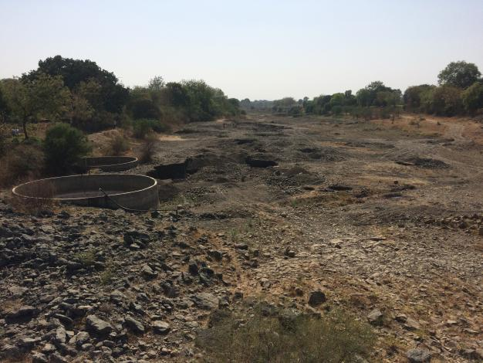
Dependencies, vulnerabilities and changing practices of groundwater access and use: some lessons from Maharashtra
Dhaval Joshi
Advanced Centre for Water Resources Development and Management ACWADAM
dhavalgy@gmail.com
Vikasanvesh Conf (Nov 2019) Abstract Theme: CPR and Rural Livelihoods

Slide 2
Context
Dependency on groundwater- agriculture and drinking water
Drought prone areas- Latur and Osmanabad
Increasing incidences of rainfall variability
Moving towards overexploitation of aquifers- leading to intense competition
Emerging challenges of drinking water security as well as livelihoods

Slide 3
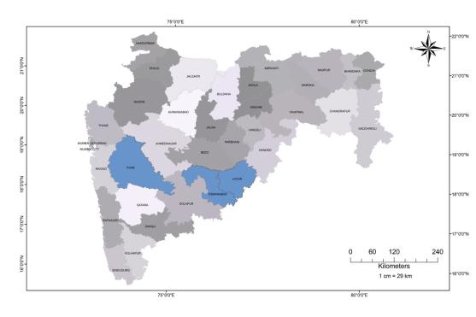
Study - methodology
Study conducted as part of UNICEF-ACWADAM programme on Drinking Water Safety and Security in overexploited watersheds of Maharashtra
17 OE watersheds selected- 111 villages (11 pilot- 100 scale up) across 3 districts- Pune, Osmanabad and Latur
Survey conducted in 11 pilot locations (about 2000 respondents)
Focused on drinking water dependency, agricultural dependency, understanding vulnerability emerging from resource scarcity, general awareness about groundwater legislation and OE status

Slide 4
Dependency
Groundwater important for drinking water and agricultural needs
Multiple aquifer systems tapped today
Dependency shaping sanitation practices

Slide 5
Increasing vulnerability
Drying up of dug-wells- poor state of unconfined systems
Water scarcity a persistent phenomena- needs longer engagement and solutions
Intense competition scenario- multiple sources tapped by individuals, failure of sources

Slide 6
Changing practice of groundwater access
Percentage of shared sources more when it comes to dug-wells than bore-wells
Cheaper drilling provides for more privatized access
Capacity of bore-wells less than dug-wells (so difficult to share)
Dug-wells older- shared through hereditary property rights

Slide 7
Changing practices of groundwater use
Irrigating Kharif crops through groundwater- rainfall variability
Bore-well to Dug-well water transfers as unconfined aquifer systems deplete; in many areas water transferred to farm ponds

Slide 8
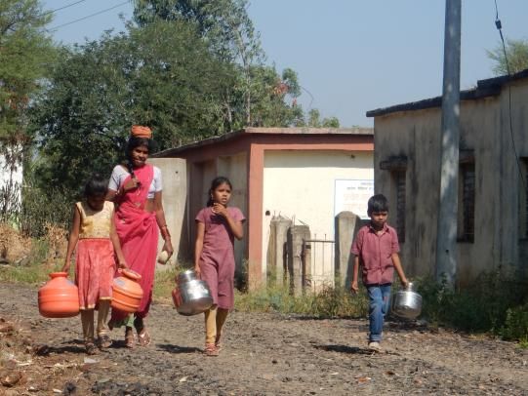
Discussion
Response to resource scarcity and climate change?
Do the changing practices of groundwater use indicate response by communities to climate change
Emerging local knowledge about adaptation/mitigation to resource scarcity and climate change
How common are commons today?
Although today multiple aquifers are tapped than ever before, but do they inform equity
How does one define equity in a multiple, overexploited aquifer regime
Does tragedy of commons invoke environmental migration?
Evidences for groundwater scarcity induced migration are sparsely documented
How does overexploitation of a common pool resource like groundwater shape larger decisions like migration

Slide 9
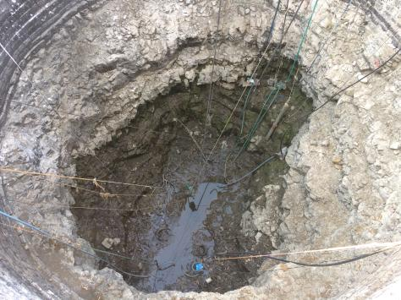
Conclusion
The larger pool of research and action on CPR focuses on conservation and sustainability of the resource
Need to integrate key knowledge themes linked to practices of access, use, distribution of CPR and how resource characteristics shape them
Need to understand intense groundwater use for agriculture while planning Har Ghar Jal, since 85 percent sources today are groundwater based
Need to move beyond drip/sprinkler discussion for demand side management on groundwater

Slide 10
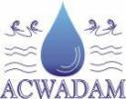
References
NRDWP (2019): Format B26, List of Schemes
MoWR (2017) Report of 5th Minor Irrigation Census
Guhathakurta, P., & Saji, E. (2013). Detecting changes in rainfall pattern and seasonality index vis-à-vis increasing water scarcity in Maharashtra. Journal of Earth System Science, 122(3), 639-649.
GSDA (2014): Report on Dynamic groundwater resources of Maharashtra

