Slide 1
Evolving a methodology for People’s Commons’ Register (PCR)
- VikasAnvesh Foundation

Slide 2
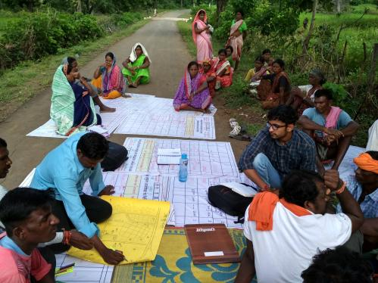
Vision
Preparing reliable database around Commons
To record customary regimes around the commons
To facilitate improved communication across stakeholders for conservation of the Commons
For better implementation of tenure reforms
For better understanding of changing Commons in dynamic rural landscape
Creation of reliable database
Prepared by local communities
Facilitated by field research in evolution of the process

Slide 3
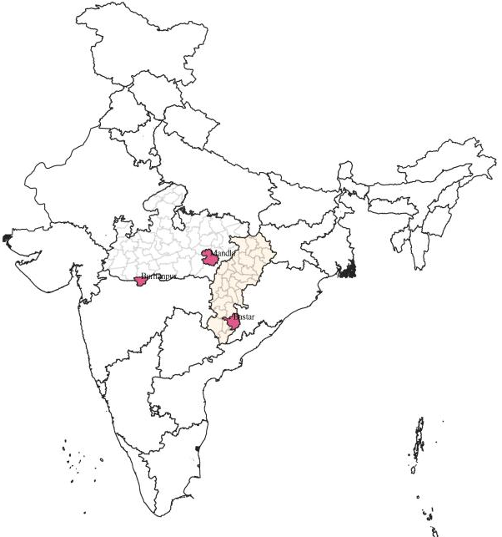
Area of intervention
State | District | Block | No of villages
Chhattisgarh | Bastar | Darbha | 10
Madhya Pradesh | Burhanpur | Khakanar | 16
Madhya Pradesh | Mandla | Bichhia | 31
Total villages |  |  | 57
8000 to 10000 hectare of contiguous area preferably in a milli-watershed
Diverse community context
Diverse relationship with the Commons

Slide 4
Methodology
Bundles of rights approach (Schlager & Ostrom, 1992)
to record the different rights possessed by different users of a common pool resource
De jure and the de facto with a focus on the de facto customary communal tenure system (Cousins, 2000)
Rights Category | Ambit of the rights
Use rights | Right of access and withdrawal from the resource, exploitation of the resource for economic benefits
Control/Decision-making rights | Rights to manage the resource and exclude people
Alienation/Ownership rights | Rights to rent or sell or transfer the rights of the resource
Rights categorisation in the table adopted from (Barry & Meinzen-Dick, 2008)

Slide 5
Process
Orientation with community federation and village institution
Initial community meeting
Transact walk
Facilitating ownership of the research process and outcomes
Sharing the objective with community and resource mapping
Hamlet level FDGs
Collecting information on usage/management/ownership of resources as well as changes over time
GPS tagging of identified resources
Preparing map on Google Earth
Village level meeting for validation
Validating the information with community
Handing over the PCR to the community

Slide 6
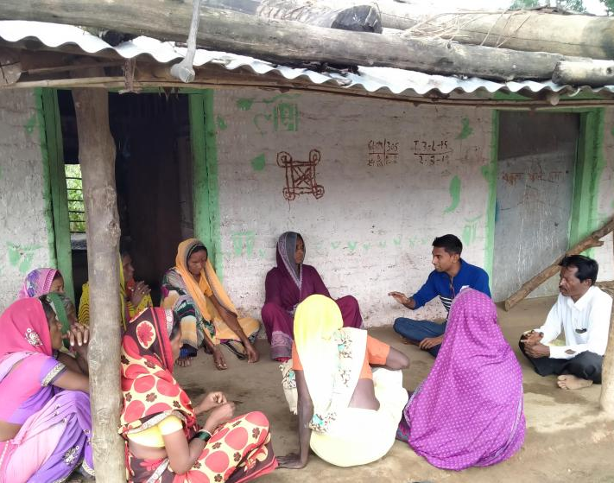
Village-level Findings from the research
Village- Thonda, Dist. – Mandla (MP)
Population- 1198
Tribal population- 58%

Slide 7
Groundwater (Open wells, borewells)
History & status | Usage since past 3 generations Fast depletion in groundwater levels in the past decade Open wells drying out during summer
Forms of usage | Household usage and irrigation (mostly for sugarcane farming) Community wise difference Only 1 out of 35 private borewells is open access
Management and Ownership | Increasing number of private borewells Charging fees for providing drinking water

Slide 8
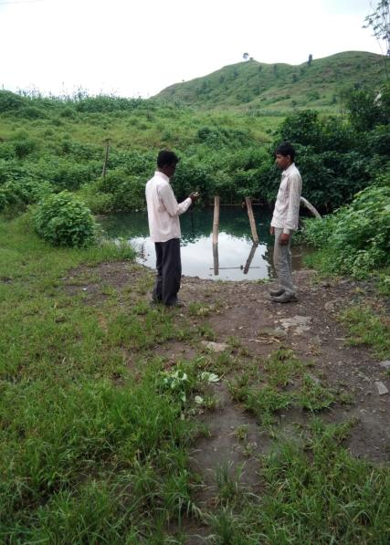
Surface Water (Ponds, water streams)
History & Status | Several ponds were built under RGMWM (2006)
Forms of usage | Around 100 tribal families dependent on running streams for drinking water during summers Open access to ponds for fisheries
Management and ownership | Few private farm ponds are used as commons Repair work for 2 of the ponds

Slide 9
Forest
History & status | Association since last three generations Rapid deforestation in the past few years due to unregulated cutting of trees by community & negligence of the forest department
Forms of usage/ association | Usage of NTFPs, firewood and wood for roof & farming equipment among others Community wise difference in the usage Spiritual Significance- worshiping the ‘Saja’ tree
Management and ownership | De facto & de jure management rights are with the forest department Community’s participation in the management Teak plantation by forest department (unilateral decision taken three years back) Opposition for teak plantation by the community this year Community has claimed rights over community forest

Slide 10
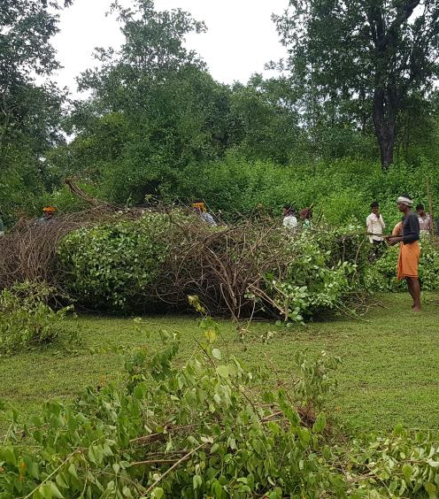
Commons Land (Grazing land, playground)
History & status | Association Since Last Three Generations Commons Land Increasingly Captured by invasive plant species
Forms of Usage/ Association | Fodder for Cattle Private Farms Also Used As Commons for Some Period
Management/ Ownership Rights | De Facto: Community, De Jure: Panchayat/Gov
Major Decisions | Eradication of Invasive species Commons Land Given to Forest Department (Instance from Burhanpur)

Slide 11
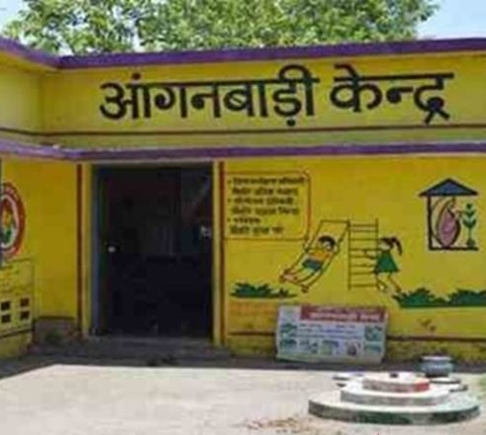
Artificial Commons (School, anganwadi, community hall, spiritual places)
History & status | Deterioration of the structures
Forms of usage/ association | Community meetings and functions Leisure activities Spiritual/religious association
Major decisions | Giving permission for functions Decisions related to maintenance

Slide 12
THANK YOU!

