Slide 1
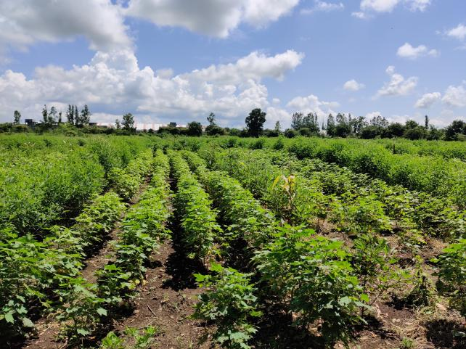
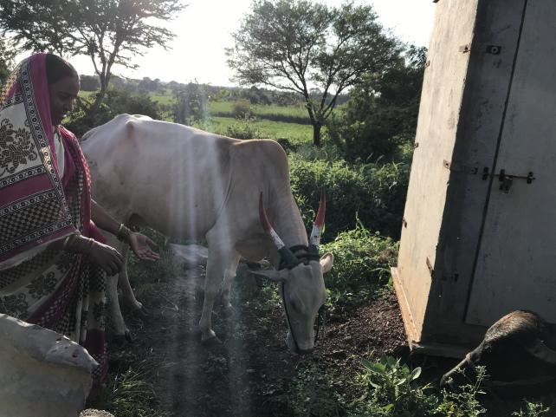
Zero budget natural farming
Exploratory Fieldwork in Maharashtra and Anantapur

Slide 2
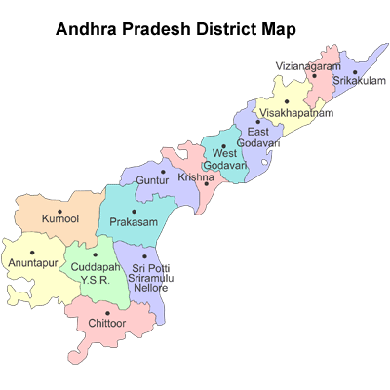
Fieldwork locations

Slide 3
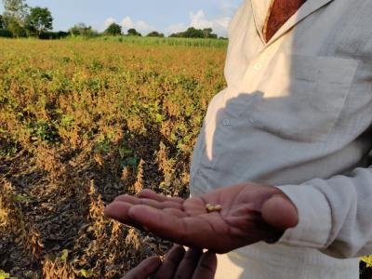
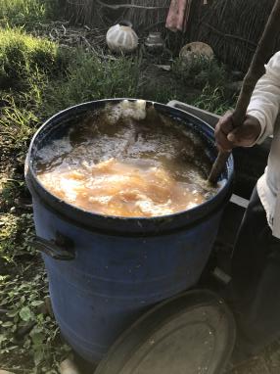
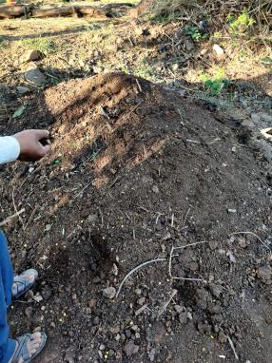
THE 4 WHEELS OF ZBNF
1. Beejamruth
Seed treatment with a) 20L water b) 5kg cowdung c) 5L cowurine d) 50g lime
Seeds mixed overnight and sown next day
2. Jeevamruth
Two types – Ghan-Jeevamruth and Dhrav-Jeevamruth
Dhrav Prepared using a) 200L water b) 2kg Jaggery c) 2kg besan d) 20L cowurine e) 10 kg cowdung and soil
Ghan prepared using 200kg cowdung (400kg in Anantapur) mixed with Dhrav Jeevamruth – applied on field before sowing
Dhrav Jeevamruth sprayed after 21 days of sowing. Then once every 15 days
Increases pest resistance, microbial and earthworm activity and attracts friendly insects
Drip water is mixed with Jeevamruth

Slide 4
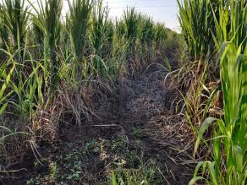
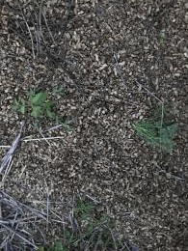
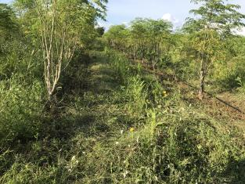
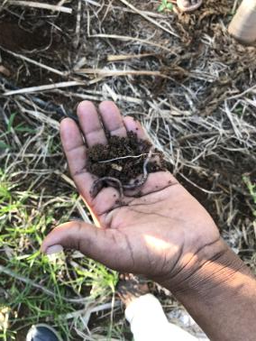
3. Achhadana
Mulching with waste plant biomass (groundnut shells, straw etc.)
Live mulching with pulses, millets
Intercrops also offset losses due to failure of main crop
4. Waaphasa
Build up of soil humus and moisture retention
Increased earthworm activity – burrows create pores for water and oxygen to enter soil

Slide 5
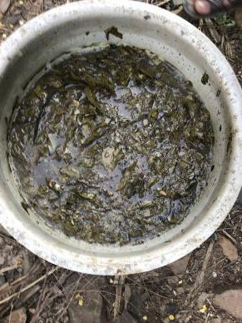
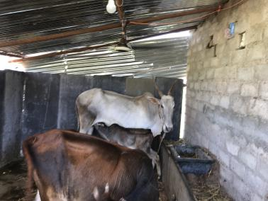
Other components
Astras
Neemastra – prepared from neem leaves and beej mixed with water and gaumutra
Agniastra – prepared using garlic, chilli, tobacco and neem boiled in gaumutra
Dashparni – stronger astra prepared using 10 different spices and leaves – takes 45 days to prepare and can be stored for 6 months
Use of Desi cow
Use of only desi cow strictly followed
One cow provides inputs for 30 acres – much less in Anantapur

Slide 6
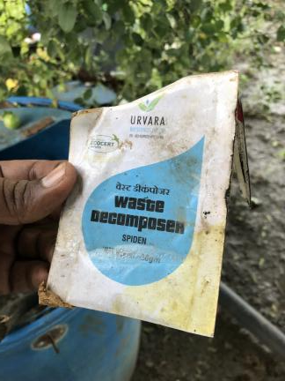
VISIT TO Yavatmal, WARDHA AND LATUR
ZBNF and other natural farming techniques taken up by mostly large farmers
ZBNF groups are present in villages – organize inputs, processing and marketing
Few purely ZBNF farmers. They also follow other farming techniques such as Beljibhai method, Avdut Baba Shivanand Swami’s Shivyog method, Agnihotra, Shendrishithi etc.
NGOs like Bajaj Foundation organize ZBNF training and Grain Festivals
Farmers critical of SPNF’s “one size fits all” approach – use composting, other pesticide alternatives that are readily available
Frequent use of Jeevamruth results in pest attack “Unni” in roots of sugarcane
Labour cost is much higher for big farmers due to frequent weeding
Farmers have also diversified into dairying – provide organic feed for desi cows and get better price for milk – Rs. 70/litre
Notes:
Farmer owns over 62 desi cows and 55 acres of land. Did ZBNF in 25 acres and chemical farming in rest

Slide 7
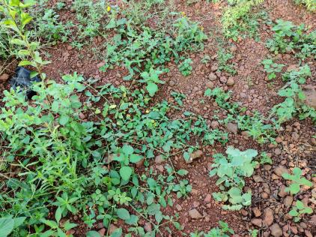
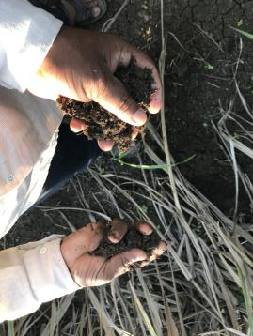
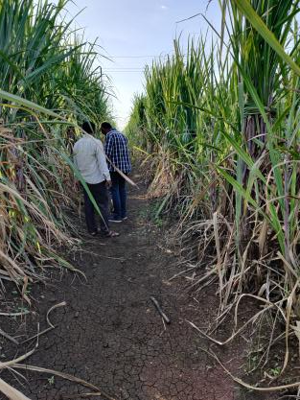
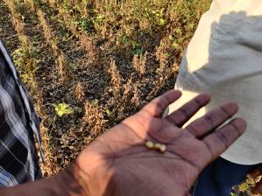
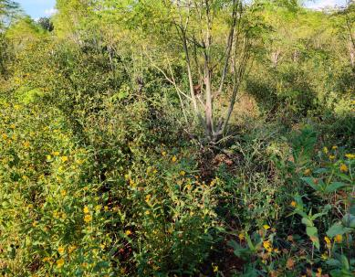
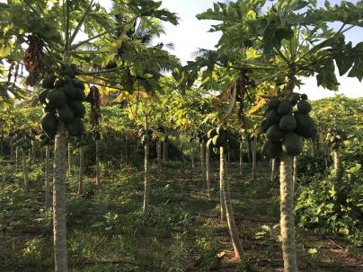
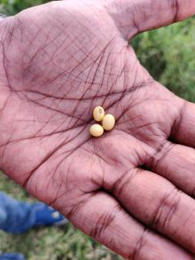
Visible Impacts

Slide 8
Yield
Increase in yield observed after at least 3 years
In Latur – soyabean yield per acre has increased to 12 kattas from 10 (1 katta = 50 kilos)
Yield is almost same or has slightly increased for wheat (by 50 to 60 kg)
Input Costs
Cotton – Ecofarms (Yavatmal): 14 acres
Activity/Input | Cost (per acre)
Tillage | 2300
Cotton seed (org) | 1200
Draught animal | 1000
Weeding | 3000
Dasparni and neemoil | 2700
Application of astras | 500
Hired labour | 300
Cotton picking | 4200 (Rs. 6 per kg)
Total | 20400
Yield = 7 quintals per acre
Realized better price by selling to Arvind Mills with organic certification

Slide 9
Water use
Change in water use not very significant
In Latur – now 4 irrigations are given instead of 5 in the case of wheat
Water use in sugarcane remains the same
Marketing ZBNF Produce
No particular large scale marketing efforts in place
Large farmers aggregate produce among their groups and sell directly to firms like Arvind Mills, Amravati National etc.

Slide 10
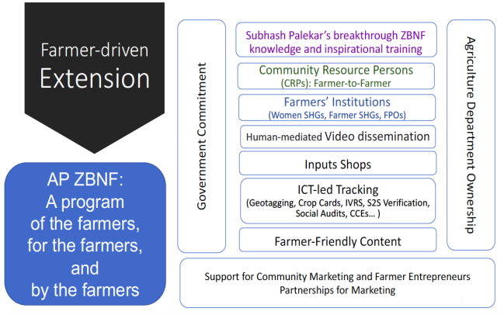
AP-ZBNF: ORGANIZATION AND STRUCTURE
State level implementation & tech support unit (Dept of Ag. & RySS)
District Program Support Unit (4 cluster teams per mandal)
NGOs
Direct Implementation
CRPs, PRPs
NFFs
ICRPs
Source: Rythu Sadhikara Samstha, Dept. of Agriculture, Andhra Pradesh
SHGs, FPOs
Govt support
Women SHGs
Champion Farmers
ZBNF Knowledge
4 pillars of APZBNF:
ZBNF Farmer

Slide 11
STAKEHOLDER ROLES
CRPs
Selected from pool of previous NPM farmers [25-50 years age; Completed 10th Std. at least]
Practice Model Farming, mobilize and provide technical know-how to other farmers
Organize meetings through SHGs
1 CA-CRP per cluster; convert entire GP to ZBNF in 6 months
Select ICRP before moving on to new cluster
NFFs
Recent Agriculture Graduates
Practice ZBNF in 1 Acre leased plot, collect empirical data and provide technical support to farmers
Annual Compensation: Rs. 1,12,000
Data Collected: Input Cost; Income; Soil Health
Try out different combinations of jeevamruth, mulch, seeding practices etc. to make region specific recommendations

Slide 12
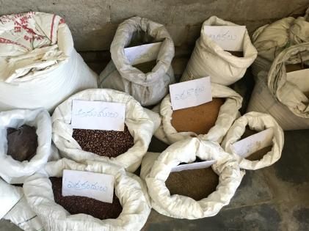
Stakeholder roles
NGOs
Work with farmers and all cluster level stakeholders to bring a target number of farmers under complete ZBNF
Help in input sourcing
Support CRPs/ICRPs for model farming
Mobilize landless/laborer/single women to take up ZBNF in kitchen garden
SHGs
Easier to mobilize both female and male farmers through support of SHGs
5-15 SHGs organized into VOs that provide financial support for ZBNF inputs (loans)
FPOs
Processing and packaging of ZBNF produce
Marketing of produce through identification of local demand [Nutrition kit, Diabetic persons] as well as by setting up stalls
Seed buy-back and discount on seeds for FPO members

Slide 13
Yield
In Anantapur – paddy yield has increased by 8 bags as compared to chemical farming (after 3 years)
Crop cutting experiments done by CRPs and NFFs in AP also show increase in yield
Input Costs
Paddy – Farmer in Jayapuram (Anantapur): 2 acres
Groundnut – Farmer in Jayapuram (Anantapur)
Some of the major costs incurred during chemical farming:
Input cost has reduced to Rs. 5000 per acre after shifting to ZBNF
Activity/Input | Cost (per acre)
Tillage | 3600
Ghan-Jeevamrith (400kg) | 4000
Groundnut waste (2 tons) | 6000
Labour for harvesting | 2000
Total | 15,760
Activity/Input | Cost per acre
DAP (4*50 kg bags) | 4000
Pesticide (3 times) | 4500
Seeds (4 packets) | 5200
Labour cost for spraying pesticide | 750
Weeding | 1500
Total | 15950
Additional Rs. 20000 was needed earlier for fertilizers, pesticides and seeds which have now been avoided

Slide 14
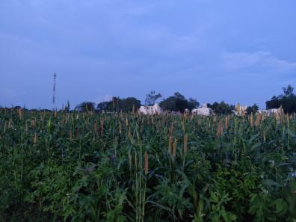
Innovations in ap-zbnf
Dry-Sowing
Tractor tilling
Application of Ghan Jeevamruth (400 kg/acre) followed by Dhrav Jeevamruth
Sowing: 23 types of seeds (Millets, oilseeds, vegetables, tubors, cereals)
Subsequent spraying of Dhrav Jeevamruth once in 15 days
3 inch mulching - 2 tonnes (groundnut husk/jowar straw + live mulching)
Harvest once every 3 months
Subsequent application of Ghan Jeevamruth once every 6 months (200 kg)
Year 1
Net Expense: Rs. 5000
Net Income: Rs. 25000

Slide 15
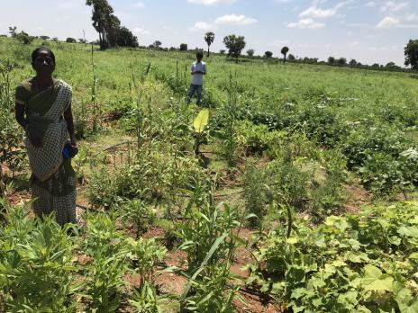
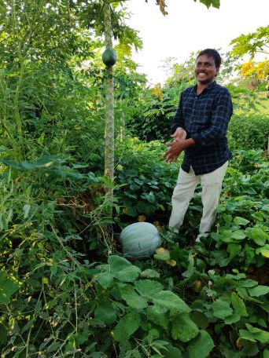
Innovations in ap-zbnf
Poly-cropping
Surya-Mandal
Five Layer Model
Crop Spacing: 36 feet- Mango; 18 feet-Guava; 9 feet- Drumsticks, Fig, Redgram; 2 feet-Vegetables, Tubors; Trap Crops-Marigold, Castor; Border Crops- Avisa, Gliricidia, Teak

Slide 16
Zbnf input market
Mulch Material: Groundnut husk, used for mulching, selling at prices between Rs. 3/kg.
Farmers who have desi cows are preparing and selling Dhrav Jeevamruth at Rs. 400-500/ 200 litre
One cow provides inputs for 30 acres – much less in Anantapur
Cost of desi cow in Anantapur market – Rs. 15,000 to 50,000
Cost of desi gaumutra in Latur = Rs. 20 per litre
Cost of cow dung for 1 acre farm in Anantapur = Rs. 500 per month
Per day one cow can provide 10kg dung and 5L gaumutra
Mixing of crossbred or any available cattle dung with desi cow urine to get good results

Slide 17
CONSTRAINTS FOR SCALe-UP
Government support to chemical farming in the form of input subsidies deterrent for switching to ZBNF
Sourcing of ZBNF Inputs: Can NPM shops be utilized to stock inputs like Jeevamrutham, Astras, Mulching materials?
Need for premium for ZBNF produce
Support required for making a centralised cow-shed and assigning people to take care of the cattle for every village

