Slide 1
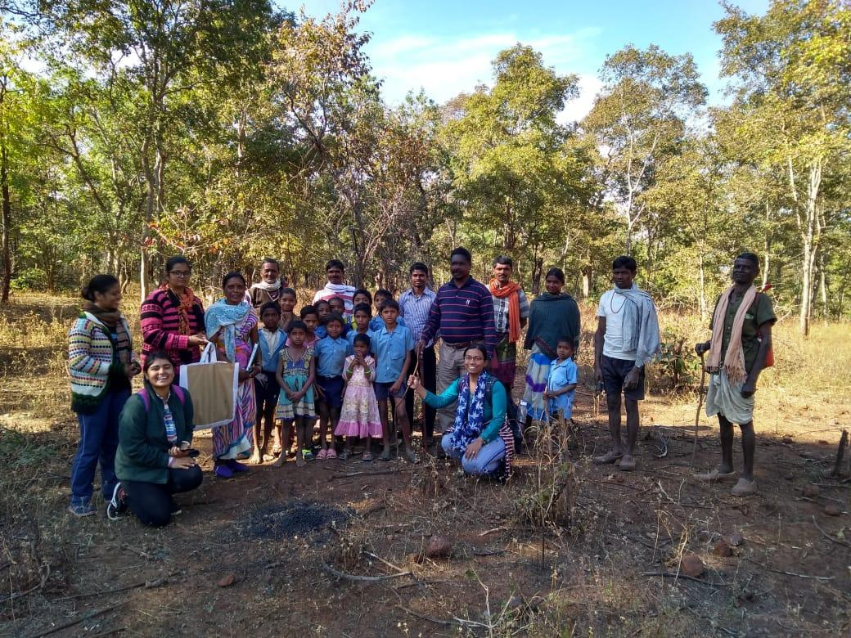
Rejuvenating forest-farm ecosystem through intergenerational exchange of knowledge
A story of Jharna Ghughri village Dindori(M.P)

Slide 2
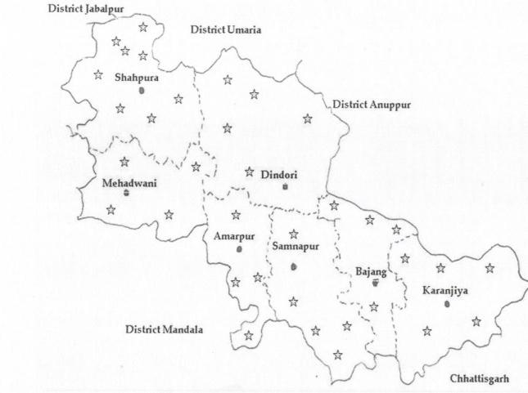
Jharna Ghughri
Jharna Ghughri

Slide 3
Exploring idea of Khushaal Zindagi
More crops
Green forest
Healthy life
Enough income opportunities in the village
Quality education

Slide 4
Present situation
Agriculture production declining
In Dindori district
Paddy production reduced from 161.3K MT in 2012 to 93.01K MT in 2016
Total cereal production reduced from 249.07K MT in 2012 to 179.44K MT 2016
- source: district statistical handbook

Slide 5
Present situation (Contd...)
Soil fertility reducing
Organic carbon in the soil 0.31-0.52 %
Nitrogen in the soil 163-230 kg/Ha

Slide 6
Present situation (Contd...)
Forest degrading
Illegal felling
Most of the timber(Tinsa, for making plough, Dhwaa) and non-timber species( Chironjee, Kosum for lac rearing, Kumbhi bark used for catching fishes, Rela used to cure snake bite etc) are disappearing
Forest department least bothered
Young generation villagers do not know the use

Slide 7
People started depending on migration

Slide 8
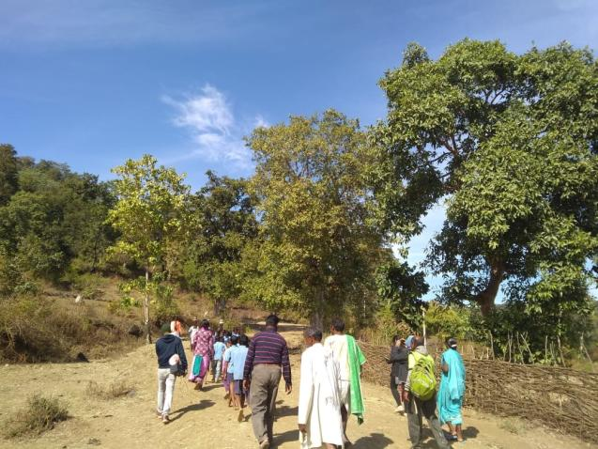
Farm-Forest-People relationship
Forest supplying biomass to the lands below
Source of medicinal plants and herbs
Source of nutrition – both animal and plant protein
Source of cash income
Source for many other household needs
Wood for agriculture implements, furniture
Any other....

Slide 9
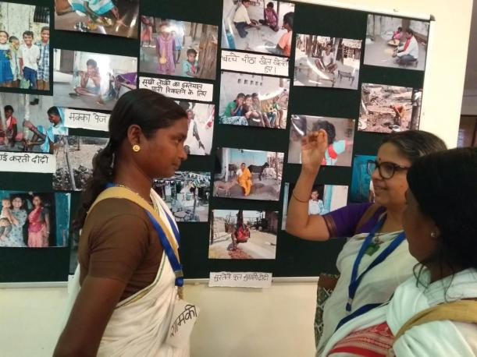
Adaptive Skilling through Action Research (ASAR)
Sustainable Intensification
Context specific solution
Not externally driven
Adapting know-how, both traditional and modern, to socio-economic, technological and ecological changes

Slide 10
The first step decided by Ghughri villagers
Rejuvenate the forest-farm ecosystem to increase production

Slide 11
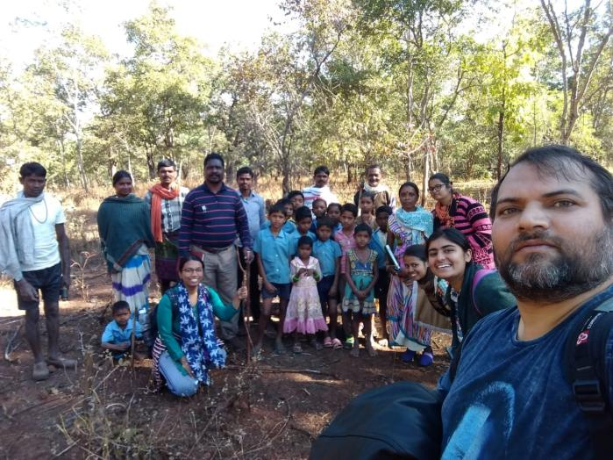
Changing F-F-P relationship
Walk through the village and forest with youths and kids
Understanding ecosystem
Knowing plant species and their use
Preparing Bio-diversity register

Slide 12
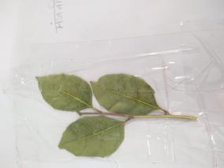
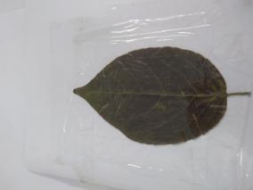
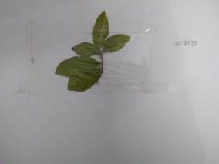
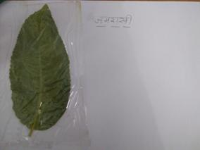
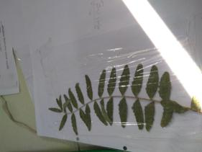
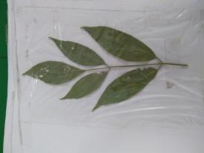
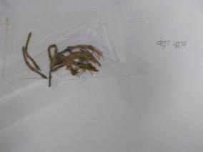
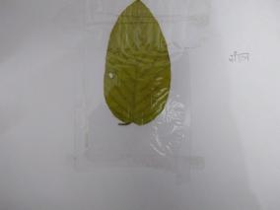
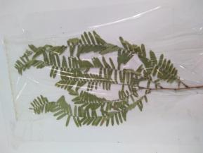
Bio Diversity Register Snaps

Slide 13
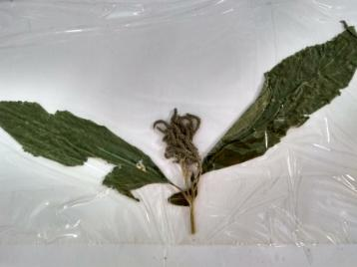
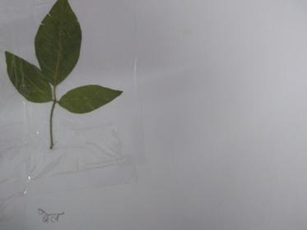
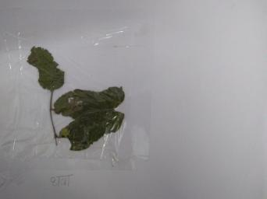
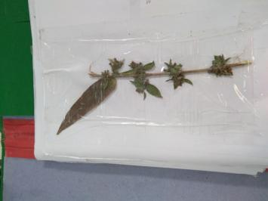
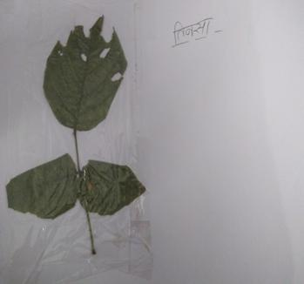
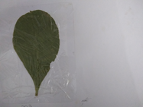
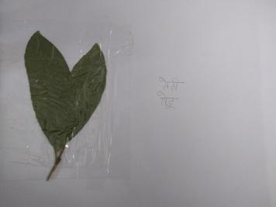
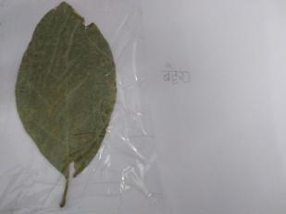
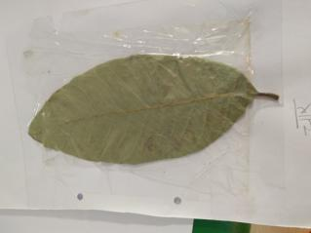

Slide 14
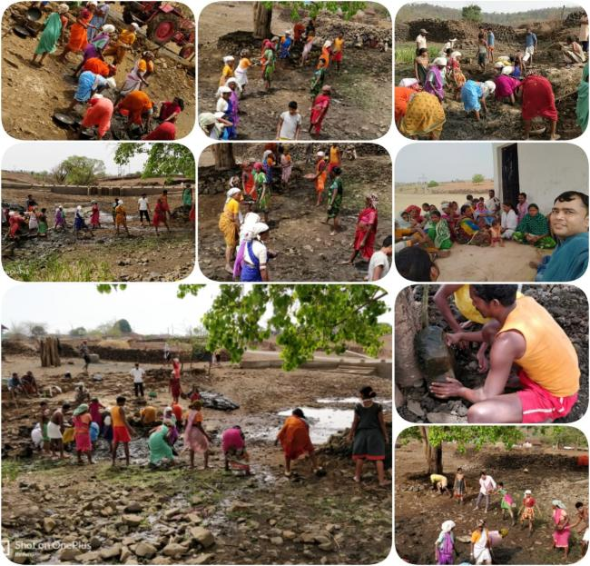
What happened after that...
Villagers started collectivizing at hamlet level and discussing issues on sustainable intensification
Bamboo and Khamer planted on fallow land
People started making FYM and using bio-fertilizers
Neighboring villages also defending forest from illegal felling

Slide 15
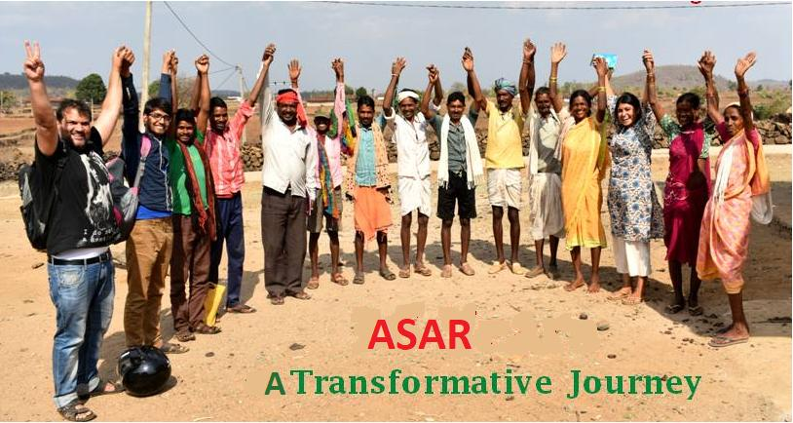
Thank You

