Slide 1
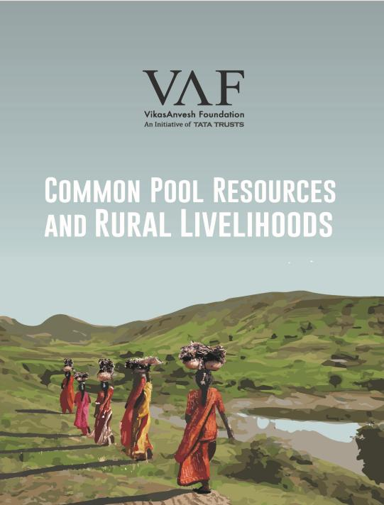
Conference on Rural India:
Towards Inclusion of the Marginalised
Synthesis Presentation:
Trends in The Contribution of Commons-Based Livelihoods to Economies of Rural Households
Date : 07/11/2019
Venue : BAIF, Warje, Pune

Slide 2
Role of the Common Pool Resources (CPR) in Rural Livelihoods
CPRs – common land, water and forest – constitute an important part of the livelihood for the rural communities in India, especially in the arid and semi-arid regions (Beck & Nesmith, 2001; Jodha, 1986; Kavoori, 1991; Nagendra, Ghate, & Rao, 2013)
Findings from NSSO survey, 54th round in 1998 (GoI, 1999)
15% of the total geographic area under the common pool land resources
48% of the households depending on CPRs
Highest contribution to the income of households dependent on wage labour
As per a study by Foundation for Ecological Security (2012)
20-40% of the household income is derived from CPRs across arid, semi-arid and sub-humid regions of India
CPRs fulfil critical fodder requirement, provide input for agriculture (its proportion to the total expense increases as the landholding reduces)

Slide 3
Loss of Commons and the identified reasons
Decline in the resources, both in terms of size and productivity, at the rate of 1.9% every five years (GoI, 1999)
Identified reasons -
Privatisation of the common land, increased population pressure and commercialisation of CPRs in western and southern Indian states (Jodha, 1989)
Changing environmental factors post economic liberalisation, leading to further diversion of CPRs for industries and the creation of development infrastructure (Gadgil & Guha, 2013; Yenneti, Day, & Golubchikov, 2016)
Urbanisation and employment opportunities attracting people from rural to urban area, at times, adversely affecting institutions around them (Robson & Nayak, 2010)
The socio-cultural, economic and political changes affecting the management and governance of the CPRs in the villages under transition (closer to urban areas) (Singh, 2004)
Need for recognition of the customary regimes around CPRs (Ostrom, 1994)

Slide 4
Research Objectives
To assess current status and access/usage rights pertaining to CPRs
To identify institutions in place for CPR management and assess their role in livelihood security of households
To assess trends in dependence of CPRs in the livelihood basket of the households over years, and the factors driving these changes

Slide 5
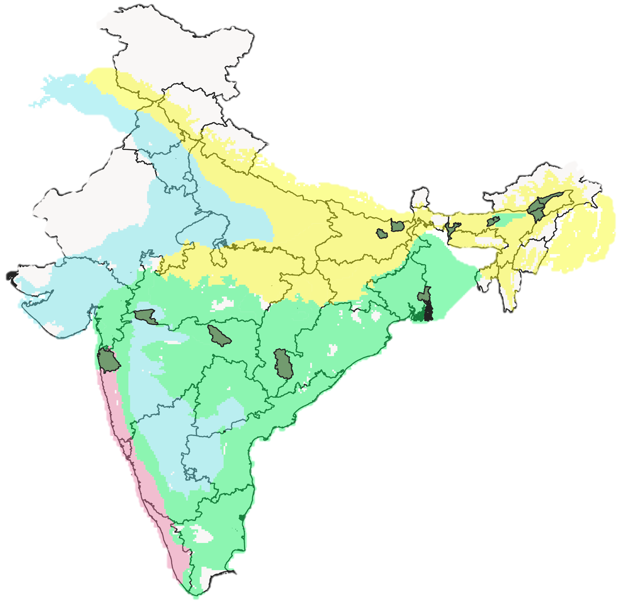
Methodology
Multi-location exploratory study across different climatic zones as per Koppen ecological classification (Semi-arid, humid subtropical, tropical wet and dry, tropical)
13 districts across 6 states of central and eastern India
Data collection using through group discussion and household level survey of 386 HHs
Purposive selection of districts and villages, based on parameters such as
Diversity of common pool resource systems
Distance of villages from market/urban centre
Population diversity (Homogeneous/Heterogenous)
Random selection of households in each location
Analysis
Perceived changes in the access and withdrawal from the major resource systems (Ostrom, 1990)
Factors responsible for these change
Lakhimpur
Dhemaji
Araria
Saharsa
Darrang
Barwani
Palghar
North 24 Pargana
Majuli
Dhubri,
South Salmara
Bastar
Wardha

Slide 6
Resource Systems
 | Forest | Grazing Land | Wetlands | Rivers | Ponds | Groundwater Aquifers | Canal | River Islands | Embankment
Assam
Bihar
Chhattisgarh
Madhya Pradesh
Maharashtra
West Bengal

Slide 7
Resource Units: Access, Withdrawal & Management
Assam
Wetlands regulated by fisheries department
Bihar
Forest department regulates
Araria: Cooperatives for ponds & fishing
Chhattisgarh
Forest Department regulates
Informal community institutions, with no written rule, conserves and manages
Madhya Pradesh
Maharashtra
West Bengal
Palghar: Gram Sabha through Van Hakh Samitis, Forest Department
Wardha: Forest Department
Forest department
No mechanism for water resources
High extraction by affluent households
Committee formed but not functional
Saharsa: Traditional community norms for water resources
Unclear property rights on river islands
Joint Forest Management Committee
Community group for canal water extraction

Slide 8
Resource Units: Dependence & Status
 | Forest | Grazing Land | Wetlands | Rivers | Ponds | Groundwater Aquifers | Canal | River Islands | Embankments
Assam |  |  | Fish & Firewood, Fodder | Fish, Firewood |  |  |  | Dwelling spaces, land for agriculture & livestock
Bihar | Firewood, Fodder |  | Agriculture | Water for irrigation | Fish
Chhattisgarh | Firewood, Fodder, Bamboo, minor forest produce
Madhya Pradesh | Firewood | Fodder |  | Water for irrigation |  | Water for irrigation, Drinking
Maharashtra | Firewood, Fodder, minor forest produce | Fodder |  |  | Water for irrigation | Water for irrigation
West Bengal | Firewood, minor forest produce |  |  | Fish and Shrimp | Water for Boro Paddy Irrigation | Irrigation and Drinking | Fish, Boro Paddy cultivation | Fodder for goats | Protection against erosion, Salinity, Agriculture, Culture fisheries

Slide 9
Instances from Field
Outcome of CPR in terms of equitable access and withdrawal i.e. allocation of benefits.
Homogeneous nature of access in Maharashtra, Chhattisgarh, Madhya Pradesh
Assam
Bihar
Communities dwelling closer to the resources assert their right over them and deny the usage to others
West Bengal
Communities dwelling closer to the resources assert their right over them and control the usage to others
Forest department decides the “authorized users” having Boat License Certificate , for honey, crab and fisheries
Godhi’ community has been given the usage rights for ponds by the government through cooperatives in Araria
Wetlands have regulated access rights given by fisheries department on contract basis through auctions, temporary wetlands have open access

Slide 10
Factors driving the change in dependence for livelihoods on resource systems
Resource System | Key Factors
Forest | Regulated access Availability of cleaner fuels (LPG) Reduced availability of MFPs High opportunity cost; alternate livelihoods (wage labour)
Grazing Land | Encroachment Increased pressure on land (people and livestock) Land annexed by forest department Invasive grass species
Groundwater aquifer | Increased extraction for agriculture Increased salinity in West Bengal; impact on drinking water and irrigation
Wetlands | Sedimentation and deposition by the river in to the chaap land increasing agriculture Regulated access; unlicensed users are given access for subsistence but charged royalty for commercial purpose

Slide 11
Factors driving the change in dependence for livelihoods on resource units
Resource System | Key Factors
Pond | Encroachment and building houses on banks Government regulations through cooperatives, leasing to individuals, restricted access to others in Bihar In West Bengal, Boro paddy cultivation; new ponds for increased agricultural activity
Rivers | Increased market opportunities and better prices for crabs and prawns in West Bengal Excessive pumping for irrigation; reduced retention of water and upstream dam construction in Madhya Pradesh Availability of LPG in Assam
Canal | Change in agriculture landscape (Boro paddy as second crop), reduced interest in fishery
River Islands | Uncertainty and risk associated with the resource Migration in Assam

Slide 12
Discussion
How are the dependencies changing with respect to different resource systems?
Decrease on forests and grazing land, increase in groundwater and surface water
What are the responsible factors?
State regulations, encroachment, alternate livelihood opportunities, availability of cleaner fuels, improved agriculture
Relevance of commons for livelihoods in the current context?

Slide 13
Mailing Address:
6th Floor, Galore Tech Lohia- Jain, LMD Chowk, Bavdhan, Pune – 411021
Email: info@vikasanvesh.in
Website: www.vikasanvesh.in

