Slide 1
The Lodhas of Singdhui, Jhargram, West Bengal: A Case Study
of “maladjusted” Livelihoods
Sanjana Biswas, Ambedkar University, Delhi.

Slide 2
Who are the Lodhas?
Lodhas are a socio-economically marginalised group residing in West Bengal and parts of Odisha. In the colonial period they were classified as a Criminal Tribe. In the post-colonial development state post 1952 they have been decriminalised and are one of the Particularly Vulnerable Tribal Group and recognised as a Forest Dweller Group.
In the contemporary cultural landscape, the Lodhas are considered to be a “maladjusted” people, the term “Lodha” is used as an abusive and derogatory term particularly because of their “maladjusted” livelihood activities.

Slide 3
Lodhas of Singdhui- a multi-caste/tribe village in Jhargram, West Bengal
Very few Lodhas have access to irrigable land and there is a high dependency on the forests... 100 % households are dependant on tree-felling in the forests as a regular and irregular source of income, along with non-permitted quarrying of stones, and jungle clearing for silkworm rearing... AND THEREFORE THE TAG OF “MALADJUSTED”

Slide 4
Other non-maladjusted livelihood activities
Collection of Non-Timber Forest Produce eg. Mahua, Sal, Insects, Medicinal herbs etc.
Wage Labour in agricultural farms
Migration to cities
Sedentary agriculture by 3 households
Cashew farming by 3 households

Slide 5
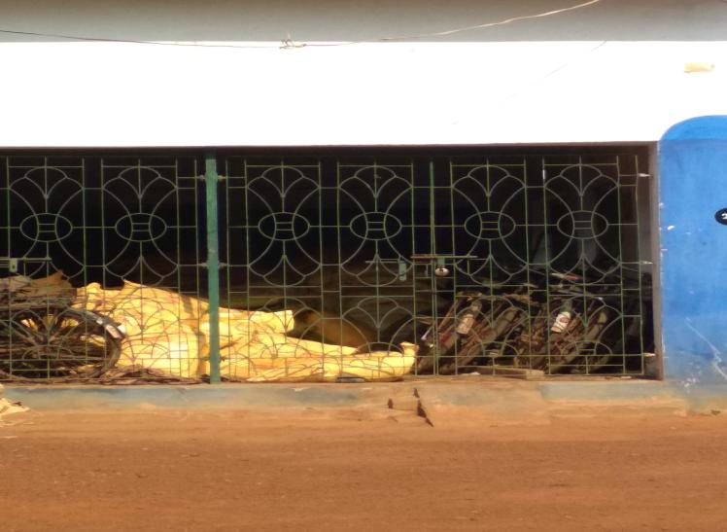
Confiscated bicycles at Chandabila Range Office

Slide 6
Why do people continue with these maladjusted livelihoods?

Slide 7
1. Maladjusted livelihood or misunderstood culture?
Jungle (non-territorial, sacred, spiritual, a part of their identity) versus Forest (territorial, governed as resource)
Individual property versus commoning
Immediate Return System versus Long term Investment

Slide 8
2. Vulnerable socio-economic position of the Lodha- Jati based historical conflict
Even if the Lodhas take interest in horticulture or sedentary agriculture they are vulnerable to other communities such as the adibashis due to historical conflict.

Slide 9
Ground Reality- Forest Department’s role
FRA implementation limited to patta allocation to Forest Dweller’s groups
A stronghold of Joint-Forest Management Village committees instead of awareness and dialogue around Community Forest Rights
Corrupt practices of the Forest Department

Slide 10
The hope
More transparent practices by the Forest Department to protect people from getting cheated
Building trustworthy relationship with the community
Creating a space of dialogue for collective action w.r.t Community Forest Rights
Awareness building of FRA at all levels

