Slide 1
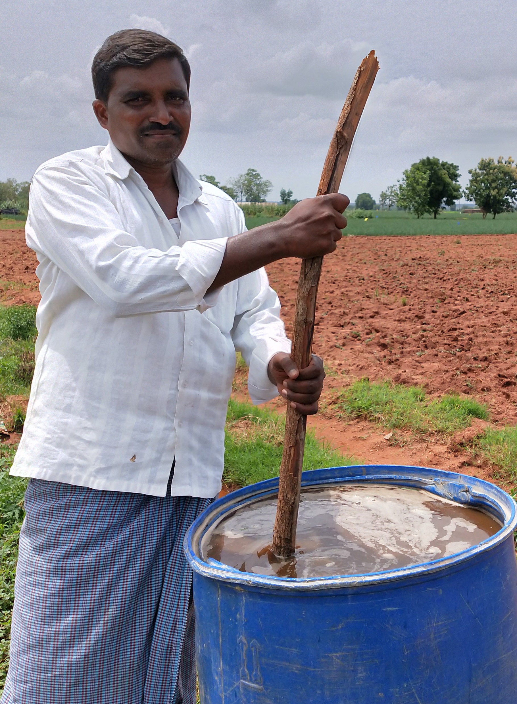
Zero Budget Natural Farming Andhra Pradesh
Rajesh Serupally
Independent Researcher and Journalist
Holds Masters Degree in Public Policy

Slide 2
Introduction
The Government of Andhra Pradesh has introduced Zero Budget Natural Farming (ZBNF) in 2016 as an alternative to chemical-based and capital intensive agriculture, through its implementing agency Rythu Sadhikara Samstha (RySS).
The main objective of the ZBNF is to make agriculture economically viable, agrarian livelihoods profitable thereby reduce agrarian distress through cost reduction and sustainable agricultural practices that are climate-resilient.
ZBNF aims to reduce cost of cultivation, enhance soil fertility, enhance yields, reduce risks, and protect from uncertainties of climate change by promoting the adoption of an agro-ecology framework.

Slide 3
Findings

Slide 4
Findings (cont.,)
Jivamruth and Insect traps are largely used by most of the farmers.
One can also notice the use of line transplant model.

Slide 5
Challenges
Challenges are identified in every field, but varies with field.
Low yield, Weed Management, High labor requirement, Drudgery can be seen as one set .
Marketing challenges and Lack of institutional support are other set of changes.

Slide 6
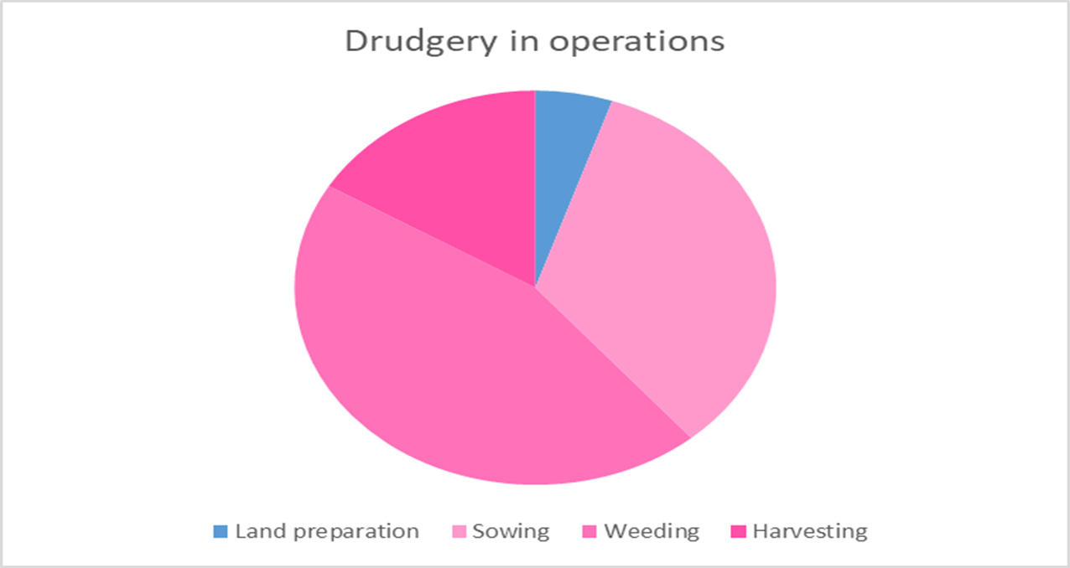
Gender in Labour & Role of Women

Slide 7
Challenges & Recommendation
Tenancy
FPO
Seed
Livestock
Certification
Market
Storage facilities for ZBNF products
Recognition of women as farmers
Debt non institutional

